Slide 1
Inter-Warp Instruction Temporal Locality in Deep-Multithreaded GPUs
Ahmad Lashgar, Amirali Baniasadi, Ahmad Khonsari
ECE, University of Tehran, ECE, University of Victoria

Slide 2
This Work
Accelerators
Designed to maximize throughput
ILT: fetch the same instruction repeatedly
Wasted
Our solution:
Keep fetched instructions in small buffer, save energy
Key result: 19% front-end energy reduction

Slide 3
Outline
Background
Instruction Locality
Exploiting Instruction Locality
Decoded-Instruction Buffer
Row Buffer
Filter Cache
Case Study: Filter Cache
Organization
Experimental Setup
Experimental Results

Slide 4
Heterogonous Systems
Heterogonous system to achieve optimal performance/watt
Superscalar speculative out-of-order processor for
latency-intensive serial workloads
Accelerator (Multi-threaded in-order SIMD processor) for
High-throughput parallel workloads
6 of 10 Top500.org supercomputers today employ accelerators
IBM Power BQC 16C 1.60 GHz (1st, 3th, 8th, and 9th)
NVIDIA Tesla (6th and 7th)

Slide 5
GPUs as Accelerators
GPUs are most available accelerators
Class of general-purpose processors named SIMT
Integrated on same die with CPU (Sandy Bridge, etc)
High energy efficiency
GPU achieves 200 pJ/instruction
CPU achieves 2 nJ/instruction
[Dally’2010]

Slide 6
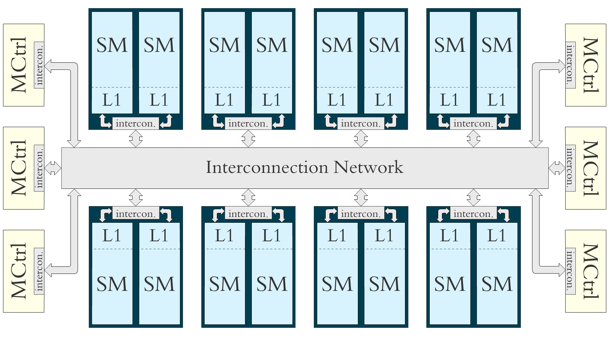
SIMT Accelerator
SIMT (Single-Instruction Multiple-Thread)
Goal is throughput
Deep-multithreaded
Designed for latency hiding
8- to 32-lane SIMD
Notes:
-This is the architecture we are modeling.

Slide 7
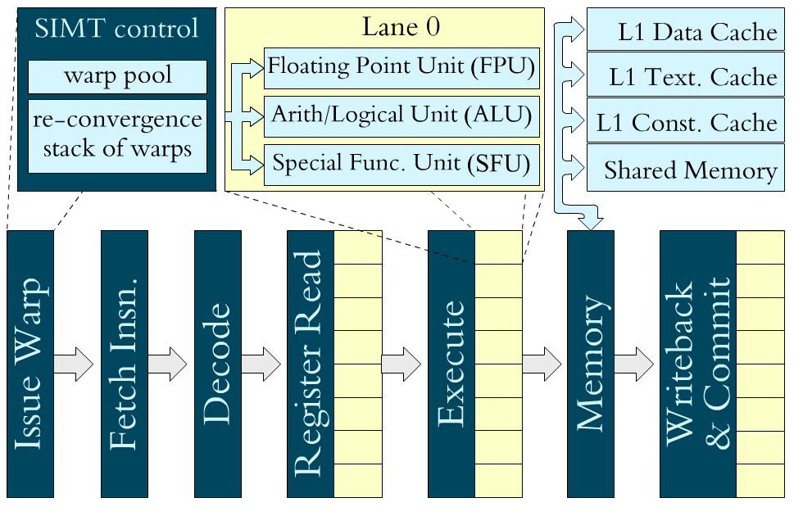
Streaming Multiprocessor (SM), CTA & Warps
Threads of same thread-block (CTA)
Communicate through fast shared memory
Synchronized through fast synchronizer
A CTA is assigned to one SM
SMs execute in warp (group of 8-32 threads) granularity
Notes:
-Define warp, warp scheduler, and SIMD width
-Define the shared resource per SM: thread pool, shared memory, and register file
-Talk about memory access coalescing here

Slide 8
Warping Benefits
Thousands of threads are scheduled zero-overhead
Context of threads are all on core
Concurrent threads are grouped into warps
Share control-flow tracking overhead
Reduce scheduling overhead
Improve utilization of execution units (SIMD efficiency)
Notes:
-Define warp, warp scheduler, and SIMD width
-Define the shared resource per SM: thread pool, shared memory, and register file
-Talk about memory access coalescing here

Slide 9
Energy Reduction Potential in GPUs
Huge amount of context
Caches
Shared Memory
Register file
Execution units
To many inactive threads
Synchronization
Branch/Memory divergence
High Locality
Similar behavior by different threads

Slide 10
Baseline Pipeline Front-end
Modeled according to NVIDIA Patents
3-Stage Front-end
Instruction Fetch (IF)
Instruction Buffer (IB)
Instruction Dispatch (ID)
Energy breakdown
I-Cache second most energy consuming
Notes:
Instruction Fetch (IF)
Responsible of instruction feed
Instruction Buffer (IB)
Stall instruction to resolve instruction dependency
Instruction Dispatch (ID)
Fetch operands and issue ready instructions

Slide 11
SM Pipeline Front-end Example
1
2
3
1
W1 | ↓↓↓↓
Warp Scheduler
Instruction Buffer
Instruction Scheduler
W2 | ↓↓↓↓
1
 | insn | src1 | src2 | dest
W1
W2
PC
add r0 r1 r2
I-Cache
ld r2 -- r3
Scoreboard
 | Field1 | Field2
W1
W2
SIMD Back-end
r2
r3
Code sequence:
1: add r2 <- r0, r1
2: ld r3 <- [r2]
3:
r3t0
r3t1
r3t2
r3t3
r2t0
r2t1
r2t2
r2t3
r2t0
0
r2t1
0
r2t2
0
r2t3
0
r0t0
r1t0
r0t1
r1t1
r0t2
r1t2
r0t3
r1t3
Operand Buffering
Register File
 | lane1 | lane2 | lane3 | lane4
W1
W2
r0 r0t0 r0t1 r0t2 r0t3
r0 for all lanes
r2 r2t0 r2t1 r2t2 r2t3
r1 r1t0 r1t1 r1t2 r1t3
r1 for all lanes
r2 for all lanes
r2 for all lanes
r3 for all lanes
r3 for all lanes
r0 for all lanes

Slide 12
Inter-Thread Instruction Locality (ITL)
Warps are likely to fetch/and decode same instruction
The percentage of instructions already fetched by other currently active warps recently:

Slide 13
Exploiting ITL
Toward performance improvement
Minor improvement by reducing the latency of arithmetic pipeline
Toward energy saving
Fetch/decode bypassing similar to loop buffering
Reducing accesses to I-Cache
Row buffer
Filter Cache (our case study)

Slide 14
Fetch/Decode Bypassing
1
W1 | ↓↓↓↓
Warp Scheduler
Instruction Buffer
1
W2 | ↓↓↓↓
 | insn | src1 | src2 | dest
W1
W2
PC
add r0 r1 r2
I-Cache
Decoded-Instruction Buffer
ld r2 -- r3
PC
I-Cache tag
PC | Decoded-insn
I-Cache data
No need to access I-Cache and decode logic if buffer hits
Buffer can bypass 42% of instruction fetches

Slide 15
Row Buffer
1
W1 | ↓↓↓↓
Warp Scheduler
Instruction Buffer
1
W2 | ↓↓↓↓
 | insn | src1 | src2 | dest
W1
W2
PC
add r0 r1 r2
I-Cache
ld r2 -- r3
I-Cache tag
PC
Row Buffer
MUX
I-Cache data
Buffer last accessed I-Cache line

Slide 16
Filter Cache (Our Case Study)
1
W1 | ↓↓↓↓
Warp Scheduler
Instruction Buffer
1
W2 | ↓↓↓↓
 | insn | src1 | src2 | dest
W1
W2
PC
add r0 r1 r2
I-Cache
ld r2 -- r3
PC
I-Cache tag
Filter Cache
MUX
I-Cache data
Buffering last fetched instruction in a set-associative table

Slide 17
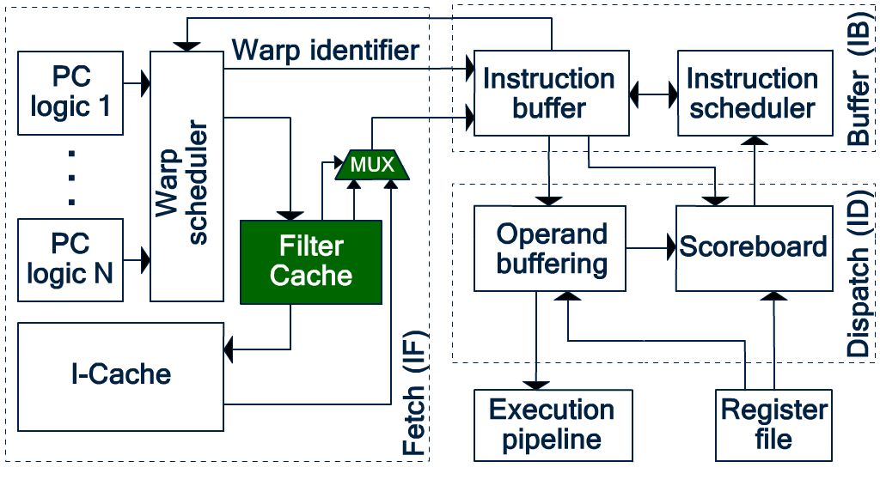
Filter Cache Enhanced Front-end
Bypass I-Cache accesses to save dynamic power
32-entry (256-byte) FC
FC hit rate
Up to ~100%
Front-end Energy Saving
Up to 19%
Front-end area overhead
4.7%
Front-end leakage overhead
0.7%

Slide 18
Methodology
Cycle-accurate simulation of CUDA workloads by GPGPU-sim
Configured to model NVIDIA Tesla architecture
16 8-wide SMs
1024 threads/SM
48 KB D-L1$/SM
4 KB I-L1$/SM (256-byte lines)
21 Workloads from:
RODINIA (Backprop, …)
CUDA SDK (Matrix Multiply, …)
GPGPU-sim (RAY,…)
Parboil (CP)
Third-party sequence alignment (MUMmerGPU++)

Slide 19
Methodology (2)
Energy evaluations under 32-nm technology using CACTI
 | Area (μm²) | Leakage (mW) | Energy per R/W (pJ) | Delay (ps)
I-Cache tag | 229 | 0.03 | 0.13 | 115.94
I-Cache data | 18204 | 1.78 | 4.30 | 221.20
Instruction Buf. | 2600 | 0.16 | 1.00 | 137.59
Scoreboard | 6921 | 0.24 | 1.57 | 162.17
Operand Buf. | 24173 | 0.53 | 4.16 | 174.05
FC tag (32-entry) | 266 | 0.03 | 0.14 | 117.28
FC data (32-entry) | 2229 | 0.11 | 0.81 | 161.76
FC tag (16-entry) | 155 | 0.02 | 0.10 | 105.47
FC data (16-entry) | 1337 | 0.05 | 0.57 | 143.38
Instruction Buf.
Scoreboard | 6921
Operand Buf.
Modeled by a wide tag array
Modeled by a data array

Slide 20
Experimental Results
FC hit rate and energy saving
32-entry FC
1024-thread per SM
Round-robin warp scheduler
Sensitivity analysis under
FC size
Thread per SM
Warp scheduler

Slide 21
FC Hit Rate and Energy Saving
 | FC hit rate | Baseline I-Cache energy (nJ) | I-Cache + FC energy (nJ) | Front-end energy-saving using FC
CP | 100% | 16532.20 | 6616.15 | 7%
HSPT | 89% | 12076.70 | 5676.64 | 8%
LPS | 83% | 14955.05 | 7625.97 | 8%
MP | 30% | 161.40 | 139.78 | 2%
MTM | 95% | 347.37 | 153.66 | 8%
NN | 99% | 132820.86 | 53780.92 | 19%
RAY | 76% | 10520.69 | 5945.77 | 6%
SCN | 97% | 562.47 | 240.70 | 9%
CP | 100% | 16532.20 | 6616.15 | 7%
MP | 30% | 161.40 | 139.78 | 2%
High-Concurrent Warps, Coherent Branch
Low-Concurrent Warps, Divergent Branch

Slide 22
Sensitivity Analysis
Filter Cache size
Larger FC provides higher hit-rate but has higher static/dynamic energy
Thread per SM
Higher thread per SM, higher the chance of instruction re-fetch
Warp Scheduling
Advanced warp schedulers (latency hiding or data cache locality boosters) may keeping the warps at the different paces
Compute
Memory Pending
Round-robin
Two-level
W0
W1
W0
W1
W0
W1
W0
W0
Time
Time
W1
W1

Slide 23
Sensitivity to Multithreading-Depth
Threads Per SM:
1024
512
~ 1%
hit reduction
~ 1%
reduction in savings
Notes:
Reducing multithreading depth is expected to reduce ITL. CP, LPS, and SCN are among the benchmarks that have enough parallelism to run more than 512 threads per SM. As reported, reducing multithreading depth to 512 threads reduces FC hit rate up to 6% (in LPS) compared to 1024 threads per SM but has minor effect on energy reduction. We expect to see lower FC hit rate under 2Lev compared to RR under fixed FC size and multithreading depth. This is because 2Lev keeps the warps of different fetch groups at different paces reducing the ITL. As reported, 2Lev impact on FC hit rate is frequent but insignificant. Among the parameters studied here, FC size has the highest impact. Lower FC size reduces FC hit rate. However, smaller FC comes with lower energy overhead. As reported, a 16-entry FC has a lower FC hit rate (on average of 9% to 10% percent) compared to a 32-entry. However, since the 16-entry consumes less energy, it still shows higher energy reduction.

Slide 24
Sensitivity to Warp Scheduling
Warp Scheduler:
Round-Robin
Two-Level
~1%
hit reduction
~1%
reduction in savings
Notes:
Reducing multithreading depth is expected to reduce ITL. CP, LPS, and SCN are among the benchmarks that have enough parallelism to run more than 512 threads per SM. As reported, reducing multithreading depth to 512 threads reduces FC hit rate up to 6% (in LPS) compared to 1024 threads per SM but has minor effect on energy reduction. We expect to see lower FC hit rate under 2Lev compared to RR under fixed FC size and multithreading depth. This is because 2Lev keeps the warps of different fetch groups at different paces reducing the ITL. As reported, 2Lev impact on FC hit rate is frequent but insignificant. Among the parameters studied here, FC size has the highest impact. Lower FC size reduces FC hit rate. However, smaller FC comes with lower energy overhead. As reported, a 16-entry FC has a lower FC hit rate (on average of 9% to 10% percent) compared to a 32-entry. However, since the 16-entry consumes less energy, it still shows higher energy reduction.

Slide 25
Sensitivity to Filter Cache Size
Number of entries in FC:
32
16
~5%
hit reduction
up to ~1%
reduction in savings
(due to lower hit rate)
Overall ~2%
increase in savings
(due to smaller FC)
Notes:
Reducing multithreading depth is expected to reduce ITL. CP, LPS, and SCN are among the benchmarks that have enough parallelism to run more than 512 threads per SM. As reported, reducing multithreading depth to 512 threads reduces FC hit rate up to 6% (in LPS) compared to 1024 threads per SM but has minor effect on energy reduction. We expect to see lower FC hit rate under 2Lev compared to RR under fixed FC size and multithreading depth. This is because 2Lev keeps the warps of different fetch groups at different paces reducing the ITL. As reported, 2Lev impact on FC hit rate is frequent but insignificant. Among the parameters studied here, FC size has the highest impact. Lower FC size reduces FC hit rate. However, smaller FC comes with lower energy overhead. As reported, a 16-entry FC has a lower FC hit rate (on average of 9% to 10% percent) compared to a 32-entry. However, since the 16-entry consumes less energy, it still shows higher energy reduction.

Slide 26
Conclusion & Future Works
We have evaluated instruction locality among concurrent warps under deep-multithreaded GPU
The locality can be exploited for performance or energy-saving
Case Study: Filter cache provides 1%-19% energy-saving for the pipeline
Future Works:
Evaluating the fetch/decode bypassing
Evaluating concurrent kernel GPUs

Slide 27
Thank you!
Question?

Slide 28
Backup-Slides

Slide 29
References
[Dally’2010]
W. J. Dally, GPU Computing: To ExaScale and Beyond, SC 2010.

Slide 30
Workloads
Abbr. | Name and Suite | Grid Size | Block Size | #Insn | CTA/SM
BFS | BFS Graph [2] | 16x(8) | 16x(512) | 1.4M | 1
BKP | Back Propagation [2] | 2x(1,64) | 2x(16,16) | 2.9M | 4
CP | Coulumb Poten. [19] | (8,32) | (16,8) | 113M | 8
DYN | Dyn_Proc [2] | 13x(35) | 13x(256) | 64M | 4
FWAL | Fast Wal. Trans. [18] | 6x(32) 3x(16) (128) | 7x(256) 3x(512) | 11M | 2, 4
GAS | Gaussian Elimin. [2] | 48x(3,3) | 48x(16,16) | 9M | 1
HSPT | Hotspot [2] | (43,43) | (16,16) | 76M | 2
LPS | Laplace 3D [1] | (4,25) | (32,4) | 81M | 6
MP2 | MUMmer-GPU++ [8] big | (196) | (256) | 139M | 2
MP | MUMmer-GPU++ [8] small | (1) | (256) | 0.3M | 1
MTM | Matrix Multiply [18] | (5,8) | (16,16) | 2.4M | 4
MU2 | MUMmer-GPU [2] big | (196) | (256) | 75M | 4

Slide 31
Workloads (2)
Abbr. | Name and Suite | Grid Size | Block Size | #Insn | CTA/SM
MU | MUMmer-GPU [2] small | (1) | (100) | 0.2M | 1
NNC | Nearest Neighbor [2] | 4x(938) | 4x(16) | 5.9M | 8
NN | Neural Network [1] | (6,28) (25,28) (100,28) (10,28) | (13,13) (5,5) 2x(1) | 68M | 5, 8
NQU | N-Queen [1] | (256) | (96) | 1.2M | 1
NW | Needleman-Wun. [2] | 2x(1) … 2x(31) (32) | 63x(16) | 12M | 2
RAY | Ray Tracing [1] | (16,32) | (16,8) | 64M | 3
SCN | Scan [18] | (64) | (256) | 3.6M | 4
SR1 | Speckle Reducing [2] big | 4x(8,8) | 4x(16,16) | 9.5M | 2, 3
SR2 | Speckle Reducing [2] small | 4x(4,4) | 4x(16,16) | 2.4M | 1

