Slide 1
Warp Size Impact in GPUs: Large or Small?
Ahmad Lashgar Amirali Baniasadi Ahmad Khonsari
ECE, University of Tehran,
ECE, University of Victoria

Slide 2
This Work
Accelerators
Accelerators amortize control-flow over groups of threads (warps)
Warp size impacts performance (branch/memory divergence & memory access coalescing)
Small Warp: Low Branch/Memory Divergence (+) , Low Memory Coalescing (-)
Large Warp: High Branch Divergence/Memory (-), High Memory Coalescing(+)
Question: Possible Solutions?
Enhance Coalescing in a Small-warp machine (SW+) OR
Enhance Divergence in a Large-warp machine (LW+)
Winner: SW+

Slide 3
Outline
Branch/Memory Divergence
Memory Access Coalescing
Warp Size Impact
Warp Size: Large or Small?
Use machine models to find the answer:
Small-Warp Coalescing-Enhanced Machine (SW+)
Large-Warp Control-flow-Enhanced Machine (LW+)
Experimental Results
Conclusions & Future Work

Slide 4
Warping
Opportunities
Reduce scheduling overhead
Improve utilization of execution units (SIMD efficiency)
Exploit inter-thread data locality
Challenges
Memory divergence
Branch divergence

Slide 5
Memory Divergence
Threads of a warp may hit or miss in L1
Warp
T0
T1
T2
T3
J = A[S];
// L1 cache access
L = K * J;
Time
Hit
Hit
Miss
Hit
Stall
Stall
Stall
Stall
Warp
T0
T1
T2
T3
Notes:
Group of threads (warp) are processed in lock-step
Unnecessary Waiting Periods

Slide 6
Branch Divergence
Branch instruction can diverge to two different paths dividing the warp to two groups:
Threads with taken outcome
Threads with not-taken outcome
Warp
T0
T1
T2
T3
If(J==K){
C[tid]=A[tid]*B[tid];
}else if(J>K){
C[tid]=0;
}
Time
Warp
X
T1
T2
X
Warp
T0
X
X
T3
Warp
T0
X
X
T3
Warp
T0
T1
T2
T3
Notes:
-Diverge, re-converge, re-convergence point,
Unnecessary Waiting Period

Slide 7
Memory Access Coalescing
Common memory access of neighbor threads are coalesced into one transaction
Warp
T0
T1
T2
T3
Miss
Miss
Miss
Miss
A
B
A
B
Mem. Req. A
Mem. Req. B
Warp
T4
T5
T6
T7
Hit
Hit
Hit
Hit
Mem. Req. C
C
C
C
C
Warp
T8
T9
T10
T11
Miss
Hit
Hit
Miss
Mem. Req. D
Mem. Req. E
D
E
E
D

Slide 8
Warp Size
Warp Size: number of threads in warp
Small Warp Advantage:
Less branch/memory divergence
Less synchronization overhead at every instruction
Large Warp Advantage:
Greater opportunity for memory access coalescing
Notes:
Justify why shorter warps are not reasonable

Slide 9
Warp Size and Branch Divergence
Lower the warp size, lower the branch divergence
2-thread warp
4-thread warp
T1
T2
T3
T4
T5
T6
T7
T8
↓
↓
↓
↓
↓
↓
↓
↓
If(J>K){
C[tid]=A[tid]*B[tid];
else{
C[tid]=0;
}
↓
↓
↓
↓
↓
↓
↓
↓
↓
↓
↓
↓
↓
↓
↓
↓
No branch divergence
Branch divergence

Slide 10
Warp Size and Memory Divergence
Small warps
Large warps
Warp
T0
T1
T2
T3
Warp
T0
T1
T2
T3
Hit
Hit
Hit
Hit
Time
Hit
Hit
Hit
Hit
Warp
T4
T5
T6
T7
T4
T5
T6
T7
Miss
Miss
Miss
Miss
Miss
Miss
Miss
Miss
Warp
T8
T9
T10
T11
T8
T9
T10
T11
Hit
Hit
Hit
Hit
Hit
Hit
Hit
Hit
Warp
T0
T1
T2
T3
Stall
Stall
Stall
Stall
Warp
T8
T9
T10
T11
Warp
T4
T5
T6
T7
Warp
T0
T1
T2
T3
T4
T5
T6
T7
Improving latency hiding
T8
T9
T10
T11

Slide 11
Warp Size and Memory Access Coalescing
Small warps
Large warps
Time
Warp
T0
T1
T2
T3
Warp
T0
T1
T2
T3
Req. A
Miss
Miss
Miss
Miss
Miss
Miss
Miss
Miss
Req. B
Warp
T4
T5
T6
T7
T4
T5
T6
T7
Miss
Miss
Miss
Miss
Req. A
Miss
Miss
Miss
Miss
Warp
T8
T9
T10
T11
T8
T9
T10
T11
Req. A
Req. A
Miss
Miss
Miss
Miss
Miss
Miss
Miss
Miss
Req. B
Req. B
5 memory requests
2 memory requests
Reducing # of memory accesses using wider coalescing

Slide 12
Warp Size Impact on Coalescing
Often Warp Size Coalescing
Notes:
Short warps reduce thread synchronization for computations
Large warps improve coalescing
Small warps reduce synchronization and divergence

Slide 13
Warp Size Impact on Idle Cycles
MU: Warp Size Divergence Idle Cycles
BKP: Warp Size Coalescing Idle Cycles
Notes:
Short warps reduce thread synchronization for computations
Large warps improve coalescing
Small warps reduce synchronization and divergence

Slide 14
Warp Size Impact on Performance
MU: Warp Size Divergence Performance
BKP: Warp Size Coalescing Performance
Notes:
Short warps reduce thread synchronization for computations
Large warps improve coalescing
Small warps reduce synchronization and divergence

Slide 15
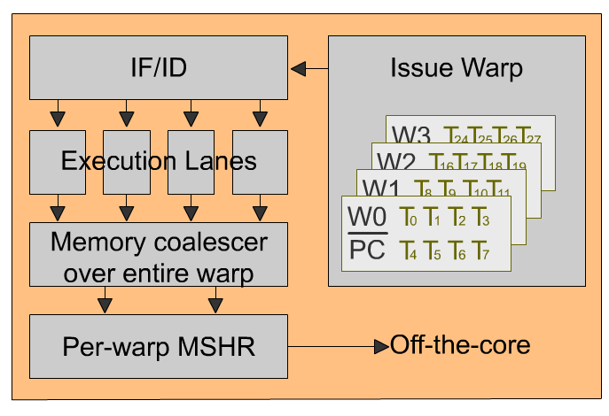
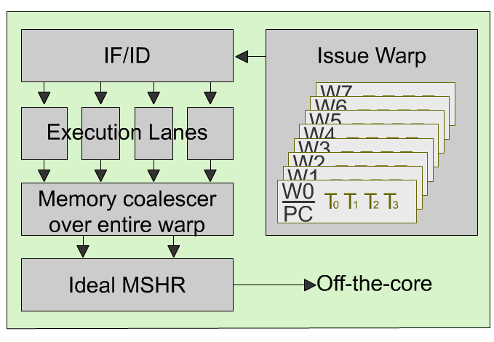
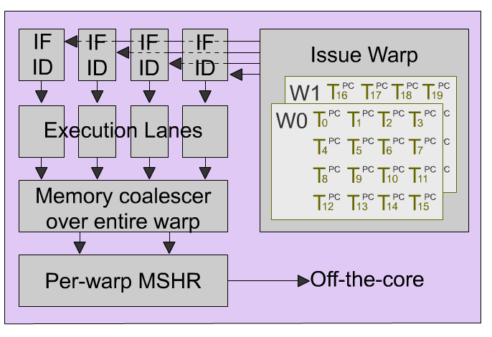
Approach
Baseline machine
SW+:
Ideal MSHR compensates coalescing loss of small warps
LW+:
MIMD lanes compensate divergence of large warps

Slide 16
SW+
Warps as wide as SIMD width
Low branch/memory divergence, Improve latency hiding
Compensating coalescing loss -> Ideal MSHR
Compensating small-warp deficiency (memory access coalescing loss)
Ideal MSHR prevents redundant memory transactions by merging the redundant requests of the warps on the same SM.
Outstanding MSHRs are searched to perform the merge

Slide 17
LW+
Warps 8x larger than SIMD width
Improve memory access coalescing
Compensating divergence -> Lock-step MIMD execution
Compensate large warp deficiency (branch/memory divergence)

Slide 18
Methodology
Cycle-accurate GPU simulation through GPGPU-sim
Six Memory Controllers (76 GB/s)
16 8-wide SMs (332.8 GFLOPS)
1024-thread per core
Warp Size: 8, 16, 32, and 64
Workloads
RODINIA
CUDA SDK
GPGPU-sim

Slide 19
Coalescing Rate
SW+: 86%, 58%, 34% higher coalescing vs. 16, 32, 64 thd/warps
LW+: 37%, 17%, higher and -1% lower coalescing vs. 16, 32, 64 thd/warps
Notes:
SW+ achieves high coalescing as a result of ideal MSHR

Slide 20
Idle Cycles
SW+: 11%, 6%, 8% less Idle Cycles vs. 8, 16, 32 thd/warps
LW+: 1% more and 4%, 2% less Idle Cycles vs. 8, 16, 32 thd/warps
Notes:
SW+ is always lower except for MTM,

Slide 21
Performance
SW+: Outperforms LW+ (11%), 8 (16%), 16(13%), 32 (20%) thd/warps.
LW+: Outperforms 8 (5%), 16 (1%), 32 (7%), 64 (15%) thd/warps.
Notes:
SW+ is always better except for MTM , NQU and SR1 where LW+ is better

Slide 22
Conclusion & Future Work
Warp Size Impacts Coalescing, Idle Cycles, and Performance
Investing in Enhancement of small-warp (SW+) machine returns higher gain than investing in enhancement of large-warp (LW+)
Future Work: Evaluating warp size impact on energy efficiency

Slide 23
Thank you!
Question?

Slide 24
Backup-Slides

Slide 25
Coalescing Width
Range of the threads in a warp which are considered for memory access coalescing
NVIDIA G80 -> Over sub-warp
NVIDIA GT200 -> Over half-warp
NVIDIA GF100 -> Over entire warp
When the coalescing width is over entire warp, optimal warp size depends on the workload

Slide 26
Warp Size and Branch Divergence (continued)
Small warps
Large warps
Warp
T0
T1
T2
T3
Warp
T0
T1
T2
T3
Warp
Time
T4
T5
T6
T7
T4
T5
T6
T7
Warp
T8
T9
T10
T11
T8
T9
T10
T11
Warp
T0
T1
X
X
Warp
T0
T1
X
X
Warp
T4
T5
T6
T7
T4
T5
T6
T7
Warp
X
T9
T10
T11
X
T9
T10
T11
Warp
X
X
T2
T3
Warp
X
X
T2
T3
Warp
T8
X
X
X
X
X
X
X
Warp
T0
T1
T2
T3
T8
X
X
X
Warp
T4
T5
T6
T7
Warp
T0
T1
T2
T3
Warp
T8
T9
T10
T11
T4
T5
T6
T7
Saving some idle cycles
T8
T9
T10
T11

Slide 27
Warping
Thousands of threads are scheduled zero-overhead
All the context of threads are on-core
Tens of threads are grouped into warp
Execute same instruction in lock-step
Notes:
-Define warp, warp scheduler, and SIMD width
-Define the shared resource per SM: thread pool, shared memory, and register file
-0 to 100: Every cycle a warp is selected

Slide 28
Key Question
Which warp size should be decided as the baseline?
Then, investing in augmenting the processor toward removing the associated deficiency
Machine models to find the answer

Slide 29
GPGPU-sim Config
NoC
Total Number of SMs | 16
Number of Memory Ctrls | 6
Number of SM Sharing an Network Interface | 2
SM
Number of thread per SM | 1024
Maximum allowed CTA per SM | 8
Shared Memory/Register File size | 16KB/64KB
SM SIMD width | 8
Warp Size | 8 / 16 / 32 / 64
L1 Data cache | 48KB: 8-way: LRU: 64BytePerBlock
L1 Texture cache | 16KB: 2-way: LRU: 64BytePerBlock
L1 Constant cache | 16KB: 2-way: LRU: 64BytePerBlock
Clocking
Core clock | 1300 MHz
Interconnect clock | 650 MHz
DRAM memory clock | 800 MHz
Memory
Number of Banks Per Memory Ctrls | 8
DRAM Scheduling Policy | FCFS

Slide 30
Workloads
Name | Grid Size | Block Size | #Insn
BFS: BFS Graph [3] | 16x(8,1,1) | 16x(512,1) | 1.4M
BKP: Back Propagation [3] | 2x(1,64,1) | 2x(16,16) | 2.9M
DYN: Dyn_Proc [3] | 13x(35,1,1) | 13x(256) | 64M
FWAL: Fast Walsh Transform [6] | 6x(32,1,1) 3x(16,1,1) (128,1,1) | 7x(256) 3x(512) | 11.1M
GAS: Gaussian Elimination [3] | 48x(3,3,1) | 48x(16,16) | 8.8M
HSPT: Hotspot [3] | (43,43,1) | (16,16,1) | 76.2M
MP: MUMmer-GPU++ [8] | (1,1,1) | (256,1,1) | 0.3M
MTM: Matrix Multiply [14] | (5,8,1) | (16,16,1) | 2.4M
MU: MUMmer-GPU [1] | (1,1,1) | (100,1,1) | 0.15M
NNC: Nearest Neighbor on cuda [2] | 4x(938,1,1) | 4x(16,1,1) | 5.9M
NQU: N-Queen [1] | (256,1,1) | (96,1,1) | 1.2M
NW: Needleman-Wunsch [3] | 2x(1,1,1) … 2x(31,1,1) (32,1,1) | 63x(16) | 12.9M
SC: Scan[14] | (64,1,1) | (256,1,1) | 3.6M
SR1: Speckle Reducing Anisotropic Diffusion [3] (large dataset) | 3x(8,8,1) | 3x(16,16) | 9.1M
SR2: Speckle Reducing Anisotropic Diffusion [3] (small dataset) | 4x(4,4,1) | 4x(16,16) | 2.4M

