Slide 1
Towards Green GPUs: Warp Size Impact Analysis
Ahmad Lashgar Amirali Baniasadi Ahmad Khonsari
ECE, University of Tehran,
ECE, University of Victoria

Slide 2
This Work
Accelerators
Control-flow amortized over tens of threads called warp
Warp size impacts branch/memory divergence & memory access coalescing
Small Warp: Low Branch/Memory Divergence (+), Low Memory Coalescing (-)
Large Warp: High Branch Divergence/Memory (-), High Memory Coalescing(+)
Key question: Which processor provides higher energy-efficiency?
Small-warp, coalescing-enhanced
Large-warp, control-flow enhanced
Key result: Small-warp enhanced processor better than large-warp enhanced processor

Slide 3
Outline
Branch/Memory divergence
Memory Access Coalescing
Warp Size Impact on Divergence and Coalescing
Warp Size: Large or Small?
Use machine models to find the answer:
Small-Warp Coalescing-Enhanced Machine (SW+)
Large-Warp Control-flow-Enhanced Machine (LW+)
Experimental Results
Conclusion

Slide 4
Warping
Opportunities
Reduce scheduling overhead
Improve utilization of execution units (SIMD efficiency)
Exploit inter-thread data locality
Challenges
Memory divergence
Branch divergence

Slide 5
Memory Divergence
Threads of a warp may take hit or miss in L1 access
Warp
T0
T1
T2
T3
J = A[S];
// L1 cache access
L = K * J;
Time
Hit
Hit
Miss
Hit
Stall
Stall
Stall
Stall
Warp
T0
T1
T2
T3
Notes:
Group of threads (warp) are processed in lock-step

Slide 6
Branch Divergence
Branch instruction can diverge to two different paths dividing the warp to two groups:
Threads with taken outcome
Threads with not-taken outcome
Warp
T0
T1
T2
T3
If(J==K){
C[tid]=A[tid]*B[tid];
}else if(J>K){
C[tid]=0;
}
Time
Warp
X
T1
T2
X
Warp
T0
X
X
T3
Warp
T0
X
X
T3
Warp
T0
T1
T2
T3
Notes:
-Diverge, re-converge, re-convergence point,

Slide 7
Memory Access Coalescing
Common memory access of neighbor threads are coalesced into one transaction
Warp
T0
T1
T2
T3
Miss
Miss
Miss
Miss
A
B
A
B
Mem. Req. A
Mem. Req. B
Warp
T4
T5
T6
T7
Hit
Hit
Hit
Hit
Mem. Req. C
C
C
C
C
Warp
T8
T9
T10
T11
Miss
Hit
Hit
Miss
Mem. Req. D
Mem. Req. E
D
E
E
D

Slide 8
Coalescing Width
Range of the threads in a warp which are considered for memory access coalescing
NVIDIA G80 -> Over sub-warp
NVIDIA GT200 -> Over half-warp
NVIDIA GF100 -> Over entire warp
When the coalescing width is over entire warp, optimal warp size depends on the workload

Slide 9
Warp Size
Warp Size is the number of threads in warp
Why small warp? (not lower that SIMD width)
Less branch/memory divergence
Less synchronization overhead at every instruction
Why large warp?
Greater opportunity for memory access coalescing
We study warp size impact on performance
Notes:
Justify why shorter warps are not reasonable

Slide 10
Warp Size and Branch Divergence
Lower the warp size, lower the branch divergence
2-thread warp
4-thread warp
T1
T2
T3
T4
T5
T6
T7
T8
↓
↓
↓
↓
↓
↓
↓
↓
If(J>K){
C[tid]=A[tid]*B[tid];
else{
C[tid]=0;
}
↓
↓
↓
↓
↓
↓
↓
↓
↓
↓
↓
↓
↓
↓
↓
↓
No branch divergence
Branch divergence

Slide 11
Warp Size and Branch Divergence (continued)
Small warps
Large warps
Warp
T0
T1
T2
T3
Warp
T0
T1
T2
T3
Warp
Time
T4
T5
T6
T7
T4
T5
T6
T7
Warp
T8
T9
T10
T11
T8
T9
T10
T11
Warp
T0
T1
X
X
Warp
T0
T1
X
X
Warp
T4
T5
T6
T7
T4
T5
T6
T7
Warp
X
T9
T10
T11
X
T9
T10
T11
Warp
X
X
T2
T3
Warp
X
X
T2
T3
Warp
T8
X
X
X
X
X
X
X
Warp
T0
T1
T2
T3
T8
X
X
X
Warp
T4
T5
T6
T7
Warp
T0
T1
T2
T3
Warp
T8
T9
T10
T11
T4
T5
T6
T7
Saving some idle cycles
T8
T9
T10
T11

Slide 12
Warp Size and Memory Divergence
Small warps
Large warps
Warp
T0
T1
T2
T3
Warp
T0
T1
T2
T3
Hit
Hit
Hit
Hit
Time
Hit
Hit
Hit
Hit
Warp
T4
T5
T6
T7
T4
T5
T6
T7
Miss
Miss
Miss
Miss
Miss
Miss
Miss
Miss
Warp
T8
T9
T10
T11
T8
T9
T10
T11
Hit
Hit
Hit
Hit
Hit
Hit
Hit
Hit
Warp
T0
T1
T2
T3
Stall
Stall
Stall
Stall
Warp
T8
T9
T10
T11
Warp
T4
T5
T6
T7
Warp
T0
T1
T2
T3
T4
T5
T6
T7
Improving latency hiding
T8
T9
T10
T11

Slide 13
Warp Size and Memory Access Coalescing
Small warps
Large warps
Time
Warp
T0
T1
T2
T3
Warp
T0
T1
T2
T3
Req. A
Miss
Miss
Miss
Miss
Miss
Miss
Miss
Miss
Req. B
Warp
T4
T5
T6
T7
T4
T5
T6
T7
Miss
Miss
Miss
Miss
Req. A
Miss
Miss
Miss
Miss
Warp
T8
T9
T10
T11
T8
T9
T10
T11
Req. A
Req. A
Miss
Miss
Miss
Miss
Miss
Miss
Miss
Miss
Req. B
Req. B
5 memory requests
2 memory requests
Reducing the number of memory accesses using wider coalescing

Slide 14
Warp Size Impact on Coalescing
Larger the warp, higher the coalescing rate
Notes:
Short warps reduce thread synchronization for computations
Large warps improve coalescing
Small warps reduce synchronization and divergence

Slide 15
Warp Size Impact on Idle Cycles
Larger the warp, higher divergence and higher idle cycles
but may reduce the idle cycles due to coalescing gain
Notes:
Short warps reduce thread synchronization for computations
Large warps improve coalescing
Small warps reduce synchronization and divergence

Slide 16
Warp Size Impact on Energy
Larger warps reduce energy if the coalescing gain could dominate the exacerbated divergence
Notes:
Short warps reduce thread synchronization for computations
Large warps improve coalescing
Small warps reduce synchronization and divergence

Slide 17
Warp Size Impact on Performance
Larger warps improve performance if the coalescing gain could dominate the exacerbated divergence
Notes:
Short warps reduce thread synchronization for computations
Large warps improve coalescing
Small warps reduce synchronization and divergence

Slide 18
Warp Size Impact on Energy-efficiency
Larger warps improve energy-efficiency if the coalescing gain could dominate the exacerbated divergence
Notes:
Short warps reduce thread synchronization for computations
Large warps improve coalescing
Small warps reduce synchronization and divergence

Slide 19
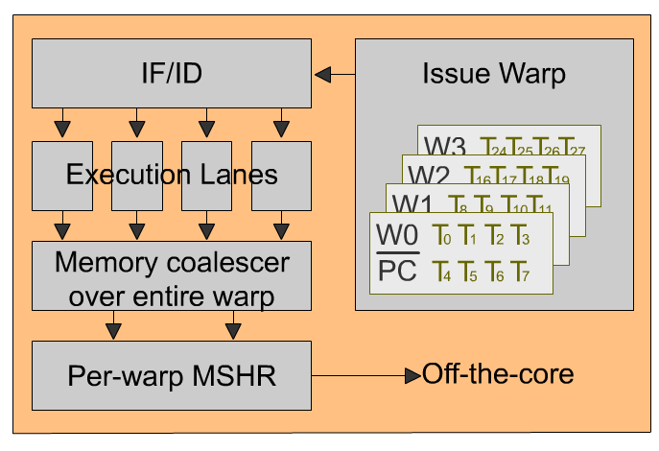
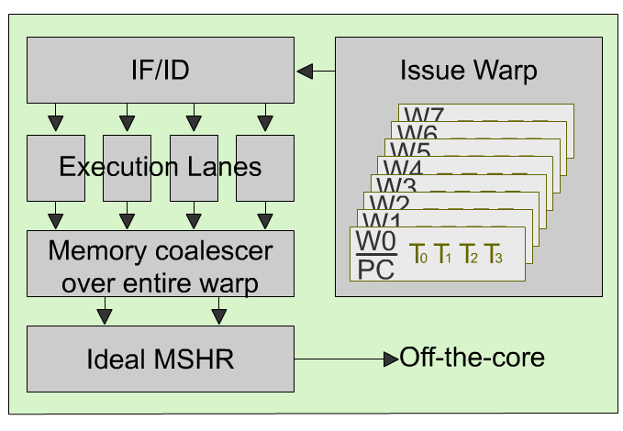
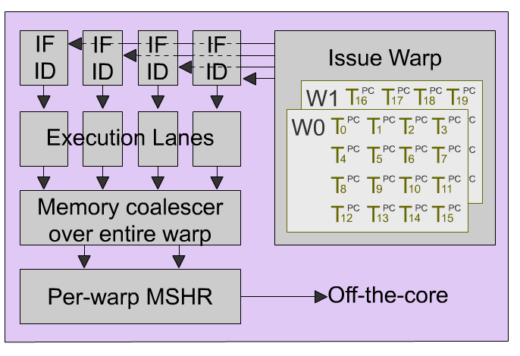
Approach
Baseline machine
Small Warp Enhanced (SW+):
Ideal MSHR to compensate coalescing lost
Large Warp Enhanced (LW+):
MIMD lanes to compensate branch divergence

Slide 20
SW+
Warps as wide as SIMD width
Minimize branch/memory divergence
Improve latency hiding
Compensating the deficiency -> Ideal MSHR
Compensating small-warp deficiency (memory access coalescing lost)
In order to merge inter-warp memory transaction, Ideal MSHR tags the per-warp outstanding MSHRs

Slide 21
LW+
Warps 8x larger than SIMD width
Improve memory access coalescing
Compensating the deficiency -> Lock-step MIMD execution
Compensate large warp deficiency (branch/memory divergence)
Parallel Fetch/Decode unit per lane

Slide 22
Methodology
Performance simulation through GPGPU-sim and power simulation through McPat
Six Memory Controllers (76 GB/s)
16 8-wide SMs (332.8 GFLOPS)
1024-thread per code
Warp Size: 8, 16, 32, and 64
Workloads
RODINIA
CUDA SDK
GPGPU-sim

Slide 23
Coalescing Rate
SW+: 103%, 67%, 40% higher coalescing vs. 16, 32, 64 thd/warps
LW+: 47%, 21%, 1% higher coalescing vs. 16, 32, 64 thd/warps

Slide 24
Idle Cycles
SW+: 12%, 8%, 10% less Idle Cycles vs. 8, 16, 32 thd/warps
LW+: 4%, 1%, 3% less Idle Cycles vs. 8, 16, 32 thd/warps

Slide 25
Energy
SW+: Outperforms 8 (26%) thd/warps.
LW+: Outperforms SW+ (19%), 8 (51%), 16 (3%) thd/warps.

Slide 26
Performance
SW+: Outperforms LW+ (7%), 8 (18%), 16(15%), 32 (25%) thd/warps.
LW+: Outperforms 8 (11%), 16 (8%), 32 (17%), 64 (30%) thd/warps.
3.2

Slide 27
Energy-efficiency
SW+: Outperforms LW+ (62%), 8 (136%), 16(13%), 32 (4%) thd/warps.
LW+: Outperforms 8 (46%), 64 (8%) thd/warps.

Slide 28
Conclusion & Future Works
Warp Size Impacts Coalescing Rate, Idle Cycles, Performance, and Energy
Investing in Enhancement of small-warp machine returns higher gain than investing in enhancement of large-warp
We use machine models to explore the answer
Evaluating wider machine models (including LWM-enhanced large-warp machine)

Slide 29
Thank you!
Question?

Slide 30
Backup-Slides

Slide 31
Warping
Thousands of threads are scheduled zero-overhead
All the context of threads are on-core
Tens of threads are grouped into warp
Execute same instruction in lock-step
Notes:
-Define warp, warp scheduler, and SIMD width
-Define the shared resource per SM: thread pool, shared memory, and register file
-0 to 100: Every cycle a warp is selected

Slide 32
Key Question
Which warp size should be decided as the baseline?
Then, investing in augmenting the processor toward removing the associated deficiency
Machine models to find the answer

Slide 33
GPGPU-sim Config
NoC
#SMs / #memory controllers |  |  |  | 16 / 6
Number of SM Sharing an Network Interface |  |  |  | 2
SM
#thread per SM / SIMD width |  |  | 1024 / 32
Maximum allowed CTA per SM |  |  | 8
Shared Memory/Register File size |  |  | 16KB/64KB
Warp Size | 8 / 16 / 32 / 64
L1 Data/Texture/Constant cache | 64KB : 16KB : 16KB
Clocking
Core / Interconnect / DRAM |  | 1300 / 650 / 800 MHz
Memory
banks per memory ctrl : DRAM Scheduling Policy |  |  | 8 : FCFS

Slide 34
Workloads
Name | Grid Size | Block Size | #Insn
BFS: BFS Graph [3] | 16x(8,1,1) | 16x(512,1) | 1.4M
BKP: Back Propagation [3] | 2x(1,64,1) | 2x(16,16) | 2.9M
CP: Distance-Cutoff Coulomb Potential [1] | (8,32,1) | (16,8,1) | 113M
GAS: Gaussian Elimination [3] | 48x(3,3,1) | 48x(16,16) | 8.8M
HSPT: Hotspot [3] | (43,43,1) | (16,16,1) | 76.2M
LPS: Laplace equation on regular 3D grid [1] | (4,25) | (32,4) | 81.7M
MP: MUMmer-GPU++ [6] | (1,1,1) | (256,1,1) | 0.3M
MU: MUMmer-GPU [1] | (1,1,1) | (100,1,1) | 0.15M
NN: Neural Network [1] | (6,28) (50,28) (100,28) (10,28) | (13,13) (5,5) 2x(1,1) | 68.1M
NNC: Nearest Neighbor [3] | 4x(938,1,1) | 4x(16,1,1) | 5.9M
NQU: N-Queen [1] | (256,1,1) | (96,1,1) | 1.2M
RAY: Ray-tracing [1] | (16,32) | (16,8) | 64.9M
SC: Scan[18] | (64,1,1) | (256,1,1) | 3.6M
SR1: SRAD [3] (large dataset) | 3x(8,8,1) | 3x(16,16) | 9.1M
SR2: SRAD [3] (small dataset) | 4x(4,4,1) | 4x(16,16) | 2.4M

