Slide 1
CUDA Programming Ahmad Lashgar
TWO Days Workshop on Multicore Processors

Slide 2
Outline
CUDA installation and compilation
CUDA for C
Runtime API 1
Simple Full Program
Runtime API 2
Inside Kernel
Notes:
CUDA for C -> mostly kernel setup
Runtime API 1 -> memory managements
Runtime API 2 -> useful remaining API
Inside Kernel -> developing advanced kernels

Slide 3
Typical CUDA Program in C/C++
Kernel Definition
int main(){
C/C++ code
CUDA Function Calls
Kernel Configuration and Launch
CUDA Function Calls
C/C++ code
}
Original C Code
CUDA C extensions
CUDA Runtime API

Slide 4
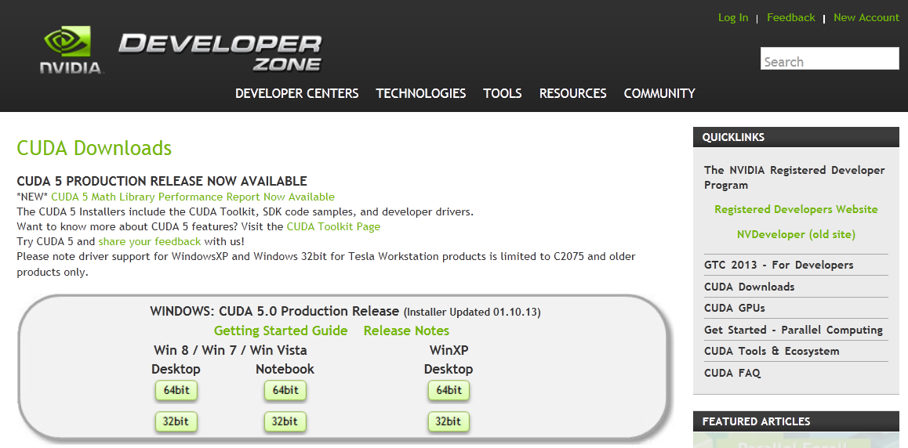
CUDA Setup and Installation
Prior to CUDA 5.0:
CUDA driver
CUDA toolkit
CUDA SDK
After CUDA 5.0:
CUDA installer
Available:
NVIDIA website:
https://developer.nvidia.com/cuda-downloads

Slide 5
Compile Flow
Develop the application in:
Standard C/C++ and make the kernel calls extern
CUDA for C extensions
Device code
.cu
Host code
.c .cpp
NVCC
System Compiler
Object codes
CUDA Libraries
System Linker
Binary

Slide 6
CUDA for C
Function Type Qualifiers
Kernel Configuration and Launch
Built-in Variables in the Kernel

Slide 7
Function Type Qualifiers
__host__
Called on host, Executed on host
__global__
Called on host, Executed on device
__device__
Called on device, Executed on device
__host__ int functionOnHost (int arg1, int *arg2, ...)
__global__ void kernel (int arg1, int *arg2, ...)
__device__ int functionOnDevice (int arg1, int *arg2, ...)
Notes:
Host -> default

Slide 8
Kernel Configuration and Launch
Kernel grid/block dimensions
Launch notation:
dim3 blockSize(16, 1, 1);
dim3 gridSize(N/blockSize.x, 1);
kernel <<< gridSize, blockSize >>> (arg1, arg2);

Slide 9
Built-in Variables in The Kernel
threadIdx
blockIdx
blockDim
3
2
4
0
0
4
0
1
4
Grid
…
Block 0
Block 1
Block 2
Block 3

Slide 10
Built-in Variables in The Kernel (2)
threadIdx, blockDim
A
0 | 0 | 0 | 0
__global__ void kernel(int *A){
A[ threadIdx.x ] = threadIdx.x;
}
kernel <<<1, 4>>> (A);
A
0 | 1 | 2 | 3
A
0 | 0 | 0 | 0
__global__ void kernel(int *A){
A[ threadIdx.x ] = blockDim.x;
}
kernel <<<1, 4>>> (A);
A
4 | 4 | 4 | 4

Slide 11
Built-in Variables in The Kernel (3)
blockIdx
A
0 | 0 | 0 | 0 | 0 | 0 | 0 | 0
__global__ void kernel(int *A){
int gtid = blockIdx.x*blockDim.x
+ threadIdx.x;
A[ gtid ] = gtid;
}
kernel<<<2,4>>>(A);
A
0 | 1 | 2 | 3 | 4 | 5 | 6 | 7
A
0 | 0 | 0 | 0 | 0 | 0 | 0 | 0
__global__ void kernel(int *A){
int gtid = blockIdx.x*blockDim.x
+ threadIdx.x;
A[ gtid ] = blockIdx.x;
}
kernel<<<2,4>>>(A);
A
0 | 0 | 0 | 0 | 1 | 1 | 1 | 1

Slide 12
Runtime API
Memory Management
Allocate
Transfer
Free
cudaMalloc ((void**)&ptr, size) ;
cudaMemcpy (dest, src, size, type) ;
cudaFree (ptr) ;
cudaMemcpyHostToDevice
cudaMemcpyDeviceToHost
cudaMemcpyDeviceToDevice
cudaMemcpyHostToHost

Slide 13
Simple Full Program (vec-vec add)
#define N 1024
__global__ void kernel(float *a, float *b, float *c, int n){
int tid=threadIdx.x+blockIdx.x*blockDim.x;
if(tid<n)
c[tid]=a[tid]+b[tid];
}
int main (void) {
float hA[N], hB[N], hC[N];
float *dA, *dB, *dC;
int S = sizeof(float) * N;
cudaMalloc((void**)&dA, S);
cudaMalloc((void**)&dB, S);
cudaMalloc((void**)&dC, S);
Original C Code
CUDA C extensions
CUDA Runtime API
Notes:
Typical colurful view avaale ke bood

Slide 14
Simple Full Program (2)
cudaMemcpy(dA, hA, S, cudaMemcpyHostToDevice);
cudaMemcpy(dB, hB, S, cudaMemcpyHostToDevice);
kernel<<<N/256,256>>>(dA, dB, dC, N);
cudaMemcpy(hC, dC, S, cudaMemcpyDeviceToHost);
// post process
cudaFree(dA);
cudaFree(dB);
cudaFree(dC);
}
Original C Code
CUDA C extensions
CUDA Runtime API

Slide 15
Outline
CUDA installation and compilation
CUDA for C
Runtime API 1
Simple Full Program
Runtime API 2
Inside Kernel

Slide 16
Runtime API (continued...)
Error Checking
Device Property
Unified Virtual Address and Page-locked Memory
Synchronization

Slide 17
Error Checking
Internal variable maintaining last error
Initial value to `cudaSuccess`
Getting last error
Getting the string of last error
Getting/Resetting last error
cudaError error = cudaGetLastError();
char* s = cudaGetErrorString(error);
cudaError error = cudaPeekAtLastError();

Slide 18
Error Checking (2)
Example:
cudaError e1 = cudaGetLastError();
if ( cudaSuccess != e1 )
{
printf( "CUDA error: %s\n", cudaGetErrorString(e1) );
exit( -1 );
}
Notes:
Real example

Slide 19
Device Property
Get the number of available devices:
Get the device properties:
Available properties:
Compute Capability (CC)
SM count
Maximum thread per block and so on
cudaGetDeviceCount( &device_count);
cudaDeviceProp devProp;
cudaGetDeviceProperties(&devProp, devID);

Slide 20
Unified Virtual Address
Single address space among host and device
Available on CC 2.x or higher
Non UVA
UVA
Host
Memory
Device
Memory
Host
Memory
Device
Memory
0x000
0xFFF
0x000
0xFFF
0x000
0xFFF
CPU
GPU
CPU
GPU

Slide 21
Unified Virtual Address (2)
Memory copies can be transparent:
int main() {
float *h_a, *h_b, *h_c;
size_t memsize= N * sizeof(float);
cudaHostAlloc((void**)&h_a, memsize,0);
cudaHostAlloc((void**)&h_b, memsize,0);
cudaHostAlloc((void**)&h_c, memsize,0);
vecAdd<<<N/256, 256>>>(h_a, h_b, h_c, N);
// post-process
cudaFree(h_a); cudaFree(h_b); cudaFree(h_c);
}

Slide 22
Synchronization of Host-Device
CPU:
GPU:
time

Slide 23
Synchronization of Host-Device (2)
Control is returned to host immediately after:
Kernel Launch
Device to Device memory copy
Less than 64K Host to Device memory copy
Async memory copies
Memory sets
Force synchronization
cudaMemcpyAsync (dest, src, size, type);
cudaMemset ((void*)ptr, value, count);
cudaDeviceSynchronize ();

Slide 24
Outline
CUDA installation and compilation
CUDA for C
Runtime API 1
Simple Full Program
Runtime API 2
Inside Kernel
Notes:
CUDA for C -> mostly kernel setup
Runtime API 1 -> memory managements
Runtime API 2 -> useful remaining API
Inside Kernel -> developing advanced kernels

Slide 25
Inside Kernel
Intra-block communication
Shared memory
Synchronizer
Race Condition
Atomic Operations
Memory Access Coalescing
Execution Configuration

Slide 26
Inter-block Communication
Follow streaming model
O(100) cycles
SM
DRAM
SM
O(10) cycles
Shared
Memory
ALU
ALU
ALU
ALU
ALU
ALU
ALU
ALU
SM
Shared
Memory
ALU
ALU
ALU
ALU
ALU
ALU
ALU
ALU
SM
Shared
Memory
ALU
ALU
ALU
ALU
ALU
ALU
ALU
ALU

Slide 27
Shared Memory
Communicate within thread block
Fast synchronization
__global__ void Kernel(int *A) {
int tid = threadIdx.x;
for(i=0; i<N/256; i++) {
__shared__ int tile[256];
tile[tid] = A[i*256+tid];
__syncthreads();
// sort the tile in-place at
// the bandwidth of shared memory
__syncthreads();
A[i*256+tid] = tile[tid];
}
}
Kernel <<<1, 256>>> (A);

Slide 28
Synchronizers
Informative __synchthreads
Returns the number of threads with non-zero predicate
Return non-zero if all threads have non-zero predicate
Return non-zero if any of threads have non-zero predicate:
int __syncthreads_count(int predicate);
int __syncthreads_and(int predicate);
int __syncthreads_or(int predicate);

Slide 29
Race Condition
Example:
__global__ void kernel(float *a, float *b, float *c)
{
if( threadIdx.x < N )
c[blockIdx.x] += a[blockIdx.x] * b[threadIdx.x];
}

Slide 30
Atomic Operations
The operations which are not interrupted
Operate on the variables on global or shared memory
Arithmetic:
atomicAdd(address, value)
atomicExch, atomicSub, atomicInc, atomicDec, atomicMin, atomicMax, atomicCAS
Bitwise
atomicAnd(address, value)
atomicOr, atomicXor

Slide 31
Atomic Operations (3)
Making critical section using atomic operations
__global__ void kernel(float *a, float *b, float *c, int N) {
__shared__ int lock;
lock=0u;
if(threadIdx.x < N) {
int leaveLoop = 0;
while (leaveLoop==0) {
if (atomicExch(&lock, 1u) == 0u) {
//critical section
leaveLoop = 1;
atomicExch(&lock,0u);
}
}
}
}

Slide 32
Memory Access Coalescing
Memory transactions are at the memory block granularity
Streaming Multiprocessor
Logical View of Memory
Request
Word 1
LD/ST
LD/ST
LD/ST
LD/ST
…
Word 1
Word 1
…
…
Word N
Word N
Reply
…

Slide 33
Memory Access Coalescing (2)
Memory accesses of the threads in a warp are merged to a few memory transactions
// memory load inside kernel
float reg = A[index];
Memory transactions
per warp
Indexing scheme
Illustration
int index = 0;
int index = threadIdx.x;
128 bytes
1
1
int index = 32*threadIdx.x;
32

Slide 34
Execution Configuration
Finding the optimal configuration:
Concurrent
Thread
Register
File
Shared
Memory
[Wikipedia]

Slide 35
ANY QUESTION?
Thank you

Slide 36
Backup Slides

Slide 37
Case Study : Sobel Filter
Problem definition:
Detecting the edges in image by applying the Sobel filter on each pixel:
[
]
-1
-2
-1
0
0
0
1
2
1

Slide 38
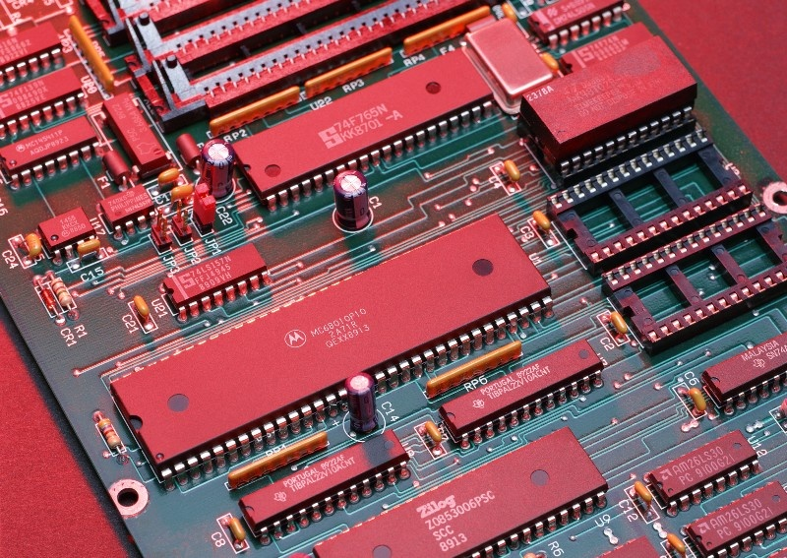
Case Study : Sobel Filter (2)
Sample operations:
Input image

Slide 39
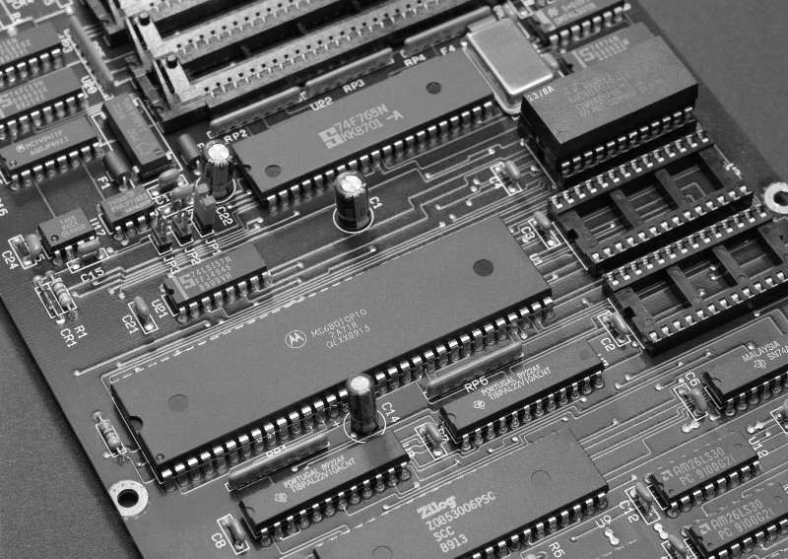
Case Study : Sobel Filter (3)
Sample operations:
Turn to grayscale

Slide 40
Case Study : Sobel Filter (4)
Sample operations:
Multiply each pixel neighborhood by the Sobel filter
[
]
-1
-2
-1
0
0
0
1
2
1
X

Slide 41
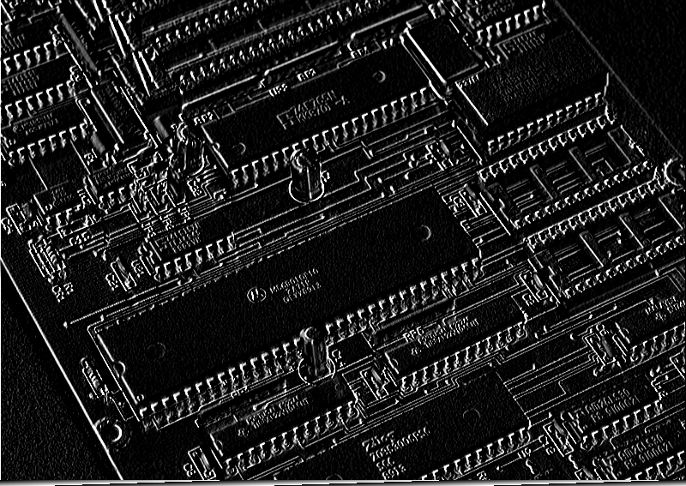
Case Study : Sobel Filter (5)
Sample operations:
Output image

Slide 42
Case Study : Sobel Filter (6)
Parallelism
The calculation of new color for each pixel is independent of the others
-1
-2
-1
0
0
1
2
1
-1
-2
-1
0
0
1
2
1
TX
TY

Slide 43
Case Study : Sobel Filter (7)
Serial Code (1)
void sobel_cpu( float *img_out,
float *img_in,
int WIDTH, int HEIGHT)
{
for(int y=0; y<HEIGHT; y++)
{
for(int x=0; x<WIDTH; x++)
{
// 1. fetch the six neighbor pixels
// 2. calculate new color
// 3. write back the new color
}
}
}

Slide 44
Case Study : Sobel Filter (7)
Serial Code (2)
{
for(int y=0; y<HEIGHT; y++)
{
for(int x=0; x<WIDTH; x++)
{
// 1. fetch the six neighbor pixels
LUp = (x-1>=0 && y-1>=0)? img_in[(x-1)+(y-1)*WIDTH]:0;
LCnt= (x-1>=0)? img_in[(x-1)+y*WIDTH]:0;
LDw = (x-1>=0 && y+1<HEIGHT)? img_in[(x-1)+(y+1)*WIDTH]:0;
RUp = (x+1<WIDTH && y-1>=0)? img_in[(x+1)+(y-1)*WIDTH]:0;
RCnt= (x+1<WIDTH)? img_in[(x+1)+y*WIDTH]:0;
RDw = (x+1<WIDTH && y+1<HEIGHT)? img_in[(x+1)+(y+1)*WIDTH]:0;
// 2. calculate new color
// 3. write back the new color
}
}
}

Slide 45
Case Study : Sobel Filter (7)
Serial Code (3)
{
for(int y=0; y<HEIGHT; y++)
{
for(int x=0; x<WIDTH; x++)
{
// 1. fetch the six neighbor pixels
// 2. calculate new color
pixel = -1*LUp + 1*RUp +
-2*LCnt + 2*RCnt +
-1*LDw + 1*RDw;
pixel=(pixel<0)?0:pixel;
pixel=(pixel>MAXRGB)?MAXRGB:pixel;
// 3. write back the new color
}
}
}

Slide 46
Case Study : Sobel Filter (7)
Serial Code (4)
{
for(int y=0; y<HEIGHT; y++)
{
for(int x=0; x<WIDTH; x++)
{
// 1. fetch the six neighbor pixels
// 2. calculate new color
// 3. write back the new color
img_out[x+y*WIDTH]=pixel;
}
}
}

Slide 47
Case Study : Sobel Filter (8)
CUDA Kernel Code (1)
__global__
void sobel_gpu( float *img_out,
float *img_in,
int WIDTH, int HEIGHT)
{
int x,y;
x=blockDim.x*blockIdx.x+threadIdx.x;
y=blockDim.y*blockIdx.y+threadIdx.y;
if(x<WIDTH && y<HEIGHT){
// 1. fetch the six neighbor pixels
// 2. calculate new color
// 3. write back the new color
}
}

Slide 48
Case Study : Sobel Filter (8)
CUDA Kernel Code (2)
{
x=blockDim.x*blockIdx.x+threadIdx.x;
y=blockDim.y*blockIdx.y+threadIdx.y;
if(x<WIDTH && y<HEIGHT){
// 1. fetch the six neighbor pixels
LUp = (x-1>=0 && y-1>=0)? img_in[(x-1)+(y-1)*WIDTH]:0;
LCnt= (x-1>=0)? img_in[(x-1)+y*WIDTH]:0;
LDw = (x-1>=0 && y+1<HEIGHT)? img_in[(x-1)+(y+1)*WIDTH]:0;
RUp = (x+1<WIDTH && y-1>=0)? img_in[(x+1)+(y-1)*WIDTH]:0;
RCnt= (x+1<WIDTH)? img_in[(x+1)+y*WIDTH]:0;
RDw = (x+1<WIDTH && y+1<HEIGHT)? img_in[(x+1)+(y+1)*WIDTH]:
// 2. calculate new color
// 3. write back the new color
}
}

Slide 49
Case Study : Sobel Filter (8)
CUDA Kernel Code (3)
{
x=blockDim.x*blockIdx.x+threadIdx.x;
y=blockDim.y*blockIdx.y+threadIdx.y;
if(x<WIDTH && y<HEIGHT){
// 1. fetch the six neighbor pixels
// 2. calculate new color
pixel = -1*LUp + 1*RUp +
-2*LCnt + 2*RCnt +
-1*LDw + 1*RDw;
pixel=(pixel<0)?0:pixel;
pixel=(pixel>MAXRGB)?MAXRGB:pixel;
// 3. write back the new color
}
}

Slide 50
Case Study : Sobel Filter (8)
CUDA Kernel Code (4)
{
x=blockDim.x*blockIdx.x+threadIdx.x;
y=blockDim.y*blockIdx.y+threadIdx.y;
if(x<WIDTH && y<HEIGHT){
// 1. fetch the six neighbor pixels
// 2. calculate new color
// 3. write back the new color
img_out[x+y*WIDTH]=pixel;
}
}

Slide 51
Case Study : Sobel Filter (9)
Kernel Call Code (1)
// 1. Allocate space on GPU
// 2. Move input image to GPU
// 3. Configure and Call the kernel
// 4. Move the output image back to CPU
// 5. Free CUDA memory

Slide 52
Case Study : Sobel Filter (9)
Kernel Call Code (2)
// 1. Allocate space on GPU
float *d_img_out_array=NULL,*d_img_in_array=NULL;
cudaMalloc((void**) &d_img_in_array,
sizeof(float)*WIDTH*HEIGHT);
cudaMalloc((void**) &d_img_out_array,
sizeof(float)*WIDTH*HEIGHT);
// 2. Move input image to GPU
cudaMemcpy(d_img_in_array, h_img_in_array,
sizeof(float)*WIDTH*HEIGHT,
cudaMemcpyHostToDevice);
// 3. Configure and Call the kernel
// 4. Move the output image back to CPU
// 5. Free CUDA memory

Slide 53
Case Study : Sobel Filter (9)
Kernel Call Code (3)
// 1. Allocate space on GPU
// 2. Move input image to GPU
// 3. Configure and Call the kernel
dim3 threads(BLOCK_SIZE, BLOCK_SIZE);
dim3 grid(WIDTH / threads.x, HEIGHT / threads.y);
sobel_gpu <<< grid, threads >>> ( d_img_out_array,
d_img_in_array,
WIDTH, HEIGHT);
cudaThreadSynchronize() ;
// 4. Move the output image back to CPU
// 5. Free CUDA memory

Slide 54
Case Study : Sobel Filter (9)
Kernel Call Code (4)
// 1. Allocate space on GPU
// 2. Move input image to GPU
// 3. Configure and Call the kernel
// 4. Move the output image back to CPU
cudaMemcpy(h_img_out_array, d_img_out_array,
sizeof(QUANTUM_TYPE)*WIDTH*HEIGHT, cudaMemcpyDeviceToHost);
// 5. Free CUDA memory
cudaFree(d_img_in_array);
cudaFree(d_img_out_array);

Slide 55
Case Study : Sobel Filter (10)
Main Code
void main()
{
// 1. Read image
// 2. Convert to gray and reformat it into 1D array
if(CUDA){
// 3.A Compute sobel on GPU
// Kernel Call Code:
}else{
// 3.B Compute sobel on CPU:
// serial code
}
// 4. Reformat for writeback
// 5. Write image back to disk
}

Slide 56
NVCC Compiler
Offline Compilation
Controlling the destination binary through `-code`
-arch=sm_20
Embedding multiple versions
-gencode code=sm_20,arch=compute_20
Just-in-time Compilation
Compile built-in PTX in driver at runtime
Cached for repetitive executions
Can be forced through CUDA_FORCE_PTX_JIT

Slide 57
Variable Type Qualifiers
__shared__
Life time of a block
Read/Write by thread of a block
__constant__
Life time of application
Read by all threads and Write by host

Slide 58
Variable Type Qualifiers (2)
Compiler optimization to prevent extra memory access
Solution: volatile
Any reference to this variable compiles to an actual memory read instruction
// myArray is an array of non-zero integers
// located in global or shared memory
__global__ void myKernel(int* result) {
...
int tid = threadIdx.x;
int ref1 = myArray[tid] * 1;
myArray[tid + 1] = 2;
int ref2 = myArray[tid] * 1;
result[tid] = ref1 * ref2;
...
}

Slide 59
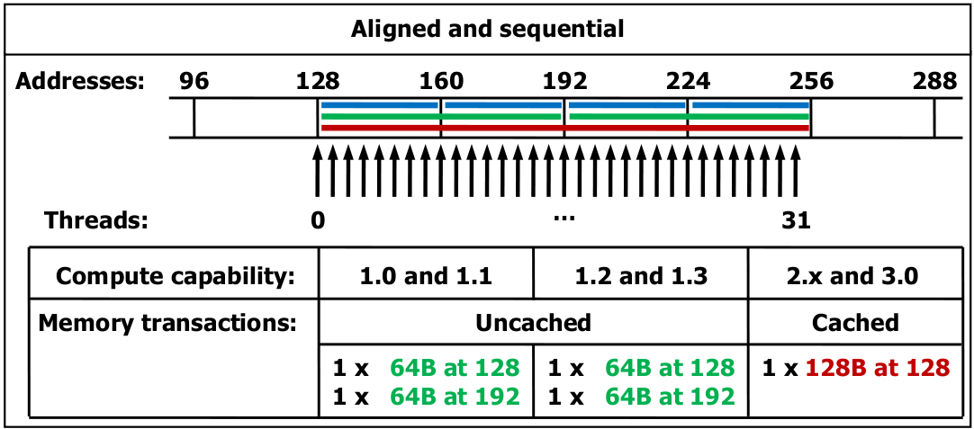
Memory Access Coalescing
Memory access coalescing
Memory access of neighbor threads to same memory block are coalesced into one transaction

Slide 60
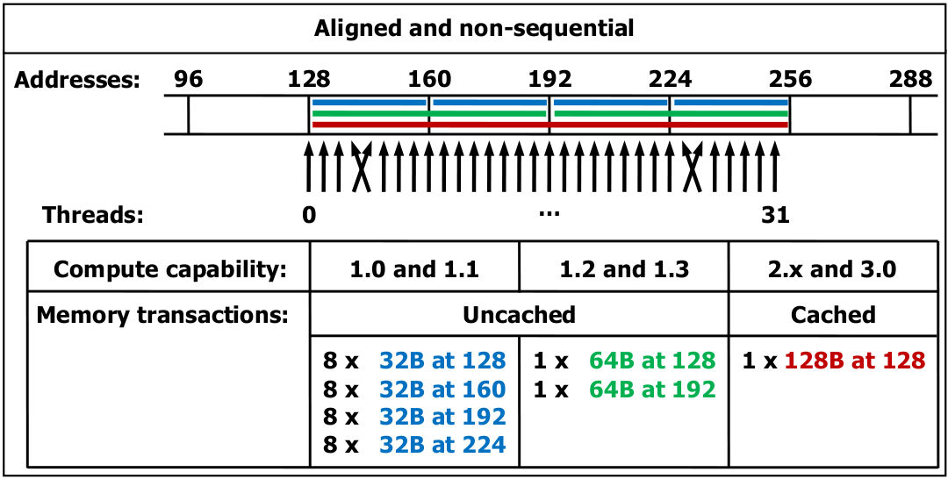
Memory Access Coalescing (2)
Memory access coalescing
Memory access of neighbor threads to same memory block are coalesced into one transaction

Slide 61
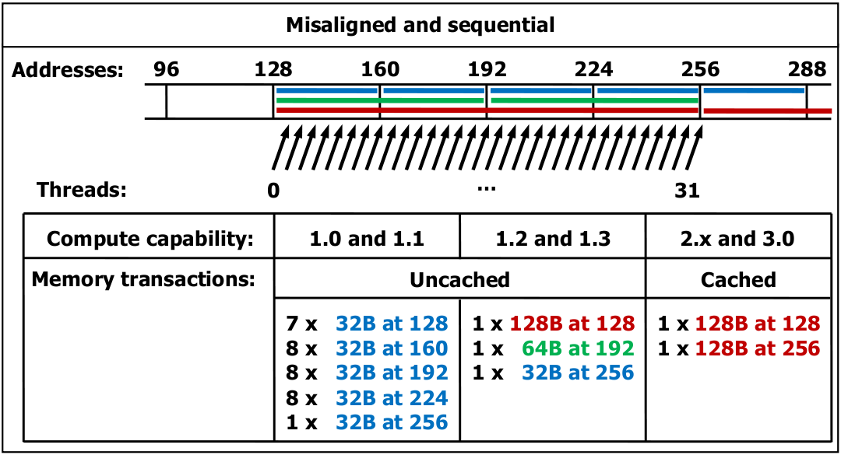
Memory Access Coalescing (3)
Memory access coalescing
Memory access of neighbor threads to same memory block are coalesced into one transaction

