Slide 1
A Case Against Small Data Types in GPGPUs
Ahmad Lashgar and Amirali Baniasadi
ECE Department
University of Victoria

Slide 2
Evaluation of Datatype Size on GPGPUs
Key Observation:
Smallest datatypes always improve memory efficiency
But they may degrade performance
Key Question:
Why smaller data type may degrade performance?
Key Finding:
Miss Status Holding Registers (MSHRs) are the contenting resource under smaller data types

Slide 3
Outline
Motivation
Background
GPU Architecture
Miss status handling structure
Case Study: 1D Stencil
Memory pattern
Methodology
Evaluation

Slide 4
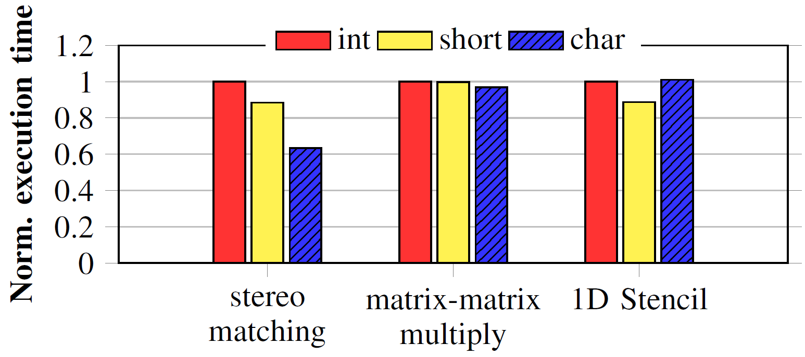
Impact of Data type Size
Performance vs Accuracy:
We relax accuracy constrain and evaluate performance
Datatype sizes:
4-byte int, 2-byte short, 1-byte char
Basic elements of applications:
Matrix multiplication: Element in matrix
1D stencil: Element in array
Stereo matching: Label in disparity map
Case Study

Slide 5
GPU Architecture
Merger fields
SM
Cache line
SM
SM
Block address
Warp Pool
MSHRs
L1$
L1$
Warp Scheduler
MW0
MW1
$ID
ADDR
W0
W1
L0
0x0A
-
-
-
-
Registerfile
L1$
Intercon. Network
-
-
-
-
-
-
-
-
Data
L2$
L2$
ALU
SFU
LSU
Tags
MSHRs
MCtrl
MCtrl

Slide 6
Outstanding memory accesses
Limited by L1$ and MSHRs capability
Without merging capability:
Best-case merging-enabled:
Worst-case merging-enabled:
Notes:
#MSHR -> number of MSHR entries
#MSHRMergers -> number of merger fields per MSHR entry
#cacheLines -> number of cache line in L1 cache
#wayInaSet -> number of sets in a L1 cache

Slide 7
Case Study: 1D Stencil
Algorithm:
CUDA code:
int i = threadIdx.x + blockIdx.x*blockDim.x;
if( i<(n-1) && i>0 ){
a_dst[i] = (a_src[i-1] + a_src[i] + a_src[i+1]) / 3;
}
Notes:
We investigate 1D stencil, under real and simulated hardware, to understand why smaller data types may degrade performance

Slide 8
Methodology
Real hardware:
NVIDIA GeForce GTX480
Simulated hardware:
GPGPU-sim v3.2.2
GTX480
32-MSHR per L1$, 8-merger per MSHR entry

Slide 9
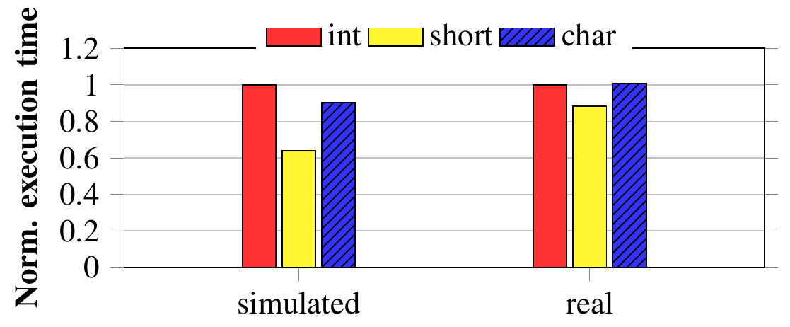
Performance
Stencil 1D under real and simulated GTX480

Slide 10
Memory efficiency
Smaller data types consistently improve memory efficiency metrics:

Slide 11
Stall breakdown
Smaller datatypes stall for merger fields
Larger datatypes stall for coalescing

Slide 12
Conclusion
Real evaluation and simulation to observe the impact of datatypes on:
Performance of GPUs
Effective cache capacity, memory latency/bandwidth/demand
Coalescing, cache, and MSHR stalls
Smaller datatypes improve memory efficiency
Depending on the memory access pattern, smaller datatypes may increase MSHR merger stalls
Future Work:
Micro-benchmarking to understand GPU MSHR structure

Slide 13
Thank you!
Question?

Slide 14
Example: Worst-case scenario
Warp Pool
W0
ALU
W1
ALU
W2
ALU
W3
LSU
W4
LSU
W5
LSU
W6
LSU
W7
LSU
L1$
Warp Scheduler
Data
L0
X
L1
X
Registerfile
Tags
L0
X
L1
X
MW0
MW1
$ID
ADDR
LSU
ALU
SFU
MSHRs
W0
W1
L0
0x0A
W2
0x0A
-
-
-
-

Slide 15
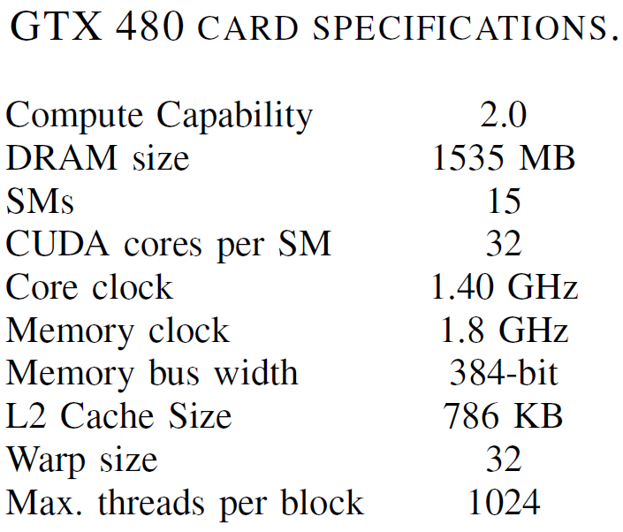
Methodology (2)

Slide 16
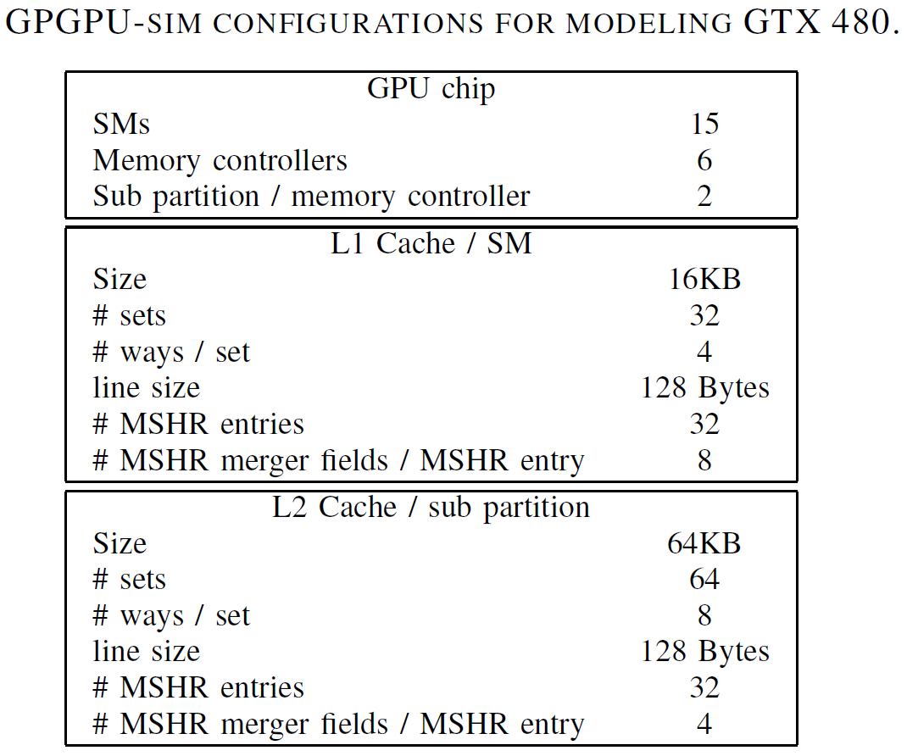
Methodology (3)

Slide 17
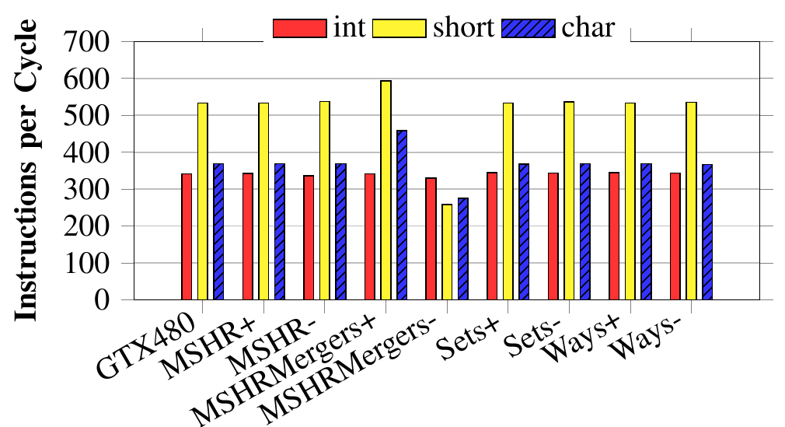
Sensitivity
Varying MSHRs, merger fields, sets, and ways

