Slide 1
Understanding Outstanding Memory Request Handling Resources in GPGPUs
Ahmad Lashgar, Ebad Salehi, and Amirali Baniasadi
ECE Department
University of Victoria
June 1, 2015
The Sixth International Symposium on Highly Efficient Accelerators and Reconfigurable Technologies (HEART 2015)

Slide 2
This Work
GPUs are energy-efficient high-throughput processors
Understanding GPUs is critical
We discover GPU microarchitecture details
HOW? We develop resource targeting microbenchmarks.
GPU
Memory pressure
Delay Analysis

Slide 3
Outline
Overview
GPU Micro-architecture design
Outstanding Memory Access Handling Unit
MSHR or PRT
Thread-Latency plot
Micro-benchmarking Fermi and Kepler GPUs
Conclusions
Notes:
-Alternative designs for handling outstanding memory accesses

Slide 4
NVIDIA-like GPU Micro-architecture
Each SM is a multi-threaded SIMD core
…
Warp Pool
GPU
SM_{N}
Outstanding memory access handling unit
?
SM₁
SM_{N}
Warp 1 | PC | T₁ T₂ T₃ T₄ |
L1$
L1$
Warp 2 | PC | T₅ T₆ T₇ T₈ |
…
Interconnect
Scoreboard
…
L2$
L2$
Load/Store Unit
Int/Float
Unit
Special Fcn
Unit
MC₁
MC_{N}
L1$
DRAM
Tag
Data
Outstanding mem. access handling unit

Slide 5
Outstanding Memory Access Handling Unit
MSHR
Miss Status/Information Holding Register
Used in GPGPU-sim [Bakhoda’2010]
PRT
Pending Request Table
Introduced in an NVIDIA patent [Nyland2013]

Slide 6
MSHR
First structure known as memory access handling unit:
Miss Status/Information Holding Register
A table of N entries
Each entry tracks one missing memory block
Each entry can be shared among M memory requests

Slide 7
MSHR Sample Operation
Cache Miss
SM
L1 $
Issued Instruction
Tag
Data
Warp 1 | PC | T₁ T₂ T₃ T₄ |
Warp 2 | PC | T₅ T₆ - T₈ |
Block addr.
M merged threads
MSHR
Load/Store Unit
MSHR ID
0x0A4
T1
T2
#1
#2
#3
#4
0x0
0x04
T₁ | T₂ | T₃ | T₄
0x0A5
T3
T4
T₅ | T₆ | - | T₈
N entry
0x0
0x04
0x0A40 | 0x0A44 | 0x0A50 | 0x0A54
0x0A64 | 0x0A68 | - | 0x0A6F
0x0A6
T5
T6
T8
0x04
0x08
0x0F
To the Lower Memory Level
0x0A4 | #1
From the Lower Memory Level
DATA | #1
DATA | #2
DATA | #3
Block addr
0x0A5 | #2
MSHR ID
0x0A6 | #3

Slide 8
PRT
Second structure known as memory access handling unit:
Pending Request Table
A table of N entries
Each entry tracks one warp memory instruction
Each entry may generate multiple memory requests
Thread mask specifies the associated threads

Slide 9
PRT Sample Operation
Cache Miss
SM
L1 $
Issued Instruction
Tag
Data
Warp 1 | PC | T₁ T₂ T₃ T₄ |
Warp 2 | PC | T₅ T₆ - T₈ |
Warp ID
Pending Requests
Offsets in mem. blocks
PRT ID
Warp size
PRT
Load/Store Unit
Warp1
1
T1
T2
T3
T4
2
#1
#2
#3
#4
0x0
0x04
0x0
0x04
T₁ | T₂ | T₃ | T₄
Warp2
1
T5
T6
T7
T8
T₅ | T₆ | - | T₈
N entry
0x04
0x08
-
0x0F
0x0A40 | 0x0A44 | 0x0A50 | 0x0A54
0x0A64 | 0x0A68 | - | 0x0A6F
PRT ID
Block addr
To the Lower Memory Level
0x0A4 | #1 | 1100
From the Lower Memory Level
DATA | #1 | 1100
DATA | #1 | 0011
DATA | #2 | 1101
0x0A5 | #1 | 0011
Thread mask
0x0A6 | #2 | 1101

Slide 10
Stressing Memory Access Handling Unit
Single-thread multiple-loads
tic = clock();
char Ld1 = A[128*1];
char Ld2 = A[128*2];
char LdN = A[128*N];
toc = clock();
Time = toc – tic;
....
kernel<<<1,1>>>(...)
Time
Which resource is
saturated?
Scoreboard ☹
1
2
3
4
5
6
7
8
Multiple-loads (N)

Slide 11
Stressing Memory Access Handling Unit (2)
Parallel-threads single-load
tic = clock();
char Ld1 = A[128*1];
__syncthreads();
toc = clock();
Time = toc – tic;
....
kernel<<<1,M>>>(...)
Time
Which resource is
saturated?
Outstanding memory
access handling unit
8
16
32
48
64
80
96
Parallel-threads (M)

Slide 12
Stressing Memory Access Handling Unit (3)
Parallel-threads multiple-loads
4 load
2 load
1 load
tic = clock();
char Ld1 = A[128*1];
char Ld2 = A[128*2];
char LdN = A[128*N];
__syncthreads();
toc = clock();
Time = toc – tic;
....
kernel<<<1,M>>>(...)
Time
8
16
32
48
64
80
96
Parallel-threads (M)
Found a way to occupy resources:
Parallel-threads multiple-loads

Slide 13
MSHR vs PRT test?
Parallel-threads single-load
Different memory patterns:
MSHR respond:
PRT respond:
All Unique:
Every thread fetches a
unique memory block
Time
Time
X
Y
Parallel-threads
Parallel-threads
MSHR respond:
PRT respond:
Two-Coalesced:
Every two neighbor
threads fetch a common
unique memory block
Time
Time
X
2X
Y
Parallel-threads
Parallel-threads
Notes:
-How to understand if the structure is MSHR or PRT?

Slide 14
Finding MSHR Parameters
Memory patterns:
All Unique
Two-coalesced
Four-coalesced
Eight-coalesced
128-byte blocks
#10
#9
#8
#7
#6
#5
#4
#3
#2
#1
thread block | T1 | T2 | T3 | T4 | T5 | T6 | T7 | T8 | T9 | …
 | #1 | #2 | #3 | #4 | #5 | #6 | #7 | #8 | #9
thread block | T1 | T2 | T3 | T4 | T5 | T6 | T7 | T8 | T9 | …
 | #1 | #1 | #2 | #2 | #3 | #3 | #4 | #4 | #5
Global Memory address space
thread block | T1 | T2 | T3 | T4 | T5 | T6 | T7 | T8 | T9 | …
 | #1 | #1 | #1 | #1 | #2 | #2 | #2 | #2 | #3
thread block | T1 | T2 | T3 | T4 | T5 | T6 | T7 | T8 | T9 | …
 | #1 | #1 | #1 | #1 | #1 | #1 | #1 | #1 | #2

Slide 15
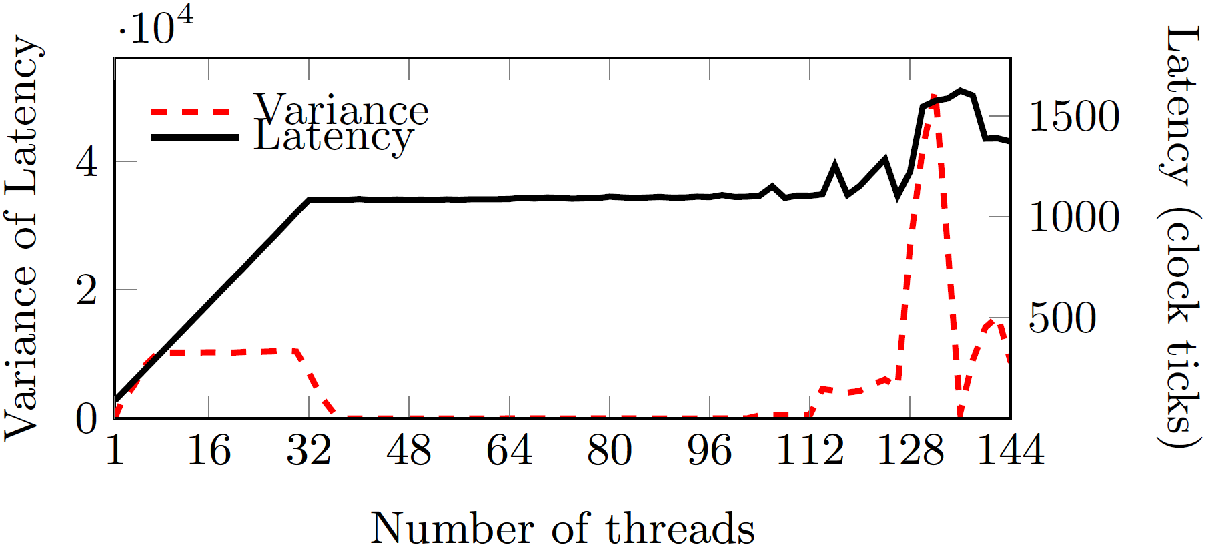
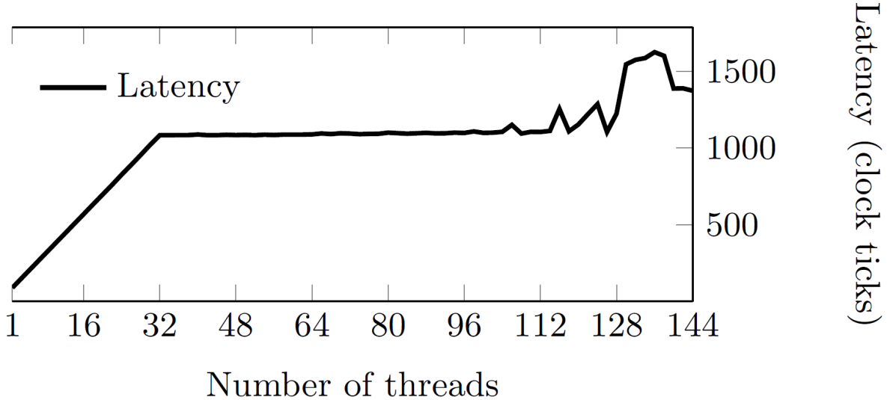
Thread-Latency Plot
Loads/thread: 1, pattern: All Unique
Notes:
-spikes in variance of latency shows huge change in latency.
-lack of data around the beginning of X, e.g. 0 thread, leads to distortion.
-we found three neighbors large enough to find the spike and small enough to avoid smoothing effects.

Slide 16
Methodology
Two NVIDIA GPUs:
Tesla C2070 (Fermi architecture)
Tesla K20c (Kepler architecture)
CUDA Toolkit v5.5
Micro-benchmarking the GPU:
MSHR or PRT?
Find the parameters of MSHR or PRT structure

Slide 17
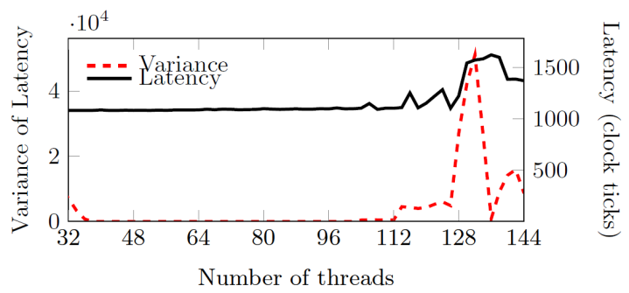
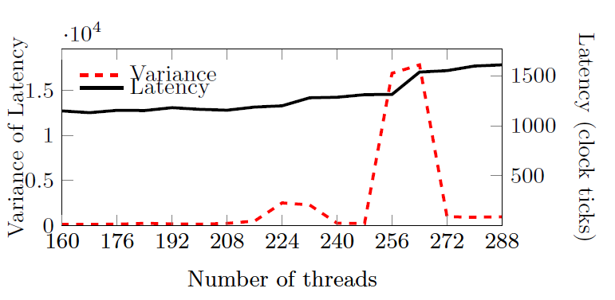
#1 Fermi: MSHR vs PRT Test?
Multiple-threads single-load
MSHR
May not be PRT
Memory Pattern:
All Unique:
Every thread fetches a
unique memory block
Two-Coalesced:
Every two neighbor
threads fetch a common
unique memory block

Slide 18
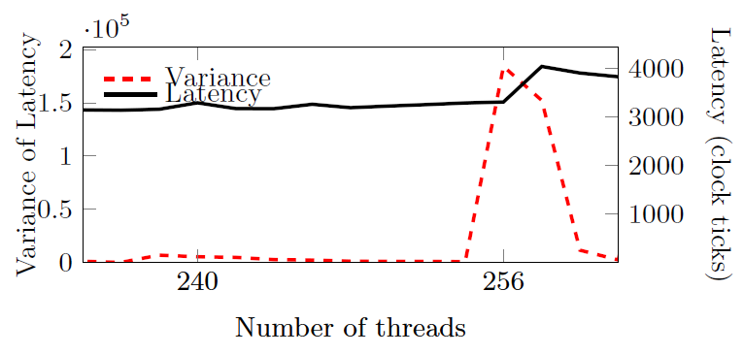
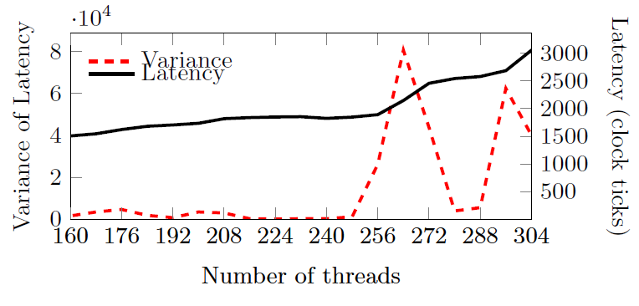
#1 Fermi: MSHR Parameters
thread block | T1 | T2 | T3 | T4 | T5 | T6 | T7 | T8 | T9 | …
 | #1 | #1 | #1 | #1 | #1 | #1 | #1 | #1 | #2
 | #a | #a | #a | #a | #a | #a | #a | #a | #b
 | #^ | #^ | #^ | #^ | #^ | #^ | #^ | #^ | #$
 | #ᵷ | #ᵷ | #ᵷ | #ᵷ | #ᵷ | #ᵷ | #ᵷ | #ᵷ | #ᶋ
thread block | T1 | T2 | T3 | T4 | T5 | T6 | T7 | T8 | T9 | …
 | #1 | #1 | #1 | #1 | #2 | #2 | #2 | #2 | #3
 | #a | #a | #a | #a | #b | #b | #b | #b | #c
thread block | T1 | T2 | T3 | T4 | T5 | T6 | T7 | T8 | T9 | …
 | #1 | #2 | #3 | #4 | #5 | #6 | #7 | #8 | #9
thread block | T1 | T2 | T3 | T4 | T5 | T6 | T7 | T8 | T9 | …
 | #1 | #1 | #2 | #2 | #3 | #3 | #4 | #4 | #5
We didn’t observe spike beyond merger8
Conclusion: 128 entries + 8 mergers per entry at least
Loads/thread: 2, pattern: Four-Coalesced
Loads/thread: 1, pattern: Two-Coalesced
Loads/thread: 1, pattern: All Unique
Loads/thread: 4, pattern: Eight-Coalesced
Loads per thread (LdpT)
Pattern (1=All Unique, 2=Two-coalesced, etc)
Threads
# warp = Threads / 32
Unique mem = LdpT * (Threads / Pattern)
max # MSHR entries = Unique mem
min # MSHR mergers = pattern
1
1
1
2
2
4
4
8
Config
128
4
128
256
8
128
256
8
128
256
8
128
Spike
128
1
128
2
128
4
128
8
Finding

Slide 19
#2 Kepler: MSHR vs PRT Test?
Memory Pattern:
Multiple-threads two-loads
All Unique:
Every thread fetches a
unique memory block
PRT
May not be MSHR
Two-Coalesced:
Every two neighbor
threads fetch a common
unique memory block

Slide 20
#2 Kepler: PRT Parameters
We observed scoreboard saturation beyond 3LdpT
Conclusion: 44 entries at least
Loads per thread (LdpT)
Pattern (1=All Unique, 2=Two-coalesced, etc)
Threads
# warp = Threads / 32
Unique mem = LdpT * (Threads / Pattern)
max # PRT entries = # warp x LdpT
1
1
2
1
3
1
NoSpike
-
-
678
~22
1356
454
~15
1362
-
~44
~45

Slide 21
Conclusion
Findings:
Tesla C2070: MSHR
128 MSHR entry, utmost, 8 mergers per entry, at least
MLP per SM:
Coalesced = 1024 (128 x 8)
Un-coalesced = 128
Tesla K20c: PRT
44 PRT entries, utmost, 32 requests per entry (warp size)
MLP per SM:
Coalesced/Un-coalesced = 1408 (44 x 32)
Optimization for programmer
Diminishing return of coalescing on recent architectures
Notes:
-We observe slight sensitivity to coalescing under K20c, which shows it’s a powerful architecture in MLP. e.g. we compared naiive matrix-matrix multiplication to tiling optimized version under both architectures.

Slide 22
Thank You!
Questions?

Slide 23
References
[Nyland2013] L. Nyland et al. Systems and methods for coalescing memory accesses of parallel threads, Mar. 5 2013. US Patent 8,392,669.
[Bakhoda’2009] A. Bakhoda et al. Analyzing cuda workloads using a detailed gpu simulator. In ISPASS 2009.

Slide 24
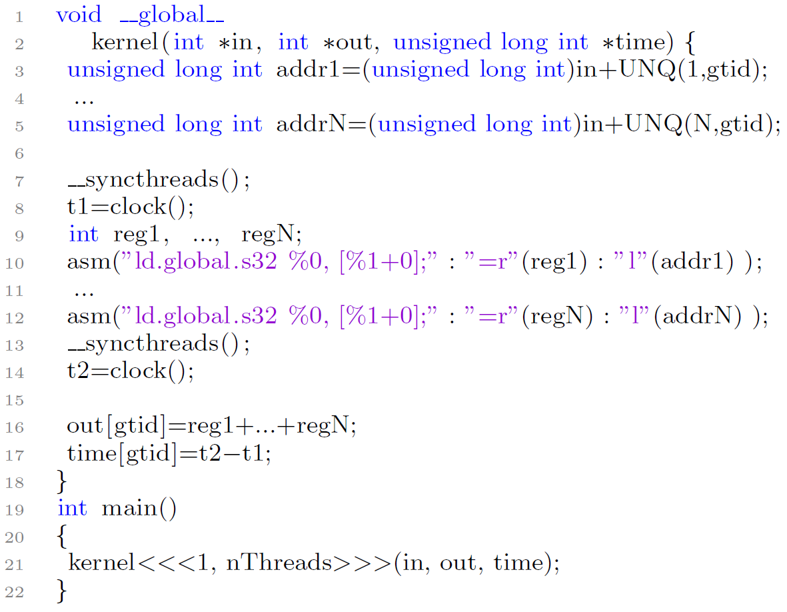
Micro-benchmark Skeleton
Modifying the UNQ procedure to get different memory patterns
Each access is unique
Every two, four, eight, 16, or
32 neighbor threads access a
unique block
nThreads:
1 - 1024
Notes:
-Simplify this slide.

Slide 25
Thread-Latency Plot
Loads/thread: 1, pattern: merger1
Notes:
-spikes in variance of latency shows huge change in latency.
-lack of data around the beginning of the of X, e.g. 0 thread, leads to distortion.
-we found three neighbors large enough to find the spike and small enough to avoid smoothing effects.

Slide 26
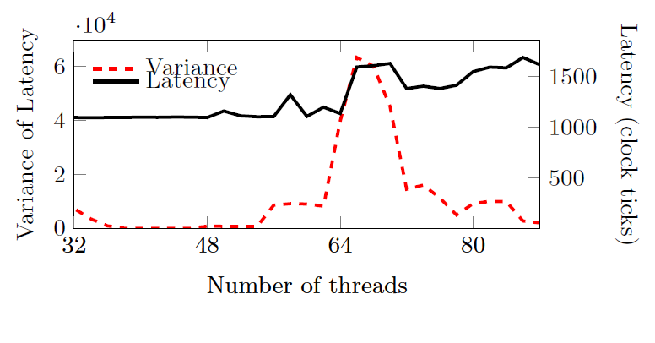
#1 Tesla C2070: MSHR or PRT Test?
thread block | T1 | T2 | T3 | T4 | T5 | T6 | T7 | T8 | T9 | …
 | #1 | #2 | #3 | #4 | #5 | #6 | #7 | #8 | #9
thread block | T1 | T2 | T3 | T4 | T5 | T6 | T7 | T8 | T9 | …
 | #1 | #2 | #3 | #4 | #5 | #6 | #7 | #8 | #9
 | #a | #b | #c | #d | #e | #f | #g | #h | #i
thread block | T1 | T2 | T3 | T4 | T5 | T6 | T7 | T8 | T9 | …
 | #1 | #1 | #2 | #2 | #3 | #3 | #4 | #4 | #5
Loads/thread: 2, pattern: merger1
Loads/thread: 1, pattern: merger1
Loads/thread: 1, pattern: merger2
Loads per thread (LdpT)
Pattern (merger1, 2, 4, 8)
Threads
# warp = Threads / 32
Unique mem = LdpT * (Threads / Pattern)
max # PRT entries = # warp x LdpT
max # MSHR entries = Unique mem
1
1
2
1
1
2
May not be PRT
MSHR
128
4
128
64
2
128
256
8
128
4
128
4
128
8
128

Slide 27
#1 Tesla C2070: MSHR Parameters
thread block | T1 | T2 | T3 | T4 | T5 | T6 | T7 | T8 | T9 | …
 | #1 | #1 | #1 | #1 | #1 | #1 | #1 | #1 | #2
 | #a | #a | #a | #a | #a | #a | #a | #a | #b
 | #^ | #^ | #^ | #^ | #^ | #^ | #^ | #^ | #$
 | #ᵷ | #ᵷ | #ᵷ | #ᵷ | #ᵷ | #ᵷ | #ᵷ | #ᵷ | #ᶋ
thread block | T1 | T2 | T3 | T4 | T5 | T6 | T7 | T8 | T9 | …
 | #1 | #1 | #1 | #1 | #2 | #2 | #2 | #2 | #3
 | #a | #a | #a | #a | #b | #b | #b | #b | #c
thread block | T1 | T2 | T3 | T4 | T5 | T6 | T7 | T8 | T9 | …
 | #1 | #2 | #3 | #4 | #5 | #6 | #7 | #8 | #9
thread block | T1 | T2 | T3 | T4 | T5 | T6 | T7 | T8 | T9 | …
 | #1 | #1 | #2 | #2 | #3 | #3 | #4 | #4 | #5
We didn’t observe spike beyond merger8
Conclusion: 128 entries + 8 mergers per entry at least
Loads/thread: 1, pattern: merger1
Loads/thread: 1, pattern: merger2
Loads/thread: 2, pattern: merger4
Loads/thread: 4, pattern: merger8
Loads per thread (LdpT)
Pattern (merger1, 2, 4, 8)
Threads
# warp = Threads / 32
Unique mem = LdpT * (Threads / Pattern)
max # MSHR entries = Unique mem
min # MSHR mergers = pattern
1
1
1
2
2
4
4
8
128
4
128
256
8
128
256
8
128
256
8
128
128
1
128
2
128
4
128
8

Slide 28
#2 Tesla K20c: MSHR or PRT Test?
PRT
Loads per thread (LdpT)
Pattern (merger1, 2, 4, 8)
Threads
# warp = Threads / 32
Unique mem = LdpT * (Threads / Pattern)
max # PRT entries = # warp x LdpT
max # MSHR entries = Unique mem
2
1
2
2
2
4
May not be MSHR
678
~22
1356
682
~22
682
682
~22
341
44
1356
44
682
44
341
Notes:
-remove third column

Slide 29
#2 Tesla K20c: PRT Parameters
We observed scoreboard saturation beyond 3LdpT
Conclusion: 44 entries at least
Loads per thread (LdpT)
Pattern (merger1, 2, 4, 8)
Threads
# warp = Threads / 32
Unique mem = LdpT * (Threads / Pattern)
max # PRT entries = # warp x LdpT
1
1
2
1
3
1
NoSpike
-
-
678
~22
1356
454
~15
1362
-
~44
~45

Slide 30
Stressing Outstanding Memory Access Resources
Launch single thread block
1 to 1024 threads
Each threads fetches single unique memory block
Multiple loads per thread
1 to 4 loads
128-byte blocks
0x0280
Thread Block
First Load
Second load
0x0200
Global Memory address space
0x0180
Thread#1
Address
Address
0x0100
Thread#2
Address
Address
0x0080
Thread#3
Address
Address
0x0000
Notes:
-To occupy outstanding memory accessing resources on single SM
-Stop before saturating the scoreboard

