Slide 1
Rethinking Prefetching in GPGPUs: Exploiting Unique Opportunities
Ahmad Lashgar and Amirali Baniasadi
ECE Department
University of Victoria

Slide 2
Overview
Prefetching Challenges:
Prefetching accuracy
Timeliness
Bandwidth control
Proposed scheme:
Predict data statically in software
Prefetch dynamically in hardware (per block)
Addressing Challenges in GPGPUs:
Prefetching accuracy:
Software: Static analysis
Timeliness & Bandwidth control:
Hardware: Stall blocks until prefetching completes
Notes:
Put #

Slide 3
Outline
Static Predictability of Memory Accesses
Proposed Prefetching Scheme
Software
Hardware
Experimental Results:
Machine Models
Prefetch Buffer Implementation
Notes:
-Share of Predictable & Unpredictable array indexes.

Slide 4
Static Predictability of Memory Accesses
Steps:
Parse the kernel
Extracts all array indexes (global memory accesses)
Groups indexes based on the predictability of the index
Based on the operators and terms forming the index
Statically Predictable
Quasi-static Predictable
Unpredictable (induction, indirect, control)
__global__ void
kernel(float *outArr, float*inArr){
int bIdx = blockIdx.x;
int tIdx = threadIdx.x;
outArr[bIdx*blockDim.x+tIdx] = inArr[bIdx*blockDim.x+tIdx];
}

Slide 5
Unpredictable indexes
Index is formed by operators other than + and x
Index depends on runtime terms
Induction: loop iterator variable
Indirect: load from another memory location
Control: a control statement defines the value
e.g. value = array[ 127 / varA + varB ]
e.g. for(int i=0; i<N; i+=m)
value = array[ threadIdx.x + i ]
e.g. value = array[ arrayB[ threadIdx.x ] ]
e.g. value = array[ control ? threadIdx.x : 0 ]

Slide 6
Predictable
Statically Predictable
Index is formed by + and x operators and constant terms
Quasi-static Predictable
Index is formed by + and x operators, constant terms, and CUDA built-in variables
e.g. value = array[ 128*4+5 ]
e.g. value = array[ threadIdx.x ]
e.g. value = array[ blockIdx.x*blockDim.x + threadIdx.x ]
e.g. value = array[ blockIdx.x*13 + threadIdx.x + 9*54 ]

Slide 7
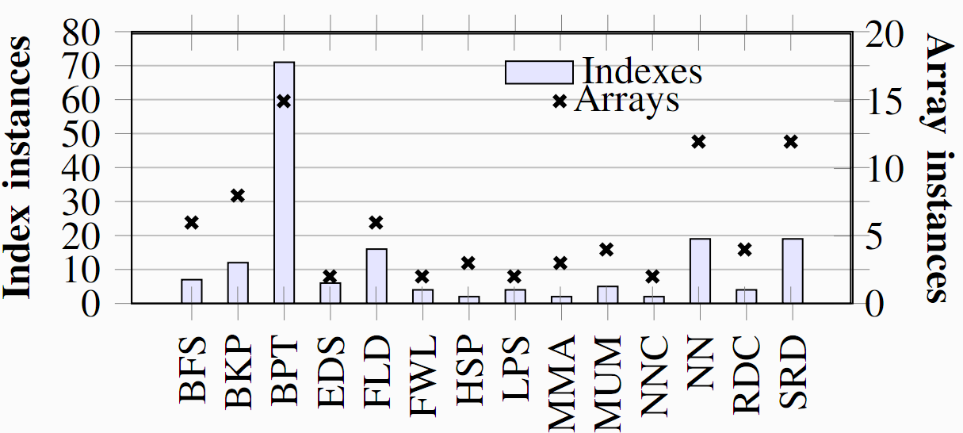
Predictability Analysis for 14 Benchmarks
Number of arrays and indexes

Slide 8
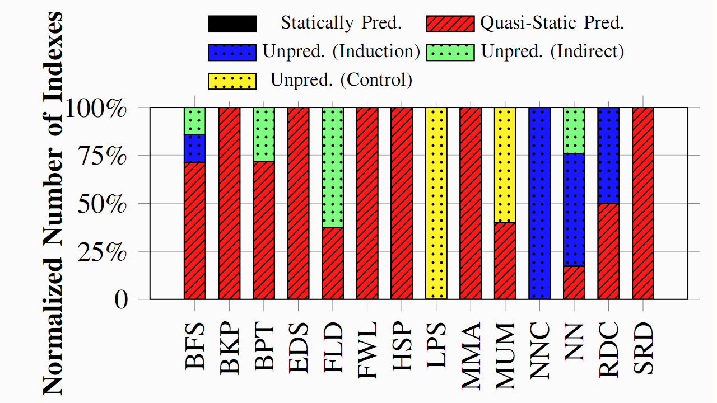
Predictability Analysis for 14 Benchmarks (2)
Breakdown of predictability of indexes
Indexes are highly predictable
Key Idea: Pass information about predictable indexes to hardware and
based on runtime value of CUDA built-in variables do prefetching.

Slide 9
Proposed Prefetching Scheme
Software Side
Static analyzer to extract information
Forming information into API calls
Injecting the calls in the code, immediately before kernel launch
API calls set a prefetching table in the hardware
Hardware Side
Prefetch controller
Prefetch buffer
Prefetch table

Slide 10
Simplify the information in form of API
We look for minimum and maximum values that index may have
CUDA built-in variables:
threadIdx -> Range of this variable is constant
gridDim and blockDim -> Constant for each kernel
blockIdx -> Constant for each thread block
Predictable index can be simplified to one CUDA built-in variable
Example
If kernel launch sets blockDim.x to 256, then:
value = array[ blockIdx.x*blockDim.x + threadIdx.x ]
Index minimum = blockIdx.x*256 + 0
Index maximum = blockIdx.x*256 + 255

Slide 11
Proposed API call
Prototype of the API call passing a prefetch stride to hardware
Sets a row in prefetch table on the GPU

Slide 12
Hardware – Prefetch Table
Every row stores information from one API call and corresponds to an stride of data
Thread Block Dispatch
Prefetch Table
Memory Controller #0
Interconn. Network
Memory Controller #1
GPU Core #0
GPU Core #1
ptr | Type size | min-bxp | min-byp | min-bzp | min-off | max-bxp | max-byp | max-bzp | max-off

Slide 13
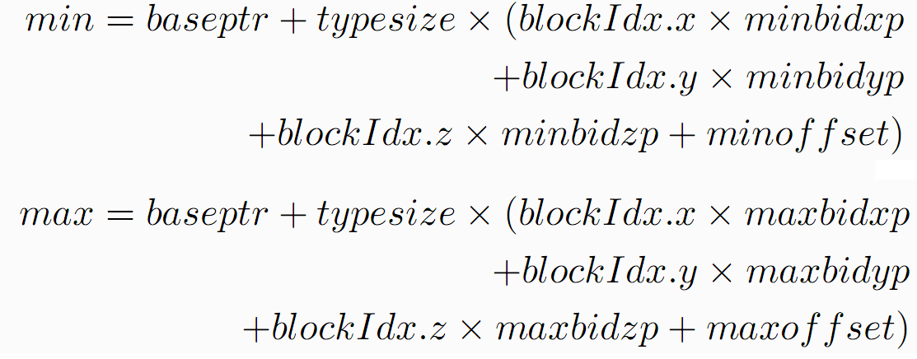
Hardware – Prefetch Controller Unit
Prefetch controller unit calculates the range of prefetch stride for about-to-dispatch thread blocks from prefetch table:
Thread Block Dispatch
Prefetch Controller Unit
Prefetch Table
Memory Controller #0
Interconn. Network
Memory Controller #1
GPU Core #0
GPU Core #1

Slide 14
Hardware – Prefetch Buffer
Prefetch buffer is a logical buffer at each GPU core to store prefetched data
can be a dedicated buffer, space from the cache, or shared memory.
Thread Block Dispatch
Prefetch Controller Unit
Prefetch Table
Memory Controller #0
Interconn. Network
Memory Controller #1
GPU Core #0
GPU Core #1
Prefetch Buffer
Prefetch Buffer

Slide 15
Prefetch Timeliness
Performing prefetching at the thread block granularity
Assuring timeliness:
Thread block remains inactive on the GPU core until prefetching completes
Stalling the thread block also prevents threads from issuing redundant accesses

Slide 16
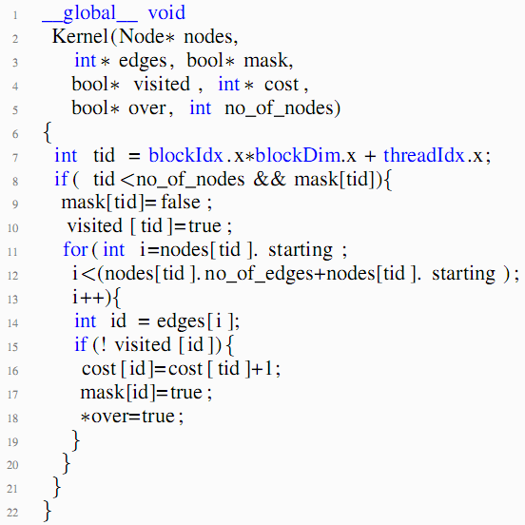
Case Study: BFS
The kernel

Slide 17
Case Study: BFS
Predictability of array accesses

Slide 18
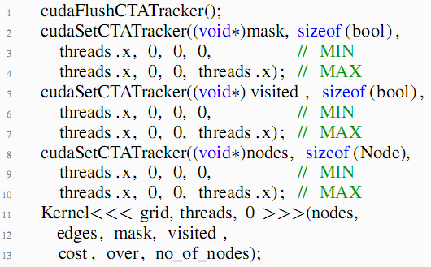
Case Study: BFS
API calls

Slide 19
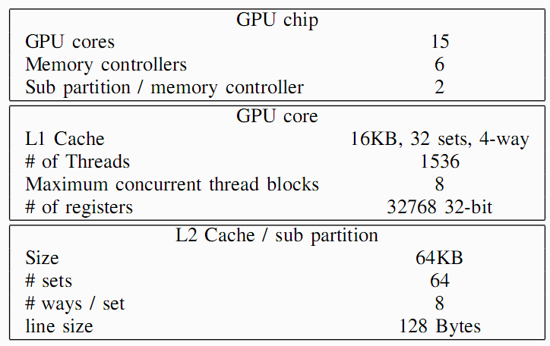
Methodology
Prefetching scheme is implemented in GPGPU-sim
Benchmarks from RODINIA, CUDA SDK, and Third-Party

Slide 20
Machine Models
Measure the potential behind the prefetching scheme relaxing the performance overheads
I-Machine -> No Prefetching Request No thread block stall
S-Machine-> Prefetching Requests No thread block stall
R-Machine-> Prefetching Requests Thread block stall
All machines have ideal prefetch buffer (unlimited size, fully-associative)

Slide 21
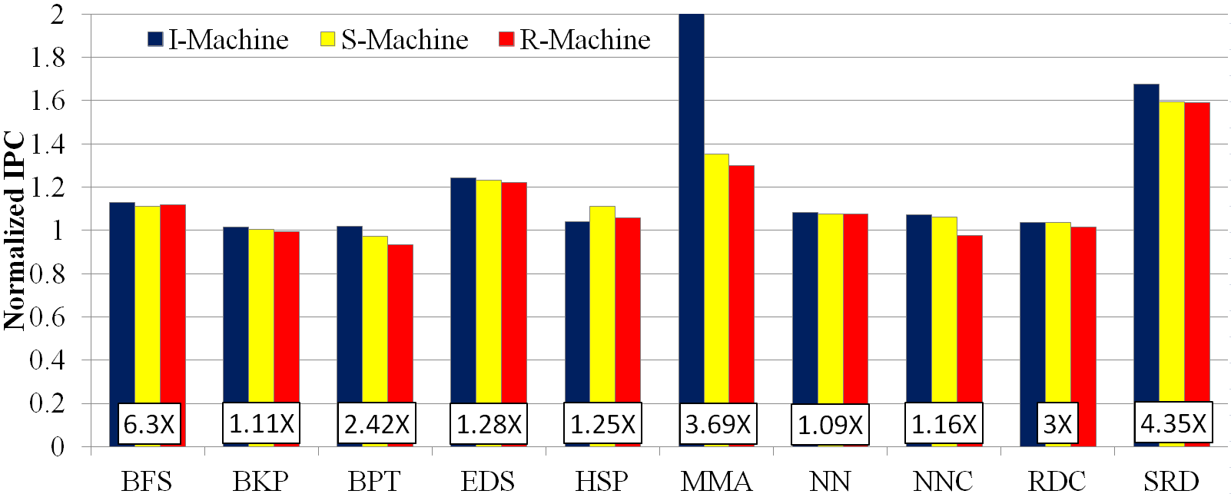
Machine Models – Performance
Numbers are normalized to no-prefetching baseline
Labels below the bars show the achievable speedup via ideal zero-latency memory
Notes:
-Issuing prefetching request impose significant performance overhead (Comparing I-Machine to S-Machine)
-Overhead of stalling thread block is significant when the total load of block is low (e.g. NNC)

Slide 22
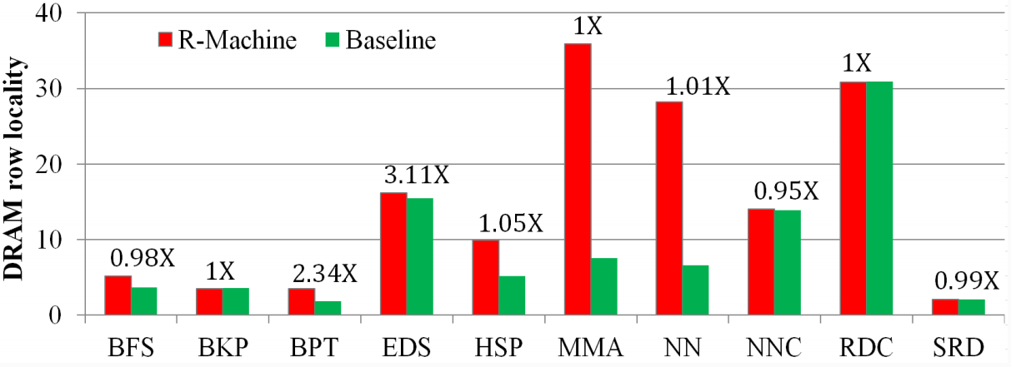
Machine Models – DRAM Row Locality
Row locality = total accesses / row changes
Numbers above the bars reports R-Machine DRAM accesses, normalized to baseline
Notes:
-Generally improves row locality while keeping the total accesses the same (except BPT and EDS)

Slide 23
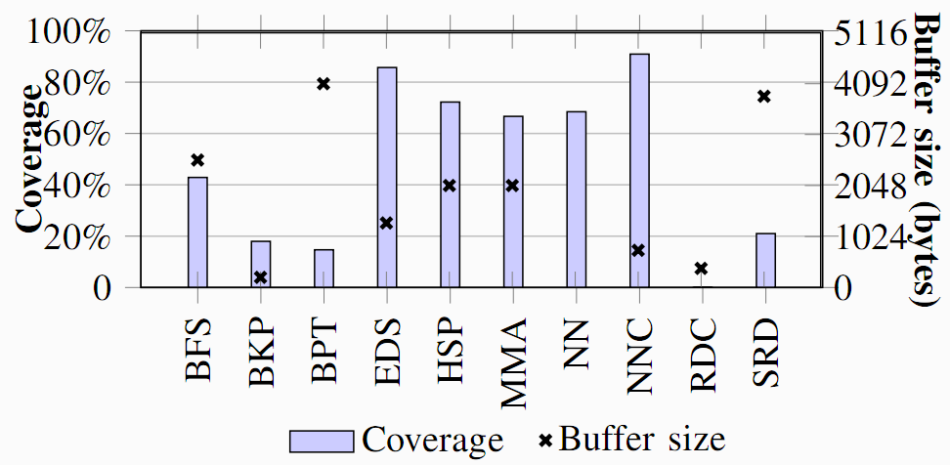
Machine Models – Prefetch Buffer
Coverage: percentage of memory accesses that found in prefetch buffer
Buffer size: maximum size of prefetch buffer for a thread block
Notes:
As we pointed it out earlier, machine models have unlimited prefetch buffer size.

Slide 24
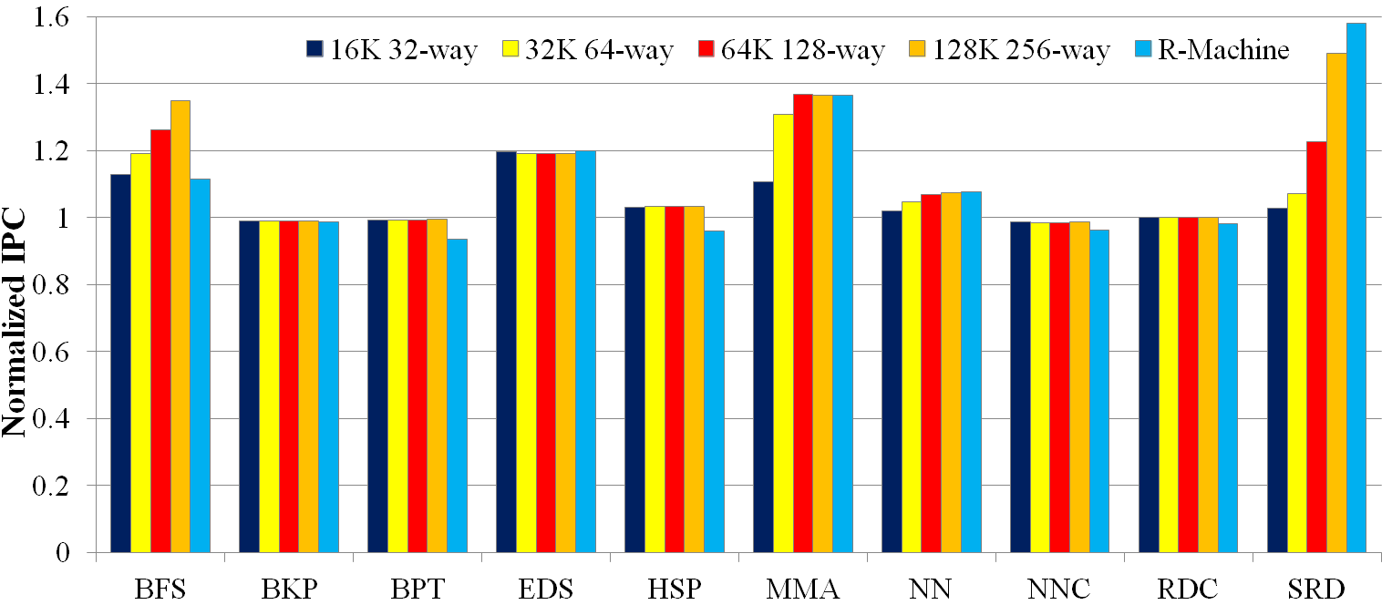
Real Implementations - Performance
Implementing the prefetch buffer using a set-associative cache

Slide 25
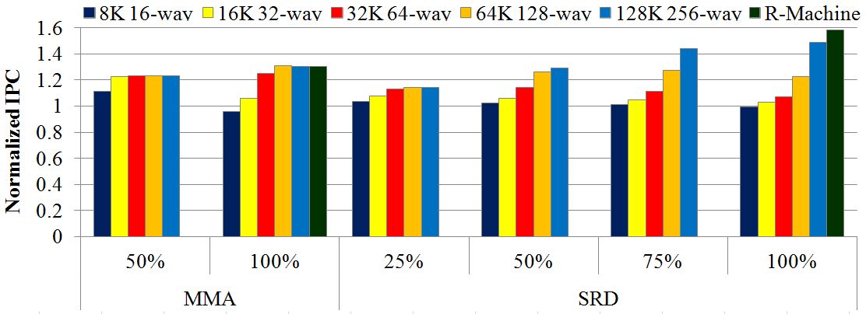
Real Implementations - Tuning Prefetching
Potential behind compiler heuristics injecting API calls intelligently
Notes:
-Adjusting the prefetching size to the cache size

Slide 26
Conclusion
Proposed an scheme to statically predict & dynamically prefetch for thread blocks
Evaluations show a clear advantage behind the prefetching scheme
20% to 49% over the baseline without prefetching
Future work:
Improving the static analyzer to capture induction unpredictable indexes
Developing compiler heuristics to adjust API to cache size

