Slide 1
Employing compression solutions under openacc
Ebad Salehi, Ahmad Lashgar and Amirali Baniasadi
Electrical and Computer Engineering Department
University of Victoria

Slide 2
This Work
Motivation: Effective memory bandwidth usage is needed to achieve high performance in GPUs.
Our solution: Compress floating point numbers before transferring
How: We propose a compression method and set of OpenACC clauses
We achieve up to 1.36X speedup

Slide 3
Outline
Introduction & Background
GPU Architecture
OpenACC
Clauses and the Compression Method
Experimental Results
Conclusion

Slide 4
Introduction
GPU has promising peak performance
but hard to achieve in practice.
The main problem is memory bandwidth
Thousands of threads compete for data
Memory optimization calls for skills and experience.
Good GPU programs need extensive development effort.
Frameworks such OpenACC makes it easier.

Slide 5
GPU Architecture
Warps Pool
Streaming Multiprocessors (SM)
Consists of Streaming Processors (SP)
32 thread group is called Warp
Threads in a warp execute instructions at once
Therefore they send memory request at the same time
SM
Warp 1 | T₁ T₂ T₃ T₄ |
Warp 2 | T₅ T₆ T₇ T₈ |
…
Load/Store Unit
Int/Float
Unit
Special Fcn
Unit
L1 Cache
Data

Slide 6
GPU Memory Subsystem
DRAM (Global Memory)
Accessed through a 2-level cache hierarchy
Memory bandwidth is a bottleneck for many applications.
Bandwidth utilization depends on the access pattern.
The smallest memory transaction size is 32 bytes.
GPU
SM₁
SM_{N}
L1$
L1$
Interconnect
…
L2$
L2$
MC₁
MC_{N}
DRAM
Notes:
Tell about memory blocks here. The goal is reducing memory transactions.

Slide 7
OpenACC
Directive-based extension to Fortran, C, C++
Maps compute-intensive loops to accelerators
Manages data movement between the CPU(Host) and the accelerator
Lowers programming effort
Coarse grained control
Notes:
Directive based extenstion, Code still compiles for host-only,
Each iteration to a thread
3.
4. It’s host directed. Host calls the kernels and data transfer functions.
5. The fact that it is directive-based and programmer doesn’t need to change the source code, decreases the programming effort/time.
6. But it comes at a price. It has less flexiblity than CUDA/OpenCL. It’s hard or even not possible to implemented complicated algorithms.
It’s similar to OpenMP except Openacc model is more suitable for accelerators which are capable of running a great number of lightweight threads.

Slide 8
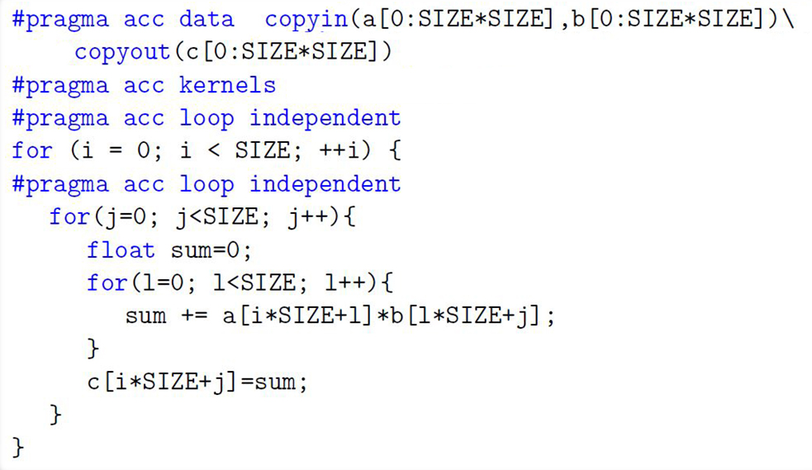
OpenACC
Matrix-matrix multiplication example:
Notes:
Transparent pragma
Directives
Clauses

Slide 9
Proposed Clauses
Our goal is proposing a method to alleviate the memory contention problem
Ease the work of programmers.
We extend the OpenACC model by new clauses.
Notes:
By analysis

Slide 10
Proposed Clauses
Data Transfer Clauses
Instruct the compiler to apply the compression technique to data sets at transfer time.
Kernels Compression Clause
Instructs the compiler to treat the marked data sets as compressed at kernel generation time.
Notes:
The reason why we separated these two.

Slide 11
Proposed Clauses
Regular Data | Compressed Data
copyin | compression_copyin(ccopyin)
copy | compression_copy(ccopy)
copyout | compression_copyout(ccopyout)
Example:
#pragma acc data compression_copy(data[0:size:min:max])
Notes:
Min and max are optional.
The reason for max and min discussed later.

Slide 12
Proposed Clauses
Compression clause on kernels directive
Example:
#pragma acc kernels compression(d1, d2, d3)
{
…
//kernels region
…
}

Slide 13
Proposed Clauses
Matrix-matrix multiplication example:

Slide 14
Compression Method
Applicable on floating point data. 32 or 64 bit
Flexible compression ratio
Low overhead
Lossy

Slide 15
Compression
Floating point:

Slide 16
Compression Steps
This process is performed on the data set
Division by twice the maximum absolute value of the data set to map to (-0.5,+0.5).
Adding to 1.5 to map to (1,2).
Omitting the exponent.
Omitting the least significant bits.
Notes:
*In Which ones we lose accuracy?

Slide 17
Compression Steps
Pi most accurate representation in single precision ≈ 3.1415405
Notes:
Dividing by 4

Slide 18
Decompression Steps
Pi most accurate representation in single precision ≈ 3.1415405
Pi after decompression ≈ 3.1415927

Slide 19
Decompression Steps
Reformulate to use fused multiply-add instruction.
Notes:
The exact reverse operation is not efficient. We reformulate to use fused multiply-add unit.

Slide 20
Methodology and Results
Benchmarks:
Matrix Multiplication, HotSpot, Nearest Neighbors and Dyadic Convolution
Compilers:
IPMACC, NVCC, GNU GCC 4.4.7
Platform:
CUDA6.0 on NVIDIA Tesla K20c
Intel Xeon CPU E5-2620, 16 GB RAM
Scientific Linux 6.5 (Carbon) x86 64
Notes:
Tell about the benchmarks. Kernel time

Slide 21
Matrix Multiplication

Slide 22
HotSpot

Slide 23
Nearest Neighbors
Finds k-nearest neighbor points in a two dimensional space.
Each point is a C struct with two attributes; latitude, longitude.
We transform array of structs to struct of arrays to enhance spatial locality.

Slide 24
Nearest Neighbors
Transforming array of structs to struct of arrays at compression stage.
lat0
lng0
Lat1
lng1
lat2
lng2

Slide 25
Nearest Neighbors

Slide 26
Dyadic Convolution

Slide 27
Conclusion
Easy to use OpenACC clauses proposed
Transparent compression scheme
Data compression
Reduces the bandwidth usage
Increase the cache hit rate
Good solution for data sizes larger than L2 cache
Up to 2X in synthetic benchmarks
Up to 1.36X in real world benchmarks

Slide 28
Related Works
Samadi et al. developed a transparent approximation system. Accepts CUDA code and generate multiple kernels with different accuracy level.
Sathish et al. show the efficiency of hardware-based lossless and lossy compression dram bandwidth. Their proposed compression hardware can improves the performance memory-bound workloads by 26% for GPUs with L1 caches but without L2 caches.

Slide 29
Future Work
Adaptive compression
Compression methods on different data types.
Using hardware compression solutions

Slide 30
Thank you
Questions?

Slide 31
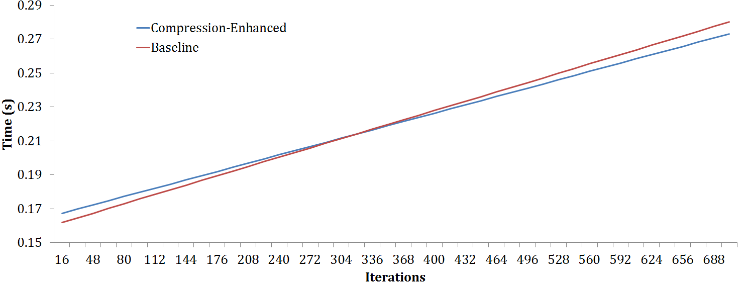
HotSpot Application

Slide 32
Matrix Multiplication
Matrix-matrix multiplication

