Slide 1
OpenACC cache Directive: Opportunities and Optimizations
Ahmad Lashgar & Amirali Baniasadi
ECE Department
University of Victoria
November 14, 2016

Slide 2
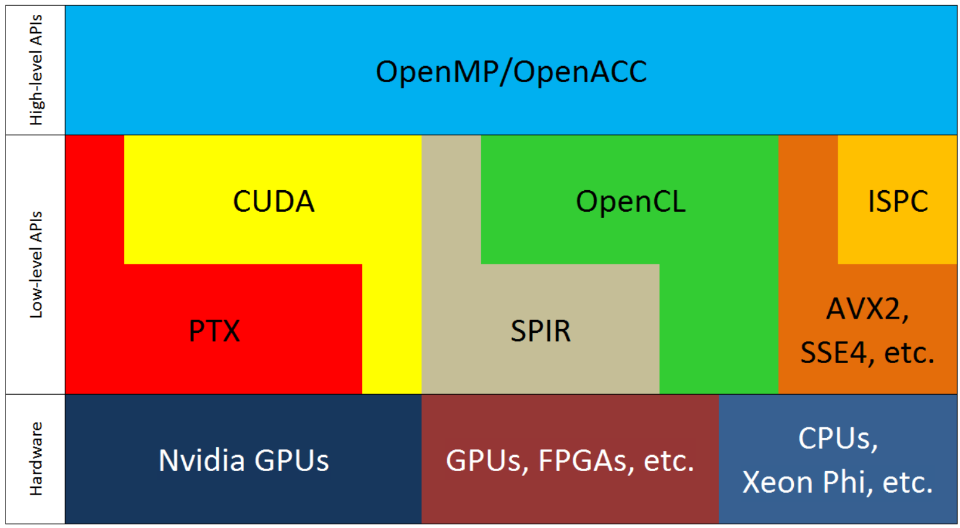
Directive-based Accelerator Programming Models
Higher Performance
Lower Development Effort
Notes:
-Low-level APIs for accelerators are mature nowadays and focus has shifted toward higher level programming models.
-Two major APIs: OpenMP and OpenACC
-Moving from bottom to up, we deliver lower development effort, but losing performance.
-In this work, we focus on narrowing down this gap, while maintaining the programming effort low.

Slide 3
Software-managed Cache In GPUs
__QUALIFIER__ float smc[1024];
smc[threadIdx.x] = 0;
...
float sum = a[i] + smc[threadIdx.x]
...
DRAM
GPU core #1
SMC
SIMD
GPU core #2
SMC
SIMD
Notes:
-Software-managed cache (SMC) is a local on-core cache shared among threads of the thread block.
-SMC is managed by programmer, removes cache conflicts.
-SMC can be used as a buffer to fetch the data IN FEW REGULAR MEMORY ACCESSES and then access the data IN ARBITRARY PATTERN (without sacrificing the performance)
-SMC can also be used to shared data among threads of thread block locally, through higher bandwidth and lower latency than global memory.
-Global memory bandwidth demand is drastically reduced as GPU cores always read from their local cache.

Slide 4
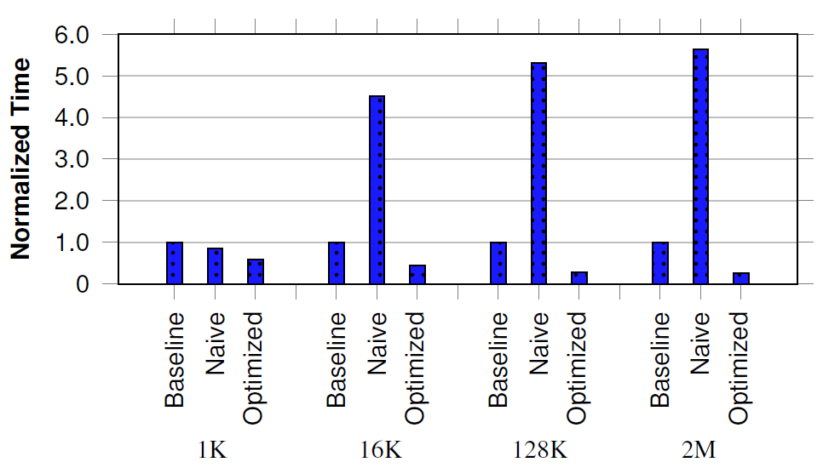
Software-managed Cache Performance Potential In OpenACC
1D Stencil 30-element radius
Naïve implementation downgrades performance, undesirably.
Cache sharing is crucial to deliver speedup over the baseline.
Notes:
-Performance advantages behind SMC in OpenACC. Performance gap between naive implementation and proposed implementation.
-Benchmark is 1D stencil, radius is set to 30-elements. 1K, 16K, 128K, and 2M element problem sizes are evaluated. Thread block size is 256 under all implementaitons.
-Methods:
Baseline: OpenACC no software-managed cache
Naïve: OpenACC+cache directive; implementation isolates cache space to each parallel iteration of the loop
Optimized: OpenACC+cache directive; implementation shares cache spaces among threads and applies optimizations introduced in this work (namely parallel fetch)

Slide 5
Overview
Key contribution:
Investigating essential optimizations to implement OpenACC cache directive efficiently
Motivation:
Software-managed cache creates a significant gap between OpenACC and CUDA applications
OpenACC cache directive can narrow down this gap, potentially
Naïve cache implementation, inversely, downgrades performance
Goals:
Investigating challenges in implementing cache directive efficiently
Introducing compiler passes to implement cache directive
Findings:
Sharing cache space among chunk of parallel iterations is essential optimization
Best implementation performs very close to CUDA equivalent
Notes:
-Discussion applies to CUDA as well

Slide 6
Outline
cache Directive Syntax/Usage
Proposed Implementations
Emulating Hardware Cache
Range-based Conservative
Range-based Intelligent
Optimizations
Cache fetch
Cache sharing
Cache write policy
Index mapping
Evaluations
Notes:
-Introducing the syntax of cache directive based on OpenACC standard, and explaining the notation via an example
-Three implementations are introduced. Implementations differ based on how the range specified by cache directive is maintained in the software-managed cache.
-Four independent optimizations are introduced to optimize cache implementations.
-Presenting our finding and results.

Slide 7
cache Directive
From OpenACC API Standard:
“The cache directive may appear at the top of (inside of) a loop. It specifies array elements or subarrays that should be fetched into the highest level of the cache for the body of the loop.”
Syntax:
#pragma acc cache(var-list)
{
// cache region
}
Var-list e.g. array[start:length]
Notes:
-var-list is a subarray denoted by start index and length. Start is the first index of array that should be cached on the accelerator. Length is the number of elements that should be cached, starting from start.
-cache directive applies to a code block, all accesses to the var-list within the cache region should be cached.

Slide 8
cache Directive Usage
Example:
#pragma acc data copy(a[0:LEN],b[0:LEN])
for(n=0; n<K; ++n){
#pragma acc parallel loop
for(i=1; i<LEN-1; ++i){
int lower = i-1, upper = i+1;
float sum = 0;
#pragma acc cache(a[(i-1):3])
{
for(j=lower; j<=upper; ++j)
sum += a[j];
}
b[i] = sum/(upper-lower+1);
}
float *tmp=a; a=b; b=tmp;
}
Notes:
-The example presents 1D stencil kernel, radius is 1 ranging from i-1 to i+1
-outer data directive surrounding the loop iterated by n transfers the data to the accelerator before the loop and transfers them back after the loop.
-most outer loop is a serial loop, the middle loop can be executed in parallel, the most inner loop is a reduction.
-the range of data used by the most inner loop can be cached and it is known to be in [i-1 to i+1]
-(MOVE ON THE ANIMATION TO SHOW THE CACHE DIRECTIVE)
-cache directive denotes a subarray of a, starting from (i-1) and length of 3 elements (i+1).

Slide 9
Proposed Implementations
First: Emulating Hardware Cache (EHC)
Data & Tag arrays are allocated in the cache
Tag can be direct-map, set-associative, or fully-associative
Pros and Cons:
Adapts to available cache size
Allows fully or partially caching the subarray
Storing Tag array shrinks effective cache size
Maintaining Tag array imposes performance overhead (minimum of two cache accesses per request)
Notes:
If cache is direct-map, each array read will be replaced by:
-Hit case: Map index to line + TAG read + TAG compare + DATA read
-Miss case: Map index to line + TAG read + TAG compare + global memory read + DATA write +TAG write

Slide 10
Proposed Implementations (2)
Second: Range-based Conservative (RBC)
Data array is allocated in the cache
Two pointers keep track of the elements stored in the cache; start and end
If requests fall within start and end, data is read from the cache, otherwise global access is made.
Pros and Cons:
One cache access to read/write
Simple mapping from global to cache space (1 subtraction)
Scales to multi-dimensional by storing a pair per dimension
Control-flow overhead to assure data is cached
Notes:
-Exploits the fact that cache directive always points to an stride of data
-This method exploits the fact that elements of subarray are a row of consequent elements from the original array and minimizes the overhead for maintaining the track of the cached data (compared to EHC).
-Pointers are indexes of subarray stored in the cache, specifying the start and end indexes that are cached.
-Location of data in the shared memory is determined by subtracting the incoming request index from the start pointer.
-Each array read will be replaced by:
-If is within the range specified by the pointers: Map index to line (subtract) + DATA read
-Otherwise: global memory read

Slide 11
Proposed Implementations (3)
Third: Range-based Intelligent (RBI)
Same as RBC, except avoiding control-flow overhead for cache accesses
Assumes accesses fall within the cached range, relying on OpenACC 2.5 spec.
Pros and Cons:
Cache read/write involves one subtraction (for mapping) and one cache load/write
Notes:
-Data is assured to be in the cache. Hence operations for reading the data are:
- Map index to line (subtract) + DATA read

Slide 12
Optimizations
Cache fetch
Cache sharing
Cache write policy
Index mapping

Slide 13
Optimization: Cache Fetch
Cache fetch routine is called before cache region starts, once per parallel iteration
Critical to optimize if cache region is small
__cache_fetch();
// #pragma acc cache(subarray[])
{
// cache region
}
void __cache_fetch(subarray, start, length){
for(int i=0; i<length; ++i)
__cache[i] = subarray[i+start];
}
Notes:
-To implement the cache directive, the specified range should be fetched to the allocated space in the cache, before executing the cache region. This process can be written as a routine; referred to as cache fetch routine.
-Every instance of the parallel loop (containing the cache region) must call cache fetch routine to initialize the cache space, before getting to execute the cache region.
-Performance of this routine is severely important if cache region is short (since cache fetch will take more time than the region, Amdahl’s law)
-fetch routine normally is implemented using a loop, iteratively fetching the elements within start-length range.

Slide 14
Optimization: Cache Fetch (2)
Loop unrolling, if the subarray size is known
void __cache_fetch(subarray, start){
// length is know to be 3, statically
__cache[0] = subarray[0+start];
__cache[1] = subarray[1+start];
__cache[2] = subarray[2+start];
}
void __cache_fetch(subarray,
start, length){
for(int i=0; i<length; ++i)
__cache[i] = subarray[i+start];
}
Notes:
-Unrolling the loop to avoid control-flow statement

Slide 15
Optimization: Cache Fetch (3)
Share loop among multiple subarrays
void __cache_fetch(length,
subarr1, subarr2, subarr3,
start1, start2, start3){
for(int i=0; i<length; ++i){
__cache_s1[i] = subarr1[i+start1];
__cache_s2[i] = subarr2[i+start2];
__cache_s3[i] = subarr3[i+start3];
}
}
void __cache_fetch(subarray,
start, length){
for(int i=0; i<length; ++i)
__cache[i] = subarray[i+start];
}
Notes:
-sharing the loop among multiple subarrays is possible if length of subarrays are equal
-amortizes the overhead of for loop control flow

Slide 16
Optimization: Cache Fetch (4)
Using parallel threads to reduce loop iterations (or omitting the loop)
void __cache_fetch(sa,
start, length){
for(int i=threadIdx.x;
i<length;
i+=blockDim.x)
__cache[i] = sa[i+start];
}
Length unknown
void __cache_fetch(subarray,
start, length){
for(int i=0; i<length; ++i)
__cache[i] = subarray[i+start];
}
void __cache_fetch(sa,
start, length){
uint tid = threadIdx.x;
uint d = blockDim.x;
__cache[tid] = sa[tid+start];
__cache[d*1+tid] = sa[d*1+tid+start];
__cache[d*2+tid] = sa[d*2+tid+start];
...
}
Length is multiple of
thread block size
Notes:
-Use parallel threads along x to fetch data in parallel.
-Works perfectly along the next optimization, cache sharing.

Slide 17
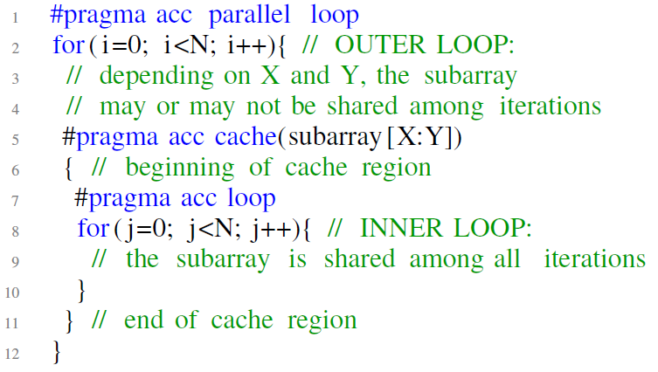
Optimization: Cache Sharing
What sharing means?
Subarray
Fetch once
and share
Iteration #1
This is private!
Iteration #2
Iteration #3
Iteration #X
Iteration #1, #2, #3
Notes:
(MOVE ANIMATION FORWARD)
Subarray is:
shared among iterations of loop iterated by j
private to iterations of loop iterated by i
Sharing along j is not enough
Exploring the opportunity to share along i too
(MOVE ANIMATION FORWARD)
Subarray is to be cached
(MOVE ANIMATION FORWARD)
N iterations execute the parallel region
(MOVE ANIMATION FORWARD)
Each iteration fetches a different range of subarray
(MOVE ANIMATION FORWARD)
First iteration fetches the first three elements
(MOVE ANIMATION FORWARD)
Second iteration ....
(MOVE ANIMATION FORWARD)
fetches [2-4]
(MOVE ANIMATION FORWARD)
Thirds iteration ....
(MOVE ANIMATION FORWARD)
fetches [3-5]
(MOVE ANIMATION FORWARD)
And similarly other iterations do
(MOVE ANIMATION FORWARD – EXPLOSION MARK)
This is store in a location private to each iteration
(MOVE ANIMATION FORWARD – EXPLOSION DISAPPEARS)
(MOVE ANIMATION FORWARD)
Though these iterations share 66% of the data
(MOVE ANIMATION FORWARD)
And this can be fetched once and shared among these all

Slide 18
Optimization: Cache Sharing (2)
How to share the cache?
The problem is finding subarrays that can be shared?
Subarray
CUDA GPU Core
SIMD
Shared Memory
Notes:
-How to share the cache?
-(MOVE ANIMATION FORWARD) Imagine we have the same iterations, (MOVE ANIMATION FORWARD) and the same subarray to be cached.
-Implementing cache directive in CUDA (MOVE ANIMATION FORWARD), iterations are mapped to threads and thread blocks (MOVE ANIMATION FORWARD), Threads in a thread block share data through CUDA Shared Memory fast and efficiently (MOVE ANIMATION FORWARD).

Slide 19
Optimization: Cache Sharing (3)
Problem:
How to find out if subarray can be shared?
Inputs:
Specifications of outer parallel loops (# of iterations, increment steps)
Cache directive’s subarray’s start & length
Output:
Subarrays that can be shared
If subarray can be shared, pointers pointing to the location of cache associated with the iteration, in the shared space
If subarray can be shared, size of the new shared cache

Slide 20
Optimization: Cache Sharing (4)
Proposed compiler pass to find sharable caches:
input:
SBs <= subarrays listed in cache directive
IDs <= induction variables associated
with outer parallel loops
LPs <= outer parallel loops increment steps
output:
SHs <= boolean vector indicating the
subarary is shared among
iterations or not
RGs <= an expression pointing to
beginning of the range cached
for the iteration
CSs <= cache size associated with each SBs
for sb in SBs:
start, length <= sb
A, B <= decompose(start, IDs)
if (A in IDs) and (abs(LPs[A]) == 1):
// subarray can be shared
SHs[sb] = True
CSs[sb] = length+blockDim.x
RGs[sb] = A + B – LPs[A] * threadIdx.x
else:
SHs[sb] = False
CSs[sb] = length
RGs[sb] = start
decompose() routine calculates AST tree of start and reforms start expression in A+B (if possible) where:
A expression is a variable listed in IDs
B expression is not composed of any variable listed in IDs
This pass can simply be extended to support multi-dimensional subarrays.
Notes:
-Presenting an algorithm to find if the cache can be shared.
-Summary: “start” expression is parsed and if it’s in the form of A+B, (where A is a loop iterator and B is not dependent of loop iterators) cache is sharable.

Slide 21
Optimization: Cache Write Policy
Write-back
Buffers cache writes and writes final changes back to DRAM at the end of the cache region
Keep track of dirty lines: a mask per word or assume all lines are dirty
Write-through
Write data both in the cache and global memory upon every write
No extra work at the end of cache region
Notes:
-Although keeping track of dirty lines can reduce the
total amount of write operations, the compiler can instead use
the brute-force write-back on the GPUs for two reasons. First,
tracking dirty lines demands extra space from the software-manage
cache to store the dirty mask. This, in turn, lowers the
occupancy of GPU. Second, the write-back routine can include
extra control flow statements to filter out dirty lines. These
control flow statements can harm performance (e.g. limiting
ILP and loop unrolling).

Slide 22
Optimization: Index Mapping
Mapping global indexes to the locations in the cache requires mapping
e.g. a subtract in RBC and RBI
For each subarray access, mapped index can be recorded in registerfile to be reused (instead of recalculating on demand)
...
int index_0 = j-(i-1);
...
...
float sum = 0;
#pragma acc cache(a[(i-1):3])
{
for(j=lower; j<=upper; ++j)
sum += a[j];
}
...
...
for(j=lower; j<=upper; ++j)
sum += a_cache[index_0];
...
...
for(j=lower; j<=upper; ++j)
sum += a_cache[j-(i-1)];
...

Slide 23
Evaluations Setup
OpenACC Compiler:
IPMACC + CUDA Runtime
Hardware
NVIDIA Tesla K20c
Benchmarks
GEMM
N-Body Simulation
Jacobi Iterations
Code versions to compare performance and development effort:
Baseline OpenACC without cache directive
OpenACC + cache directive (with RBC or RBI implementations)
Hand-written CUDA optimized for shared memory
Notes:
-For comparison, we compare to hand-optimized CUDA. we were unable to access an OpenACC compiler that implements cache directive. We tried PGI 16.1, RoseACC, accULL and Omni Compiler.
-CUDA v6.0

Slide 24
Development Effort
OpenACC+cache development effort is close to OpenACC
Notes:
-Development effort is measured in terms of the number of statements, including declaration, control, loop, return, and assignment statements.

Slide 25
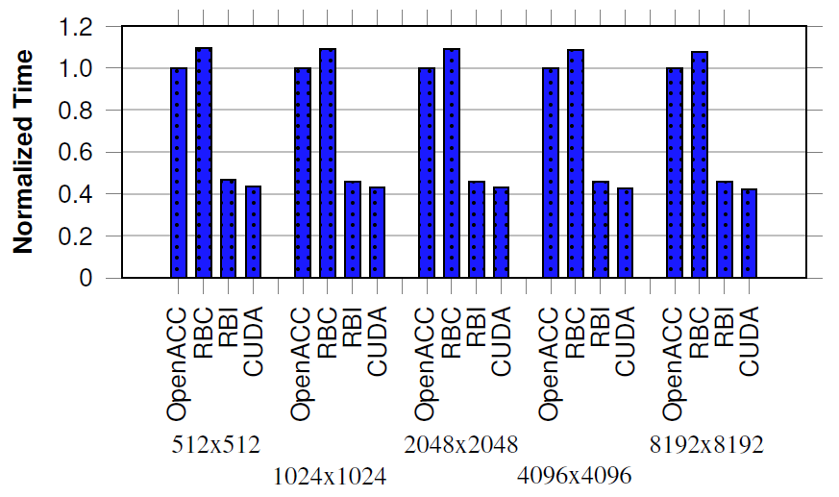
Performance
GEMM
RBI 2.18X faster than no-cache baseline OpenACC, 8% gap between CUDA and RBI
12x saving in memory loads,
compared to baseline OpenACC
Notes:
-GEMM: matrix-matrix multiplication
-16x16 tiles are fetched into SMC, by CUDA and RBC and RBI
-Under 4 different matrix sizes, 512x512, 1024x1024, etc.
-(MOVE ANIMATION) RBC, RBI, and CUDA reduce the global memory traffic significantly, compared to OpenACC. Using nvprof , we found that RBI reduces the number of global memory loads by 12X (under 1024x1024 matrices), compared to OpenACC (the very same improvement is observed under RBC and CUDA too). (This is achieved by fetching the tiles of input matrices into software-managed cache, these implementations maximize memory access coalescing. Also these implementations exploit the locality among neighbor threads to minimize redundant memory fetches.)
-(MOVE ANIMATION FORWARD) This significant saving on memory loads leads to significant performance improvement. RBI/CUDA outperforms OpenACC by more than 2x.
-(MOVE ANIMATION FORWARD) Using RBC, the compiler generates a code to check the
memory addresses dynamically and to find out if the address falls within the subarray range or not. If the address falls within the subarray range, the data is fetched from the cache. Otherwise, the data is fetched from the global memory. Under RBI, however, the compiler static passes assure that dynamic memory accesses always fall in the subarray range (if violated, the program can generate incorrect output). Therefore, dynamic checking for the address range is avoided. This explains why RBI always performs faster than RBC.

Slide 26
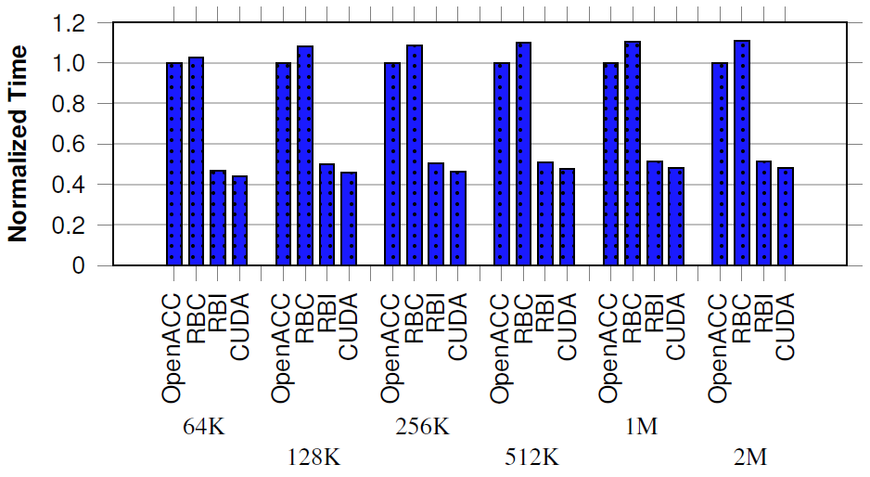
Performance (2)
N-Body Simulation
RBI 95%-113% faster than no-cache baseline OpenACC, 9% gap between RBI and CUDA
Notes:
-N-Body simulation: calculating the interaction between 64K to 2M masses.
-A tile of masses are fetched into the cached, interaction calculated against the local tile, and then this process is repeated to fetch all elements in, tile by tile, one tile at a time.
-Same discussion from previous slide holds for explaining the gap between RBC and RBI/CUDA.
-The gap between RBI and CUDA (9%) is explained by the difference between cache fetch routine. Cache fetch routine in CUDA is optimized by removing the for loop through parallel threads. This optimization is not visible to OpenACC compiler though.

Slide 27
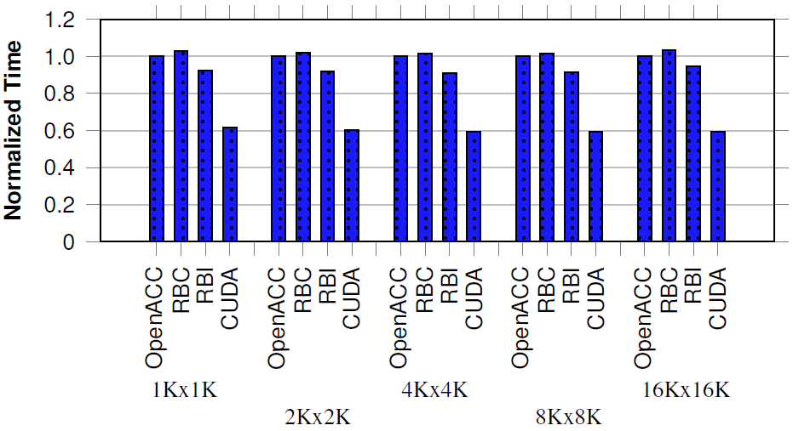
Performance (3)
Jacobi Iteration
RBI 6%-10% faster than no-cache baseline OpenACC,
Notes:
-Jacobi iteration: nine-elements, 3-by-3 tile, is read from 2D input matrix to calculate one element in the 2D output matrix.
-neighbor threads have 66% common input and can share this through SMC to avoid redundant allocation. This optimization is exploited in RBC, RBI, and CUDA.
-Same discussion from previous slide holds for explaining the gap between RBC and RBI/CUDA.
-CUDA launches thread blocks equal in size to the size of the data being used by the thread block. RBI, however, launches thread blocks equal in size to the size of the computations being performed by the thread block. This results in the CUDA version using slightly larger thread block size than RBI. Here threads at the boarder of thread block are only used for fetching the data. This reduces irregular control flow in the fetch routine. We found that this can be effectively implemented in OpenACC to reduce the gap between RBI and CUDA. However, we do not investigate it further due to the high development effort required (close to CUDA equivalent), which is not desirable for high-level OpenACC.

Slide 28
Cache Write
Synthetic workloads with different memory patterns:
Dense and Regular
Iterations write consequent words, repeatedly
Sparse
Fraction of the iterations write arbitrary words, repeatedly
Parameters of these workloads:
Parallel iterations or total work
Serial iterations within the work or write frequency
for i in 1 to total_work
#pragma acc cache(subarray[])
{
for j in 1 to write_frequency
write to subarray[]
}
Notes:
-Dense and Regular: Every parallel work serially iterates for a certain number of iterations (which is a run parameter) and computes the value of the element iteratively.
-Sparse: The second workload is the same as the first, except that only a fraction of threads are active (less than 2%) and only a fraction of serial iterations perform write (less than 2%).
-Repeats are intended to emphasize the difference between single global write (write-back) or multiple global writes (write-through.)

Slide 29
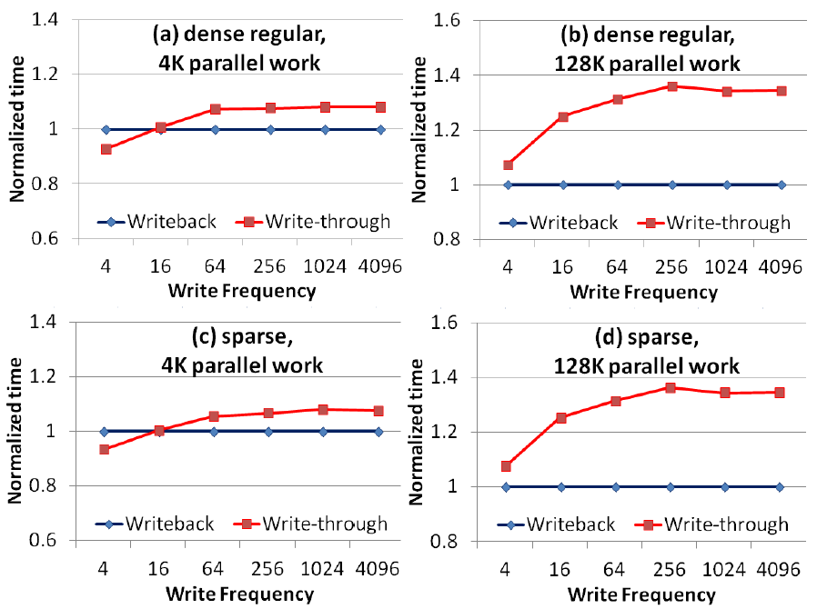
Cache Write Performance Investigation
Write-back outperform write-through when write frequency is high
Write-through outperforms write-back when memory BW is not saturated (e.g. small dataset)
Notes:
-Figure compares performance of write-back and write-through under various write frequencies. If the write frequency is lower than 16, WT outperforms WB. >=16 frequent writes to global memory downgrades performance of WT and WB outperforms WT. This pattern is dense regular which means consequent threads write consequent words. We considered 4K parallel work for this figure, 4K threads, 16 thread blocks.
-(MOVE ANIMATION FORWARD) keeping the same memory pattern, dense regular, and increasing the number of parallel work to 128K, we observer the write frequency breaking point moves under 4 and disappears from the plot. 128K work increase the memory traffic and reduce the tolerance for high memory demand of WT.
-(MOVE ANIMATION FORWARD) compared to Figure a, in Figure c changing the memory pattern to sparse, we observe the same trend.
-(MOVE ANIMATION FORWARD) compared to Figure b, in Figure d changing the memory pattern to sparse, we observe the same trend.

Slide 30
Conclusion
Studied and addressed challenges facing cache directive implementation in CUDA
Three different implementation proposed
Found out cache sharing is essential to deliver performance improvement
Found out cache directive can improve performance by 2.18x, compared to baseline OpenACC without using cache
Implementation/Benchmarks available online:
https://www.github.com/lashgar/ipmacc
There is more on the paper: compiler passes to support multi-dimensional array, micro-benchmarking CUDA shared memory to understand best performance.

Slide 31
Thank You!
Questions?

Slide 32
Backup Slides

Slide 33
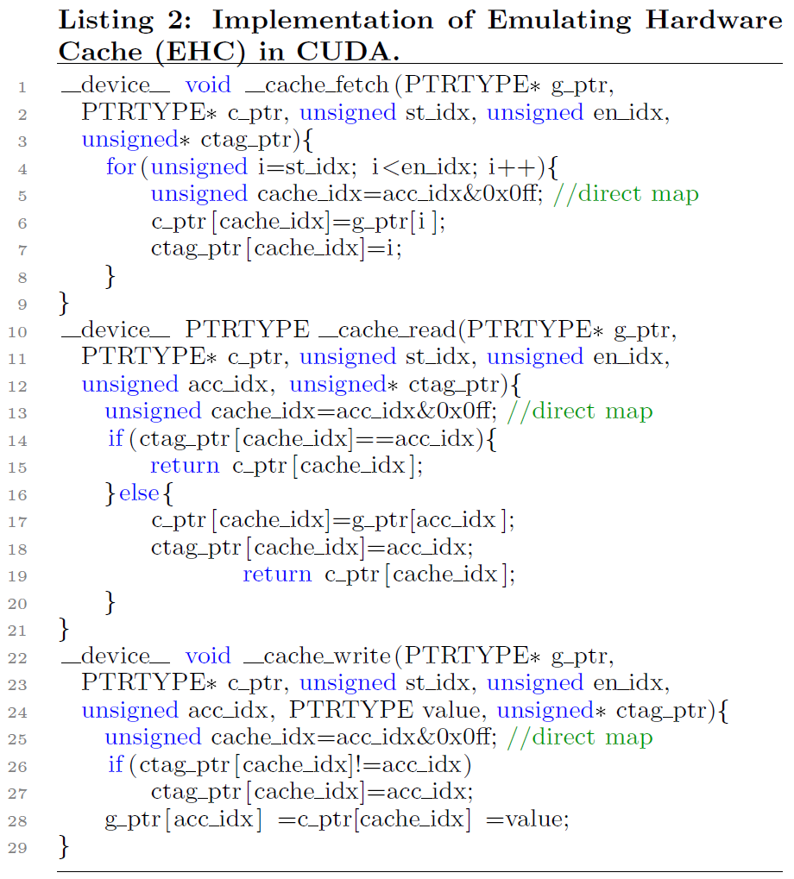
EHC Example
Notes:
CUDA implementation of EHC. Three procedures are implemented: i) __cache_fetch(), ii) __cache_read(), and
iii) __cache_write()4. During generating the accelerator code, __cache_fetch() is called early before the cache region starts. This procedure is responsible for fetching the data into the cache. Within the cache region, the compiler replaces every array read with __cache_read() call and array write statement with __cache_write() call. For these implementations, we assume a write-through cache.

Slide 34
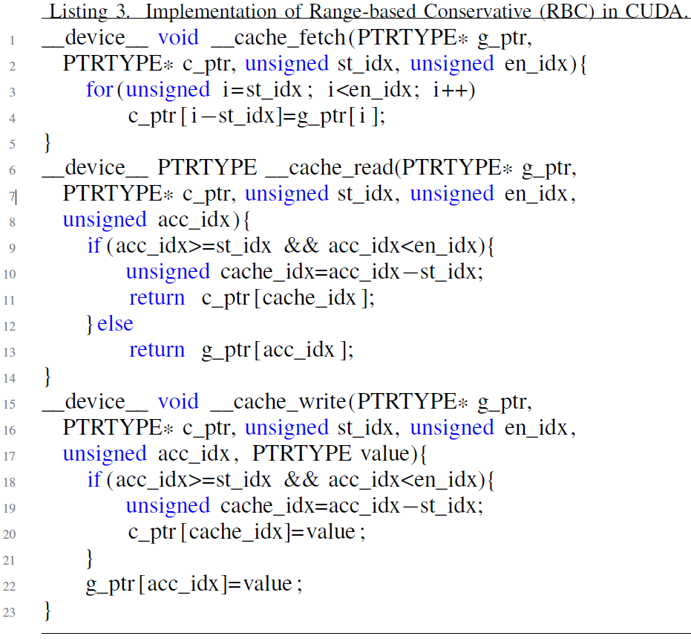
RBC Example
RBI is the same, minus
“if” control-flow statement
where assumed it’s always
TRUE.
Notes:
CUDA implementation of RBC. Three procedures are implemented: i) __cache_fetch(), ii) __cache_read(), and
iii) __cache_write()4. During generating the accelerator code, __cache_fetch() is called early before the cache region starts. This procedure is responsible for fetching the data into the cache. Within the cache region, the compiler replaces every array read with __cache_read() call and array write statement with __cache_write() call. For these implementations, we assume a write-through cache.

Slide 35
CUDA Shared Memory Bank-Conflict Evaluations
Notes:
-Bars report the execution time for three different ITERs (1, 2, and 4), two TYPEs (4-byte integer and 8-byte floating-point), two array allocation schemes (2D and flattened 2D), two shared memory access patterns (XY and YX), and two padding sizes (zero and one). ITERs, TYPEs, XY, YX, and padding is explained in the notes of next slides.
-2nd and 3rd ROW: TYPE and allocation scheme has modest effect. The latter suggests that the layout of 2D array in the shared memory banks is similar to that of the flattened 2D array.
-4th ROW: Access pattern, however, impacts performance significantly. In this benchmark, YX mapping delivers a better performance compared to XY. This is explained by how threads are grouped into warps. Warps are occupied first by the threads along the x dimension and then by the threads along y. Therefore threads along x should access consequent words in order to reduce shared memory bank conflict. This is precisely what YX mapping does.
-5th ROW: As shown in the figure, adding a padding to the array can have an impact similar to that of access pattern tunings, lowering the execution time roughly the same amount. Adding a padding to the array can lower the execution time by 57% and 56% under double and int, respectively. It should be noted that under the cases where the array is padded there is still room for improvement as evidenced by the results. Under one padding, modifying the code algorithmically for reducing bank conflict, as comparing XY to YX shows, can further lower the execution time by 8% (for both int and double).
-1st ROW: Increasing the number of iterations (ITER) increases the importance of the shared memory performance in the overall performance. For larger iterations, the impact of access pattern and padding is more significant. For example, under one iteration, the gap between zero-padding and one-padding is 23%. This gap grows to 37% and 55% under 2 and 4 iterations, respectively.

Slide 36
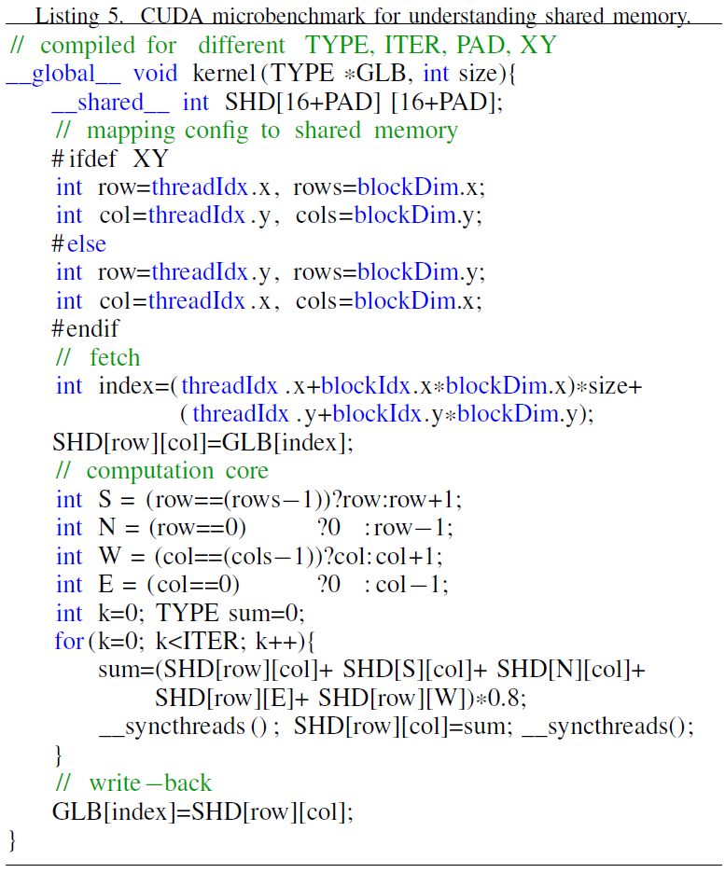
CUDA Shared Memory Bank-Conflict Evaluations (2)
Notes:
-Datatype size (TYPE): The datatype size of shared
memory array is the number of bytes allocated for each
element of array. Variations in datatype size impact bank
conflict since it determines the layout of array in the
shared memory (e.g. one element per bank, two elements
per bank, etc.).
-2D array allocation: We investigate two alternatives in
allocating 2D shared memory: 2D array notation or 1D
array notation (flattened notation). 2D array notation is
simpler in indexing and code readability. We are also
interested to understand whether flattened notation has
a different layout in the shared memory from 2D array.
-Padding (PAD): When the size of shared memory array
is multiple of memory banks, adding a small padding
to the array can mitigate the bank conflict. The padding
increases the row pitch, spreading the columns of a row
across different banks.
-Access pattern: Since bank conflict only occurs among
the threads of the same warp, it is important to mitigate
bank conflict algorithmically. We evaluate the impact of
these algorithmic optimizations by mapping threads of
the thread block to different dimensions of the shared
memory array. Operating in XY mapping, threads along
the x dimension of the thread block are mapped to the first
dimension of the shared memory array and threads along
the y dimension are mapped to the second dimension. YX
mapping reverses this as threads along x and y dimensions
are mapped to the second and first dimensions of the
array, respectively.
-Iterations (ITER): Number of iterations of the loop in
the kernel body. This number indicates the ratio of shared
memory accesses to global memory accesses.

