Slide 1
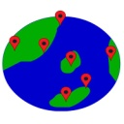
GlobeNow!
Ahmad Lashgar, PhD
Firmware Developer at Avigilon

Slide 2
GlobeNow!
A feed per city listing events that happening right now
Find every single event: small or large
The project started in February 2015
Exploring Victoria, BC, Canada

Slide 3
Automatic Event Extraction
Collect feed of latest posts from Twitter & Instagram:
Cache text, image, video, author, & URL
Text/image sources used to extract events
Apply OCR to images to extract text
Process all the texts using NLP techniques

Slide 4
NLP Techniques
Tokenization
Sanitize text and keep “important” words, called tokens
Stemming & lemmatization
Reduce space of the input
Grammar
Define rules for extracting dates

Slide 5
Practice
Token types:
Event related: year, month, day, hour, minute, weekday
General: separator, undetected
Grammar:
Month + Separator + Day => event on Month, day
Weekday => event on coming Weekday
+6

Slide 6
Example
“Official classes are starting next week! We will be hosting free trial classes for new members wanting to try us out AND for returning members too! . . . ~ On Jan 13 and Jan 15 classes will run from 6-8pm at the performance theatre on the second floor of the Nest. All levels are welcome! ...”
2 events extracted on:
January 13
January 15

Slide 7
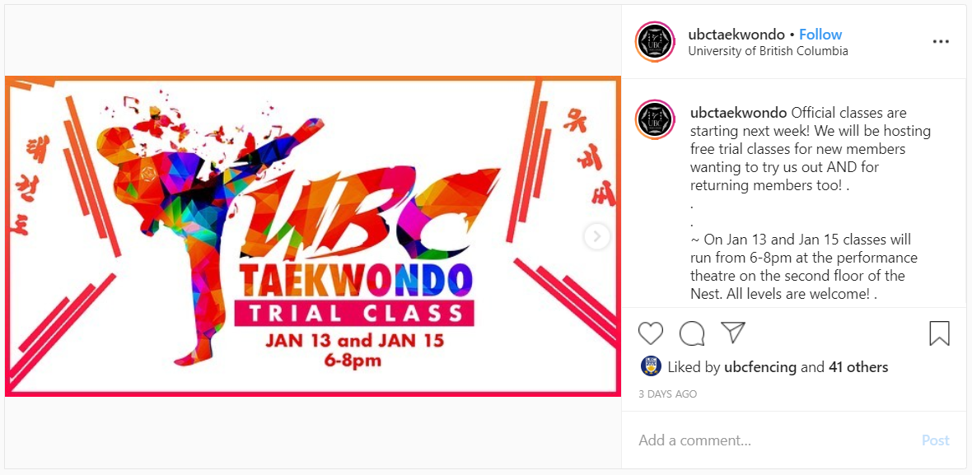
Example (continued)
Extracted event is available at Instagram:

Slide 8
Organizing The Events
Store future events only
Group by data
Group by city
Stored as a Json file
List events of the city on a given day as a feed

Slide 9
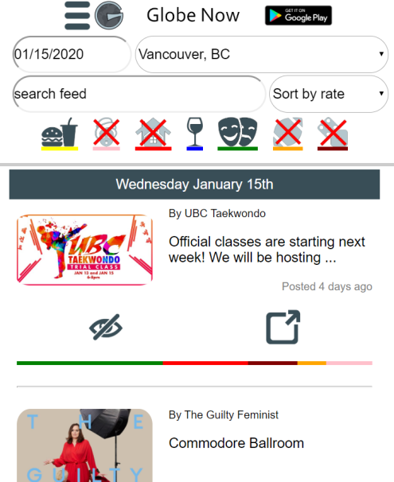
Platforms: User Interfaces
Website:
ahmado.com/GlobeNow
Android App:
play.google.com/store/apps/details?id=myapps.globenow

Slide 10
False Positives
Example:
“January 15 going to be a great day.”
Do we get false positives?
A lot!

Slide 11
How to address false positives?
Filter words
E.g. exclude adult contents
Rank events & drop low-ranked
An application of machine learning

Slide 12
How to rank events using ML?
Simple linear model Y = A * X + B
X is a boolean vector indicating words of the text
A & B are trained using good and bad datasets
Y is the rank (floating point number)
Training datasets:
High-rank: Twitter/Instagram pages that post events
Low-rank: Twitter/Instagram pages that do not post events

Slide 13
Text Topic
Would be nice to categorize events
Challenges:
Keyword-based approaches are not effective for long text
Hard to list all keywords of all topics without overlapping
How many topics is optimal?
Solution:
Latent Dirichlet Allocation: an unsupervised topic modeling
After categorization, we label every set manually

Slide 14
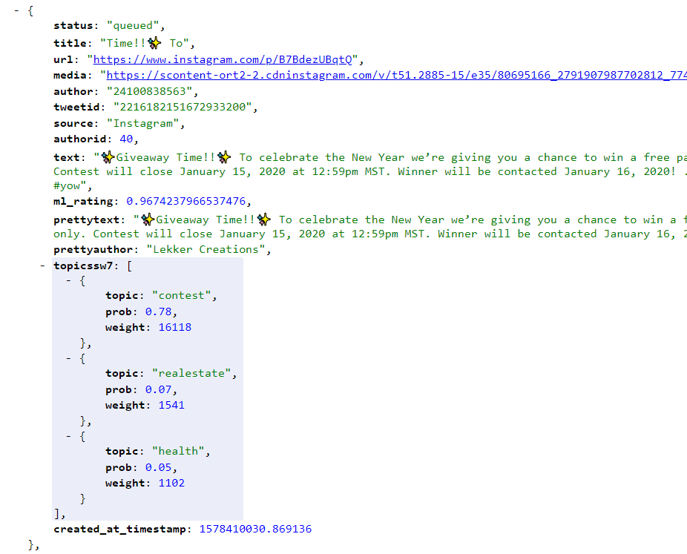
Text Topic (continued)

Slide 15
Technologies
Services running on an AWS machine
Data collector, NLP, and ML models written in Python
NLP core written from scratch, NLTK was too general
TensorFlow used for inference
Web interface written in HTML/CSS/PHP
Android App written in Android

Slide 16
Current State
Presented the idea at Dragons’ Den:
Didn’t make it to final round (project not profitable)
Up and running for Vancouver and Victoria at:
ahmado.com/GlobeNow
Listing about 200 events per day for Vancouver!

Slide 17
Thank you.

