Slide 1
A 45nm 8-Core Enterprise Xeon® Processor ’ ISSCC2009
Presented By:
Ahmad Lashgar
University Of Tehran
December 2010
Original Authors:
Stefan Rusu, Simon Tam,
Harry Muljono, Jason Stinson,
David Ayers, Jonathan Chang,
Raj Varada, Matt Ratta,
Sailesh Kottapalli
Some slides are included from original paper only for educational purposes

Slide 2
Outline
Introduction
Xeon Family
Xeon in Supercomputing
Overview of Nehalem Architecture
Pipeline
Quick Path Interconnect
Nehalem based Xeon
Platforms Configurations
Clock Domains
Clock Skews

Slide 3
Introduction
Wikipedia -> The Xeon is a brand of multiprocessing-capable x86 microprocessors from Intel mainly targeted at the server, workstation and embedded system markets.
Notes:
The Xeon is a brand of multiprocessing- or multi-socket-capable x86 microprocessors from Intel Corporation targeted at the non-consumer server, workstation and embedded system markets.
Xeon shifted from multiprocessor in-mind to reliable and multiprocessor design

Slide 4
Xeon Family^{[2]}
Current Xeon Generations:
Xeon3000
Entry and small business
Single processor servers
Xeon5000
Versatile data center
1 to 2 processor servers
Xeon6000
2 processor servers
Xeon7000
Powerful enterprise
2 to 256 processor server

Slide 5
Xeon in Supercomputing^{[3]}
Top500.org is an organization ranks supercomputers all around the world according to GFLOPS
Xeon owns 64% (391/500) of supercomputers
Nehalem 45nm
55%
Nehalem 32nm
15%
Core 45nm
26%
Core 65nm
4%

Slide 6
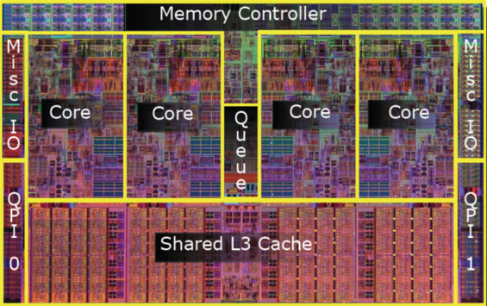
Overview of Nehalem Architecture^{[4]}
Introduced with Intel Core i7
Nehalem Overall Features:
2 up to 8 core
Optional Hyper-threading
L1 and L2 cache per core, shared L3
Integrated Memory Controller
Quick Path Interconnect
Optional Turbo Boost
Nehalem Die-Shot [5]
Notes:
QPI: Integrated Memory Controller and High-speed interconnect.

Slide 7
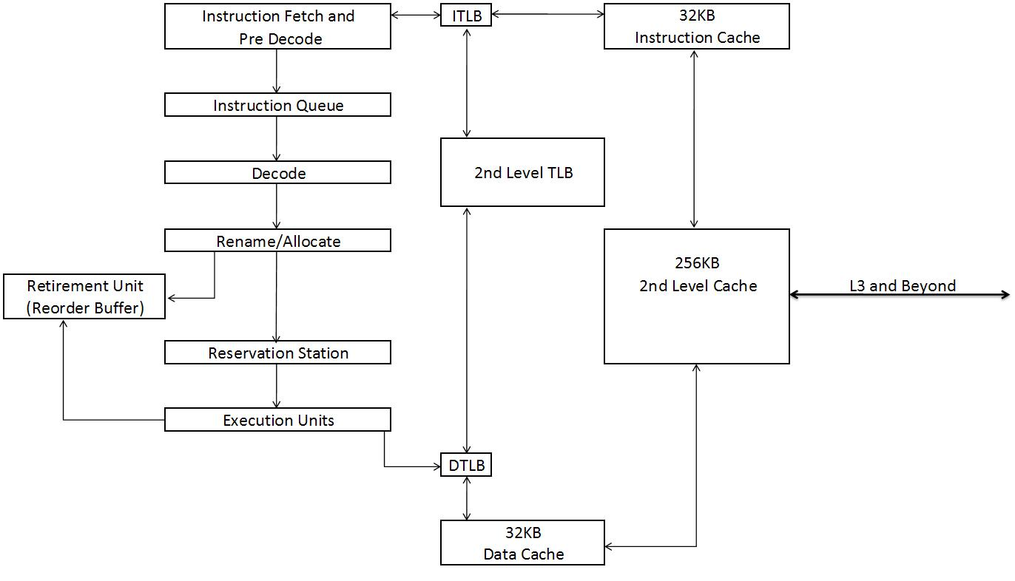
Overview of Nehalem Architecture^{[5]}
Nehalem Pipeline
Second level of Virtual Address translation
Out-of-order execution. Up to 6 insn/clk

Slide 8
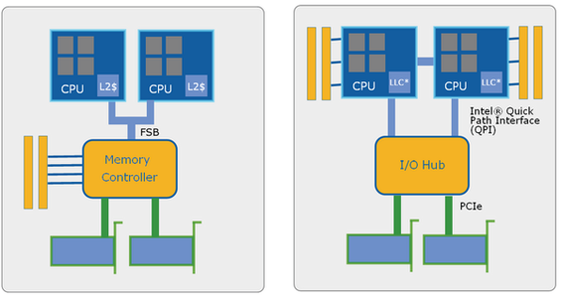
Overview of Nehalem Architecture^{[4]}
QPI and IMC:
Motivation?
High bandwidth demand in Multiprocessor systems: Processor-IO, Processor-Processor and Processor-Memory
Front Side Bus versus Quick Path Interconnect [5]
Notes:
More core on CPU demanding for higher bandwidth

Slide 9
Overview of Nehalem Architecture^{[4]}
Quick Path Interconnect:
Features
Connects a microprocessor to IO or other microprocessor
Point-To-Point link
Eliminates shared bus problems
Up to 25GByte/second (vs 10GB/s FSB)
High RAS (reliability, availability and serviceability)
CRC check with no cycles penalty
Self-healing link
Clock fail-over
Notes:
Self-healing link: avoid persistent error by re-configuring to use good parts of link
Clock fail-over: automatically re-route clock function to a data lane in event of clock-pin failure

Slide 10
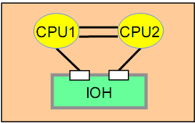
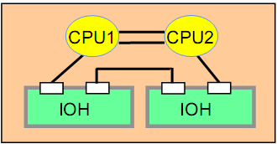
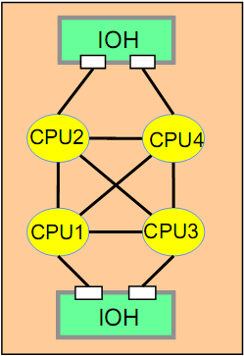
Platform Configuration in Multiprocessor Systems
2 Processor^{[1]}
4-QPI
per CPU
4 Processor^{[1]}
8 Processor^{[1]}
Notes:
QPI Port count
Consider not-shown memory ports

Slide 11
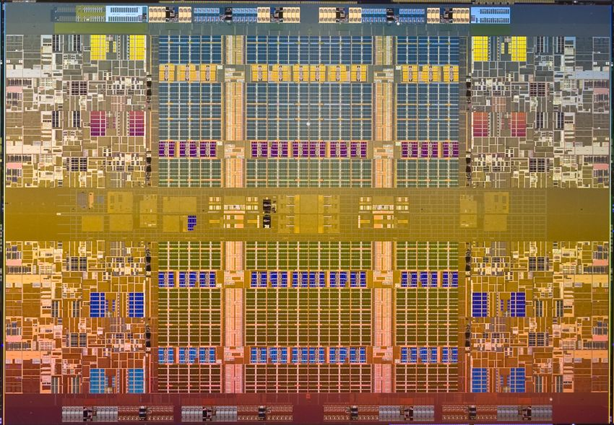
Nehalem in Xeon Processor^{[6]}
8-Core Xeon Die-shot

Slide 12
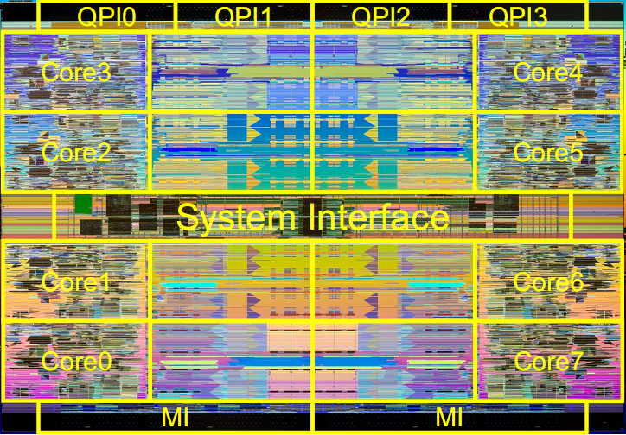
Nehalem in Xeon Processor^{[1]}
8-Core Xeon Floorplan

Slide 13
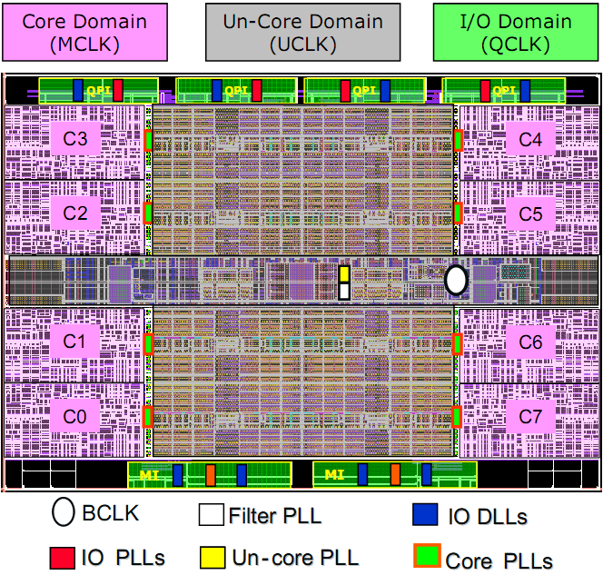
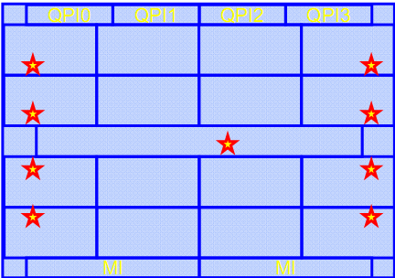
Clock Domains^{[1]}
PLLs are controlled by On-chip PCU (power Control Unit)
Controlling is done according to gathered data from sensors
3 primary clock domains:
Core
Un-core
I/O
System clock buffer that generates 133MHz
Interfaces to BCLK and delivers low-noise reference clock to all 16 PLLs
Enabling independent clock frequency for the core which is coefficient of BCLK and highly synchronized with it

Slide 14
Clock Domains^{[1]}
QPI PLLs adapting Processor-to-Processor or Processor-to-IO frequency
MI PLLs adapting Processor-to-Memory frequency

Slide 15
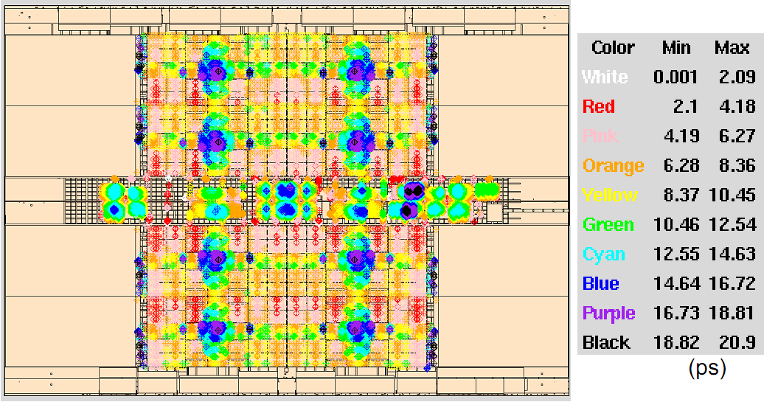
Simulated Un-Core clock skew profile^{[1]}
Simulation based on 100% layout extracted model

Slide 16
Future Works

Slide 17
References
[1] Stefan Rusu et al; 45nm 8-Core Enterprise Xeon® Processor; ISSCC 2009; page 56-57
[2] http://www.intel.com/
[3] http://www.top500.org/
[4] Intel Next Generation Microarchitecture (Nehalem) White Paper
[5] http://www.tomshardware.com/review_print.php?p1=2041
[6] http://cdn.physorg.com/newman/gfx/news/hires/NHM-EX-Die-Shot-1.jpg

Slide 18
The End
Any Question?

Slide 19
Overview of Nehalem Architecture^{[4]}
Nehalem core benefits:
Larger out-of-order window
Faster Handling of branch misprediction
More accurate branch prediction:
Second-level BTB
Better Hyper-threading:
Larger cache and bandwidth
[6]
L3 Cache
QPI

Slide 20
Intel Codenames
Intel has historically named integrated circuit (IC) development projects after geographical names of towns, rivers or mountains near the location of the Intel facility responsible for the IC.
Codenames usually mapping to many marketing names
Latest architecture of Intel microprocessors named Nehalem (Nomenclature: The Nehalem River in Oregon, or possibly the town of Nehalem in Tillamook County, Oregon)

Slide 21
Xeon Family^{[2]}
Xeon 3000
45nm technology
Processor Number | Intel® QPI Speed or Front Side Bus | L3 Cache | Base Frequency | max Turbo Frequency | Power | Number of Cores | Number of Threads
X3480 |  | 8MB | 3.06 GHz | 3.73 GHz | 95 W | 4 | 8
X3470 |  | 8MB | 2.93 GHz | 3.6 GHz | 95 W | 4 | 8
X3460 |  | 8MB | 2.8 GHz | 3.46 GHz | 95 W | 4 | 8
X3450 |  | 8MB | 2.66 GHz | 3.2 GHz | 95 W | 4 | 8
X3440 |  | 8MB | 2.53 GHz | 2.93 GHz | 95 W | 4 | 8
X3430 |  | 8MB | 2.4 GHz | 2.8 GHz | 95 W | 4 | 4
W3580 | 6.4 GT/s | 8MB | 3.33 GHz | 3.6 GHz | 130 W | 4 | 8
W3570 | 6.4 GT/s | 8MB | 3.2 GHz | 3.46 GHz | 130 W | 4 | 8
W3565 | 4.8 GT/s | 8MB | 3.2 GHz | 3.46 GHz | 130 W | 4 | 8
W3550 | 4.8 GT/s | 8MB | 3.06 GHz | 3.33 GHz | 130 W | 4 | 8
W3540 | 4.8 GT/s | 8MB | 2.93 GHz | 3.2 GHz | 130 W | 4 | 8
W3530 | 4.8 GT/s | 8MB | 2.8 GHz | 3.06 GHz | 130 W | 4 | 8
W3520 | 4.8 GT/s | 8MB | 2.66 GHz | 2.93 GHz | 130 W | 4 | 8
W3505 | 4.8 GT/s | 4MB | 2.53 GHz |  | 130 W | 2 | 2
LC3528 |  | 4MB | 1.73 GHz | 2.133 GHz | 35 W | 2 | 4
LC3518 |  | 2MB | 1.73 GHz |  | 23 W | 1 | 1
L3426 |  | 8MB | 1.86 GHz | 3.2 GHz | 45 W | 4 | 8

Slide 22
Xeon Family^{[2]}
Xeon 5000
45nm technology
Processor Number | Intel® QPI Speed or Front Side Bus | L3 Cache | Base Frequency | max Turbo Frequency | Power | Number of Cores | Number of Threads
X5570 | 6.4 GT/s | 8MB | 2.93 GHz | 3.33 Ghz | 95 W | 4 | 8
X5560 | 6.4 GT/s | 8MB | 2.8 GHz | 3.20 Ghz | 95 W | 4 | 8
X5550 | 6.4 GT/s | 8MB | 2.66 GHz | 3.06 Ghz | 95 W | 4 | 8
L5530 | 5.86 GT/s | 8MB | 2.4 GHz | 2.4 Ghz | 60 W | 4 | 8
L5520 | 5.86 GT/s | 8MB | 2.26 GHz | 2.53 Ghz | 60 W | 4 | 8
L5518 | 5.86 GT/s | 8MB | 2.13 GHz | 2.40 Ghz | 60 W | 4 | 8
L5508 | 5.86 GT/s | 8MB | 2 GHz | 2.40 Ghz | 38 W | 2 | 4
L5506 | 4.8 GT/s | 4MB | 2.13 GHz | N/A | 60 W | 4 | 4
E5540 | 5.86 GT/s | 8MB | 2.53 GHz | 2.80 Ghz | 80 W | 4 | 8
E5530 | 5.86 GT/s | 8MB | 2.4 GHz | 2.66 Ghz | 80 W | 4 | 8
E5520 | 5.86 GT/s | 8MB | 2.26 GHz | 2.53 Ghz | 80 W | 4 | 8
E5507 | 4.8 GT/s | 4MB | 2.26 GHz | N/A | 80 W | 4 | 4
E5506 | 4.8 GT/s | 4MB | 2.13 GHz | N/A | 80 W | 4 | 4
E5504 | 4.8 GT/s | 4MB | 2 GHz | N/A | 80 W | 4 | 4
E5503 | 4.8 GT/s | 4MB | 2 GHz | N/A | 80 W | 2 | 2
E5502 | 4.8 GT/s | 4MB | 1.86 GHz | N/A | 80 W | 2 | 2

Slide 23
Xeon Family^{[2]}
Xeon 6000
45nm technology
Processor Number | Intel® QPI Speed or Front Side Bus | L3 Cache | Base Frequency | max Turbo Frequency | Power | Number of Cores | Number of Threads
X6550 | 6.4 GT/s | 18MB | 2 GHz | 2.4 GHz | 130 W | 8 | 16
E6540 | 6.4 GT/s | 18MB | 2 GHz | 2.266 GHz | 105 W | 6 | 12
E6510 | 4.8 GT/s | 12MB | 1.73 GHz | 1.733 GHz | 105 W | 4 | 8

Slide 24
Xeon Family^{[2]}
Xeon 7000
45nm technology
Processor Number | Intel® QPI Speed or Front Side Bus | L3 Cache | Base Frequency | max Turbo Frequency | Power | Number of Cores | Number of Threads
X7560 | 6.4 GT/s | 24MB | 2.266 GHz | 2.666 GHz | 130 W | 8 | 16
X7550 | 6.4 GT/s | 18MB | 2 GHz | 2.4 GHz | 130 W | 8 | 16
X7542 | 5.86 GT/s | 18MB | 2.666 GHz | 2.8 GHz | 130 W | 6 | 6
X7460 | 1066 MHz | 16MB | 2.66 GHz | N/A | 130 W | 6 | 6
L7555 | 5.86 GT/s | 24MB | 1.866 GHz | 2.533 GHz | 95 W | 8 | 16
L7545 | 5.86 GT/s | 18MB | 1.866 GHz | 2.533 GHz | 95 W | 6 | 12
L7455 | 1066 MHz | 12MB | 2.13 GHz | N/A | 65 W | 6 | 6
L7445 | 1066 MHz | 12MB | 2.13 GHz | N/A | 50 W | 4 | 4
E7540 | 6.4 GT/s | 18MB | 2 GHz | 2.266 GHz | 105 W | 6 | 12
E7530 | 5.86 GT/s | 12MB | 1.866 GHz | 2.133 GHz | 105 W | 6 | 12
E7520 | 4.8 GT/s | 18MB | 1.866 GHz | 1.866 GHz | 95 W | 4 | 8
E7450 | 1066 MHz | 12MB | 2.4 GHz | N/A | 90 W | 6 | 6
E7440 | 1066 MHz | 16MB | 2.4 GHz | N/A | 90 W | 4 | 4
E7430 | 1066 MHz | 12MB | 2.13 GHz | N/A | 90 W | 4 | 4
E7420 | 1066 MHz | 8MB | 2.13 GHz | N/A | 90 W | 4 | 4

