Slide 1
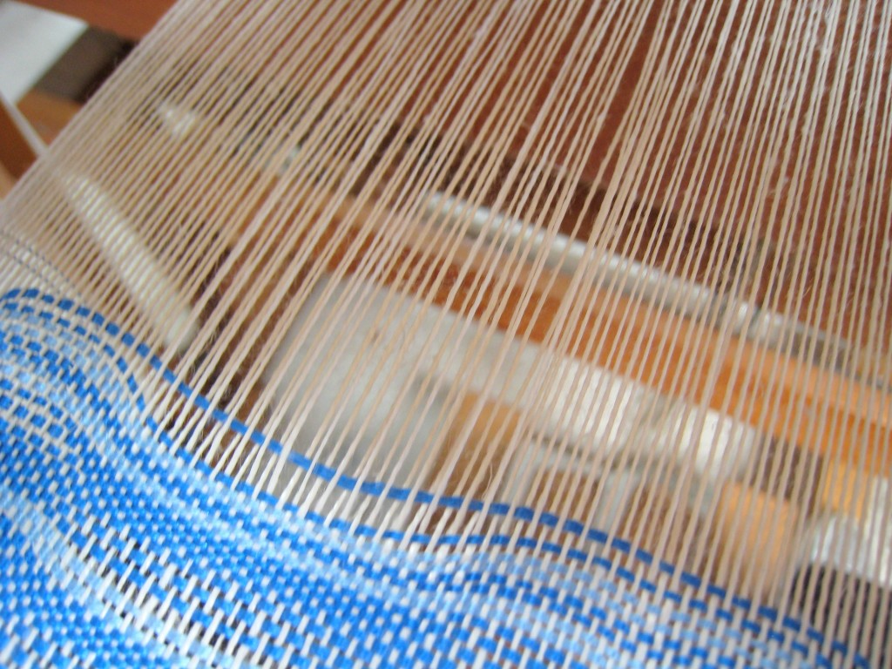
Improving GPU Performance via Improved SIMD Efficiency
Ahmad Lashgar
ECE Department
University of Tehran
Supervisors:
Ahmad Khonsari
Amirali Baniasadi
November 12, 2012

Slide 2
Outline
Introduction
Background
Warping
Branch divergence
Memory divergence
CROWN
Branch divergence management
Technique & Results
DWR
Memory access coalescing
Technique & Results
Conclusion and Future works

Slide 3
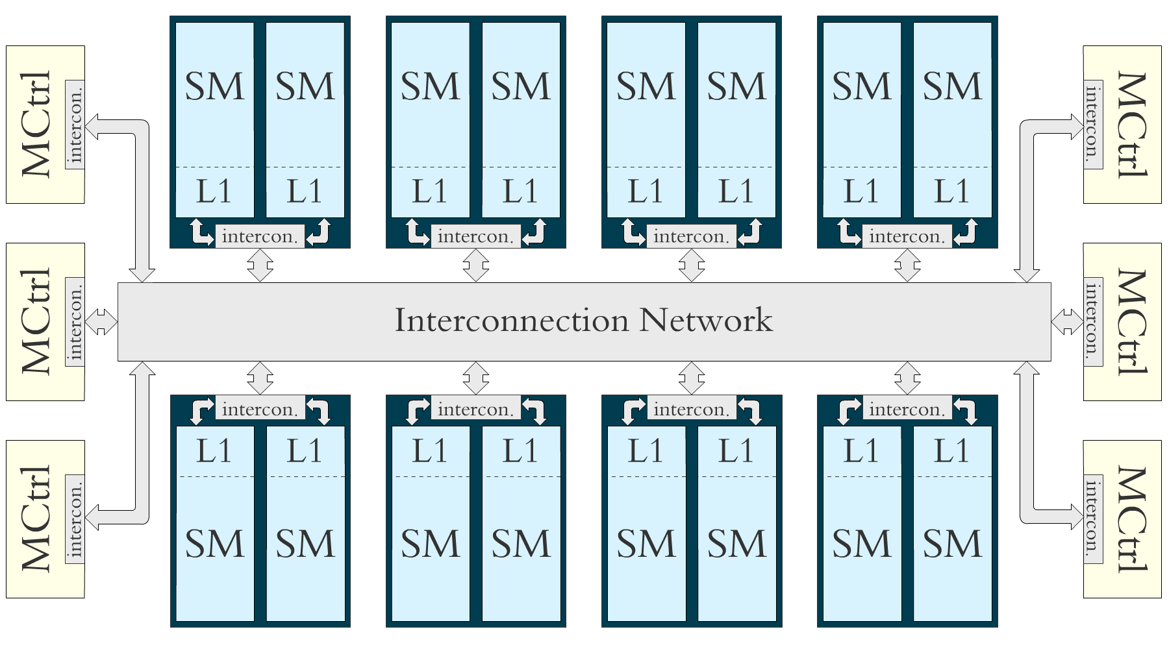
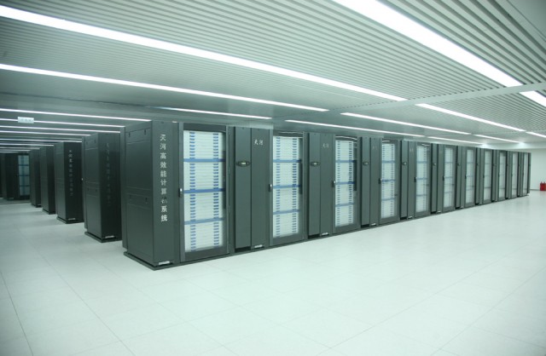
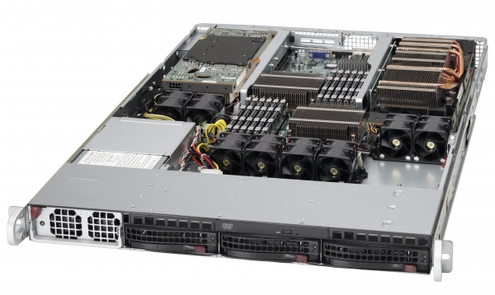
Introduction
In this study, we propose two techniques
(CROWN and DWR)
to improve the performance of GPU.
CPU
GPU
GPU
DRAM
DRAM
Simple motivation: There are different kind of threads which can be activated to improve performance.
Sepermicro® 6016GT-TF-FM209
Inactivate due to branch or memory divergence …
Tianhe-1A supercomputer

Slide 4
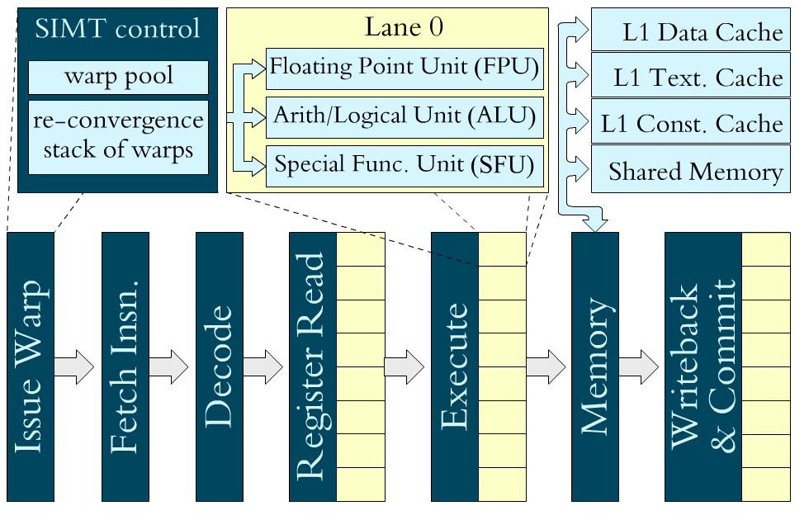
SIMT Core
SIMT (Single-Instruction Multiple-Thread)
The goal is throughput
In-order pipeline
No speculation
Deep-multithreaded
For latency hiding
8- to 16-lane SIMD
Typical core pipeline:
Notes:
-This is the architecture we are modeling.

Slide 5
Outline
Introduction
Background
Warping
Branch divergence
Memory divergence
CROWN
Branch divergence management
Technique & Results
DWR
Memory access coalescing
Technique & Results
Conclusion and Future works

Slide 6
Warping
Thousands of threads are scheduled zero-overhead
All the context of threads are on-core
Tens of threads are grouped into warp
Execute same instruction in lock-step
Notes:
-Define warp, warp scheduler, and SIMD width
-Define the shared resource per SM: thread pool, shared memory, and register file
-0 to 100: Every cycle a warp is selected

Slide 7
Warping (continued…)
Opportunities
Reduce scheduling overhead
Improve utilization of execution units (SIMD efficiency)
Challenges
Memory divergence
Branch divergence

Slide 8
Memory Divergence
Threads of a warp may take hit or miss in L1 access
Warp
T0
T1
T2
T3
J = A[S];
// L1 cache access
L = K * J;
Time
Hit
Hit
Miss
Hit
Stall
Stall
Stall
Stall
Warp
T0
T1
T2
T3
Notes:
Group of threads (warp) are processed in lock-step

Slide 9
Branch Divergence
Branch instruction can diverge to two different paths dividing the warp to two groups:
Threads with taken outcome
Threads with not-taken outcome
Warp
T0
T1
T2
T3
If(J==K){
C[tid]=A[tid]*B[tid];
}else if(J>K){
C[tid]=0;
}
Time
Warp
X
T1
T2
X
Warp
T0
X
X
T3
Warp
T0
X
X
T3
Warp
T0
T1
T2
T3
Notes:
-Diverge, re-converge, re-convergence point,

Slide 10
Outline
Introduction
Background
Warping
Branch divergence
Memory divergence
CROWN
Branch divergence management
Technique & Results
DWR
Memory access coalescing
Technique & Results
Conclusion and Future works

Slide 11
CROWN: Comprehensive Reincarnation-based Warping
Motivation
Branch divergence management
Application behavior
CROWN
Operation example
Design goal
Experimental Results
Notes:
- Least a few bits of thread's warpID determines the set which the thread is mapped to in re-convergence barrier

Slide 12
Branch Divergence Management
Stack-Based Re-convergence (SBR) is used in NVIDIA GPUs
Use a stack per warp to keep track of diverging paths and re-convergence points
Effectively manages nested divergence
Challenges
SIMD efficiency (target of DWF, and LWM)
Diverging path serialization
Re-convergence waiting

Slide 13
Stack-Based Re-convergence (SBR)
SBR – 1) SIMD Efficiency
Re-convergence
Program Counter
Program Counter
SIMD
Utilization
over time
A
W0 | 1111
W0 | RPC | PC | Mask Vector
 | - | A | 1 | 1 | 1 | 1
W0 | RPC | PC | Mask Vector
 | - | D | 1 | 1 | 1 | 1
W0 | RPC | PC | Mask Vector
 | D | B | 0 | 1 | 1 | 0
 | - | D | 1 | 1 | 1 | 1
W0 | RPC | PC | Mask Vector
 | D | D | 0 | 1 | 1 | 0
 | - | D | 1 | 1 | 1 | 1
W0 | RPC | PC | Mask Vector
 | D | C | 1 | 0 | 0 | 1
 | D | B | 0 | 1 | 1 | 0
 | - | D | 1 | 1 | 1 | 1
W0 | RPC | PC | Mask Vector
 | D | D | 1 | 0 | 0 | 1
 | D | B | 0 | 1 | 1 | 0
 | - | D | 1 | 1 | 1 | 1
TOS
B
C
W0 | 0110
W0 | 0110
W0 | 1001
SIMD efficiency
drops due to idle lanes
(down to 24%)
A: IF(k==0){
B: G[i] = 0;
}ELSE{
C: G[i] = 1;
}
D: E[i] += G[i];
D
W0 | 1111
Notes:
Color on CFG show activation of a warp and gray shows inactivation (masked warp).

Slide 14
SBR – 2) Diverging Path Serialization
SIMD
Utilization
over time
A
W0 | RPC | PC | Mask Vector
 | D | C | 1 | 0 | 0 | 1
 | D | B | 0 | 1 | 1 | 0
 | - | D | 1 | 1 | 1 | 1
TOS
B
C
W0 | 0110
W0 | 0110
W0 | 1001
Threads are inactivated due to divergence
(Up to 13% of threads)
Targeted by DWF
D
Notes:
Color on CFG show activation of a warp and gray shows inactivation (masked warp).

Slide 15
SBR – 3) Waiting at Re-convergence
SIMD
Utilization
over time
A
W0 | RPC | PC | Mask Vector
 | D | B | 0 | 1 | 1 | 0
 | - | D | 1 | 1 | 1 | 1
TOS
B
C
W0 | 0110
Threads are waiting at
re-convergence point
(Up to 46% of threads)
D
Notes:
Color on CFG show activation of a warp and gray shows inactivation (masked warp).

Slide 16
Application Behavior
Type A:
A few branch divergence
memory-bounded
Type B:
High branch divergence
low thread-per-core parallelism
Type C:
High branch divergence
high thread-per-core parallelism
IPC
IPC
IPC
Re-convergence Waiting
SIMD Efficiency
Re-convergence Waiting
SIMD Efficiency
Re-convergence Waiting
SIMD Efficiency
MU, MP,
and NQU
others
BFS
Diverging Path
Serialization
Diverging Path
Serialization
Diverging Path
Serialization

Slide 17
CROWN’s Design Goal
Proposed to address SBR challenges
SIMD Efficiency
Re-convergence
Dynamic regrouping
Diverging Path Serialization
Activate all threads
Re-convergence Waiting
Dynamic regrouping
Schedule at small warp granularity (as wide as SIMD width)

Slide 18
CROWN Example
From Commit
W1 | C | T₄T₅T₆ -
W3 | D | - T₁T₂T₇
W4 | D | T₄ - - -
W2 | D | T₀T₅T₆T₃
W0 | C | T₀ - - T₃
W1 | B | - - - T₇
W0 | B | - T₁T₂ -
A
W0 | 1111
Lookup
W1 | 1111
C | T₀T₅T₆T₃
C | T₀ - - T₃
Second-Level
B | - T₁T₂T₇
B | - T₁T₂ -
W0 | A | T₀T₁T₂T₃
W0 | A | T₀T₁T₂T₃
W2 | C | T₀T₅T₆T₃
W2 | C | T₀T₅T₆T₃
W5 | D | T₀T₁T₂T₃
C | T₄ - - -
W1 | A | T₄T₅T₆T₇
W1 | A | T₄T₅T₆T₇
W3 | B | - T₁T₂T₇
W3 | B | - T₁T₂T₇
W6 | D | T₄T₅T₆T₇
A
A
W0 | 0110
W0 | 0110
W0 | 1001
W4 | C | T₄ - - -
W4 | C | T₄ - - -
W1 | 0001
W1 | 0001
W1 | 1110
Re-convergence Barriers
D | T₀T₁T₂T₃ | 0000
D | T₀T₁T₂T₃ | 1001
D | T₀T₁T₂T₃ | 1111
D | T₄T₅T₆T₇ | 0000
D | T₄T₅T₆T₇ | 0110
D | T₄T₅T₆T₇ | 0111
D | T₄T₅T₆T₇ | 1111
A
W0 | 1111
W1 | 1111
To Fetch
W1 | A | T₄T₅T₆T₇
W2 | C | T₀T₅T₆T₃
W3 | B | - T₁T₂T₇
W4 | C | T₄ - - -
W0 | A | T₀T₁T₂T₃

Slide 19
Methodology
GPGPU-sim version 2.1.1b
Configured to model Tesla-like architecture
Workloads from RODINIA, Parboil, CUDA SDK, GPGPU-sim, and third-party sequence alignment

Slide 20
Experimental Results
Three challenges:
SIMD efficiency
Diverging path serialization
Re-convergence waiting
Throughput in term of Instruction per clock (IPC)

Slide 21
SIMD Efficiency
SIMD efficiency is only one of the three impacting issues
Type C
Type B

Slide 22
Diverging Path Serialization
Large warps may exacerbate this metric
Type B

Slide 23
Re-convergence Waiting
Type C
Type B

Slide 24
IPC
CROWN improve performance by %14, %12, and %10 compared to SBR, DWF, and LWM respectively.
Type C
Type B

Slide 25
Outline
Introduction
Background
Warping
Branch divergence
Memory divergence
CROWN
Branch divergence management
Technique & Results
DWR
Memory access coalescing
Technique & Results
Conclusion and Future works

Slide 26
Memory Access Coalescing
Common memory access of neighbor threads are coalesced into one transaction
Warp
T0
T1
T2
T3
Miss
Miss
Miss
Miss
A
B
A
B
Mem. Req. A
Mem. Req. B
Warp
T4
T5
T6
T7
Hit
Hit
Hit
Hit
Mem. Req. C
C
C
C
C
Warp
T8
T9
T10
T11
Miss
Hit
Hit
Miss
Mem. Req. D
Mem. Req. E
D
E
E
D

Slide 27
Coalescing Width
Range of the threads in a warp which are considered for memory access coalescing
Over sub-warp
Over half-warp
Over entire warp
When the coalescing width is over entire warp, optimal warp size depends on the workload

Slide 28
Warp Size
Warp Size is the number of threads in warp
Why small warp? (not lower that SIMD width)
Less branch/memory divergence
Less synchronization overhead at every instruction
Why large warp?
Greater opportunity for memory access coalescing
We study warp size impact on performance
Notes:
Justify why shorter warps are not reasonable

Slide 29
Warp Size and Branch Divergence
Lower the warp size, lower the branch divergence
2-thread warp
4-thread warp
T0
T1
T2
T3
T4
T5
T6
T7
↓
↓
↓
↓
↓
↓
↓
↓
If(J>K){
C[tid]=A[tid]*B[tid];
else{
C[tid]=0;
}
↓
↓
↓
↓
↓
↓
↓
↓
↓
↓
↓
↓
↓
↓
↓
↓
No branch divergence
Branch divergence

Slide 30
Warp Size and Branch Divergence (continued)
Small warps
Large warps
Warp
T0
T1
T2
T3
Warp
T0
T1
T2
T3
Warp
Time
T4
T5
T6
T7
T4
T5
T6
T7
Warp
T8
T9
T10
T11
T8
T9
T10
T11
Warp
T0
T1
X
X
Warp
T0
T1
X
X
Warp
T4
T5
T6
T7
T4
T5
T6
T7
Warp
X
T9
T10
T11
X
T9
T10
T11
Warp
X
X
T2
T3
Warp
X
X
T2
T3
Warp
T8
X
X
X
X
X
X
X
Warp
T0
T1
T2
T3
T8
X
X
X
Warp
T4
T5
T6
T7
Warp
T0
T1
T2
T3
Warp
T8
T9
T10
T11
T4
T5
T6
T7
Saving some idle cycles
T8
T9
T10
T11

Slide 31
Warp Size and Memory Divergence
Small warps
Large warps
Warp
T0
T1
T2
T3
Warp
T0
T1
T2
T3
Hit
Hit
Hit
Hit
Time
Hit
Hit
Hit
Hit
Warp
T4
T5
T6
T7
T4
T5
T6
T7
Miss
Miss
Miss
Miss
Miss
Miss
Miss
Miss
Warp
T8
T9
T10
T11
T8
T9
T10
T11
Hit
Hit
Hit
Hit
Hit
Hit
Hit
Hit
Warp
T0
T1
T2
T3
Stall
Stall
Stall
Stall
Warp
T8
T9
T10
T11
Warp
T4
T5
T6
T7
Warp
T0
T1
T2
T3
T4
T5
T6
T7
Improving memory access latency hiding
T8
T9
T10
T11

Slide 32
Warp Size and Memory Access Coalescing
Small warps
Large warps
Time
Warp
T0
T1
T2
T3
Warp
T0
T1
T2
T3
Req. A
Miss
Miss
Miss
Miss
Miss
Miss
Miss
Miss
Req. B
Warp
T4
T5
T6
T7
T4
T5
T6
T7
Miss
Miss
Miss
Miss
Req. A
Miss
Miss
Miss
Miss
Warp
T8
T9
T10
T11
T8
T9
T10
T11
Req. A
Req. A
Miss
Miss
Miss
Miss
Miss
Miss
Miss
Miss
Req. B
Req. B
5 memory requests
2 memory requests
Reducing the number of memory accesses using wider coalescing

Slide 33
Motivation
Study of warp size
Coalescing over entire warp
Notes:
Short warps reduce thread synchronization for computations
Large warps improve coalescing
Small warps reduce synchronization and divergence

Slide 34
DWR: Dynamic Warp Resizing
Basic Idea:
Large warps are only useful for coalescing gain. So work at small warp granularity and synchronize small warp to execute memory accesses using one large warps.
The instruction which are execute faster using large warp are called LAT
Detecting LAT
Static approach
Dynamic approach
Notes:
Small warps, as wide as SIMD width, are called sub-warp

Slide 35
Static Approach for Detecting LATs
Modify ISA and add new synchronization instruction
cvt.u64.s32 %rd1, %r3; ld.param.u64 %rd2, [__parm1]; add.u64 %rd3, %rd2, %rd1; ld.global.s8 %r5, [%rd3+0]; mov.u32 %r6, 0; setp.eq.s32 %p2, %r5, %r6; @%p2 bra $Lt_0_5122; mov.s16 %rh2, 0; st.global.s8 [%rd3+0], %rh2; | cvt.u64.s32 %rd1, %r3; ld.param.u64 %rd2, [__parm1]; add.u64 %rd3, %rd2, %rd1; bar.synch_partner 0; ld.global.s8 %r5, [%rd3+0]; mov.u32 %r6, 0; setp.eq.s32 %p2, %r5, %r6; @%p2 bra $Lt_0_5122; mov.s16 %rh2, 0; bar.synch_partner 0; st.global.s8 [%rd3+0], %rh2;
Notes:
BFS Kernel
Discuss about static approach where the LAT is detected after first decode. This LAT is stored in a table for future detections.

Slide 36
Micro-architecture
Configurable parameters:
Number of sub-warps per SM (N)
Number of Large warps per SM (M)
Number of entries in set-associative ILT (K)
N/M sub-warps synchronized by PST for executing LAT
PST → Partner-Synch Table
ILT → Ignore List Table
SCO → Sub-warp Combiner
Notes:
-Scheduler Subdivide a warp into sub-warps and schedule threads at sub-warp granularity
-PST Synchronizes sub-warps at the barrier just before the memory instruction
-SCO issues one large warp when the sub-warps are synchronized.

Slide 37
Experimental Results
Methodology
DWR-X where X is the largest warp size
We assume 32-entry per ILT
Results
Coalescing rate
Idle Cycles
Performance
Sensitivity Analysis
SIMD width
ILT Size

Slide 38
Coalescing Rate
DWR-64 reaches 97% of the coalescing rate of 64-thread per warp and improve 8-thread by 14%

Slide 39
Idle Cycles
DWR-64 reduces idle cycles by 26%, 12%, 17% and 25% compared to 8, 16, 32 and 64 threads per warp

Slide 40
Performance
DWR-64 improves performance by 8%, 8%, 11% and 18% compared to 8, 16, 32 and 64 threads per warp
Notes:
Where the warp size affects performance, DWR performs near the best warp size

Slide 41
Conclusion & Future Works
Proposed mechanism are based on scheduling the short warps
When the coalescing width is over SIMD
CROWN can improve performance by 14% compared to conventional control-flow mechanism at the cost of 4.2% area overhead
When the coalescing width is over entire warp
DWR can improve the performance of baseline micro-architecture by 8% at the cost of less than 1% area overhead
Energy-Efficiency of proposed mechanism should be evaluated
Full simulation
Exploiting locality

Slide 42
References
[1] A. Bakhoda, G.L. Yuan, W.W.L. Fung, H. Wong, T.M. Aamodt. "Analyzing CUDA workloads using a detailed GPU simulator." In Proceedings of IEEE International Symposium on Performance Analysis of Systems and Software (ISPASS). 2009. 163 - 174.
[2] W. W. L. Fung, I. Sham, G. Yuan, T.M. Aamodt. "Dynamic Warp Formation and Scheduling for Efficient GPU Control Flow." In Proceedings of 40th Annual IEEE/ACM International Symposium on Microarchitecture (MICRO). 2007. 407-420.
[3] W. W. L. Fung, T.M. Aamodt. "Thread Block Compaction for Efficient SIMT Control Flow." In Proceedings of 17th IEEE International Symposium on High-Performance Computer Architecture (HPCA-17). 2011. 25-36.
[4] V. Narasiman, M. Shebanow, C. J. Lee, R. Miftakhutdinov, O. Mutlu, Y. N. Patt. "Improving GPU performance via large warps and two-level warp scheduling." In Proceedings of the 44th Annual IEEE/ACM International Symposium on Microarchitecture (MICRO). 2011. 308-317.
[5] M. Rhu, M. Erez. "CAPRI: prediction of compaction-adequacy for handling control-divergence in GPGPU architectures." In Proceedings of the 39th International Symposium on Computer Architecture (ISCA). 2012. 61-71.
[6] N. Brunie, S. Collange, G. Diamos. "Simultaneous branch and warp interweaving for sustained GPU performance." In Proceedings of the 39th International Symposium on Computer Architecture (ISCA). 2012. 49-60.a

Slide 43
Published
[1] A. Lashgar, A. Baniasadi. "Performance in GPU Architectures: Potentials and Distances." 9th Annual Workshop on Duplicating, Deconstructing, and Debunking (WDDD), in conjunction with ISCA 2011. 2011.
[2] A. Lashgar, A. Baniasadi, A. Khonsari. "Dynamic Warp Resizing: Analysis and Benefits in High-Performance SIMT." In Proceedings of the 30th IEEE International Conference on Computer Design (ICCD) Poster Session. 2012.

Slide 44
Thank You!
Any Question?

Slide 45
Backup Slides

Slide 46
Methodology
GPGPU-sim version 2.1.1b
Configured to model Tesla-like architecture
Workloads from RODINIA, Parboil, CUDA SDK, GPGPU-sim, and third-party sequence alignment
Abbr. | Name and Suite | Grid Size | Block Size | #Insn | CTA/SM
BFS | BFS Graph [R] | 16x(8) | 16x(512) | 1.4M | 1
BKP | Back Propagation [R] | 2x(1,64) | 2x(16,16) | 2.9M | 4
CP | Coulumb Poten. [P] | (8,32) | (16,8) | 113M | 8
DYN | Dyn_Proc [R] | 13x(35) | 13x(256) | 64M | 4
FWAL | Fast Wal. Trans. [C] | 6x(32) 3x(16) (128) | 7x(256) 3x(512) | 11M | 2, 4
GAS | Gaussian Elimin. [R] | 48x(3,3) | 48x(16,16) | 9M | 1
HSPT | Hotspot [R] | (43,43) | (16,16) | 76M | 2
LPS | Laplace 3D [G] | (4,25) | (32,4) | 81M | 6
MP2 | MUMmer-GPU++ [T] big | (196) | (256) | 139M | 2
MP | MUMmer-GPU++ [T] small | (1) | (256) | 0.3M | 1
SR1 | Speckle Reducing [R] big | 4x(8,8) | 4x(16,16) | 9.5M | 2, 3
SR2 | Speckle Reducing [R] small | 4x(4,4) | 4x(16,16) | 2.4M | 1
Abbr. | Name and Suite | Grid Size | Block Size | #Insn | CTA/SM
MTM | Matrix Multiply [C] | (5,8) | (16,16) | 2.4M | 4
MU2 | MUMmer-GPU [R] big | (196) | (256) | 75M | 4
MU | MUMmer-GPU [R] small | (1) | (100) | 0.2M | 1
NNC | Nearest Neighbor [R] | 4x(938) | 4x(16) | 5.9M | 8
NN | Neural Network [G] | (6,28) (25,28) (100,28) (10,28) | (13,13) (5,5) 2x(1) | 68M | 5, 8
NQU | N-Queen [G] | (256) | (96) | 1.2M | 1
NW | Needleman-Wun. [R] | 2x(1) … 2x(31) (32) | 63x(16) | 12M | 2
RAY | Ray Tracing [G] | (16,32) | (16,8) | 64M | 3
SCN | Scan [C] | (64) | (256) | 3.6M | 4

Slide 47
CROWN backup

Slide 48
We define the SIMD efficiency as follows:
n_issues: the number of cycles where at least one SIMD lane is active
act_thds[i]: the number of active lanes once the SIMD is active

Slide 49
Estimation of Hardware Overhead
%2.5 estimated for register file
%1.7 estimated for CROWN mechanism
 | Module Specification |  |  |  |  | Area (mm²)
 | #entries | #sets | Associativity | Tag bits | Row Size (bits) | Tag | Data
Reconv. Barrier | 128 | 16 | 8 | 32+(8*(10-3)) | 32+(8*(10-3))+8 | 0.035 | 0.137
Second level | 512 | 512 | 1 |  | 32+(8*(10-3))+2 |  | 0.123
Lookup Ready | 8 | 1 | 8 | 32+(8*(10-3)) | 32+(8*(10-3)) | 0.020 | 0.091
Lookup Waiting | 8 | 1 | 8 | 32+(8*(10-3)) | 32+(8*(10-3)) | 0.020 | 0.091
Total area |  |  |  |  |  | 0.5185 mm²

Slide 50
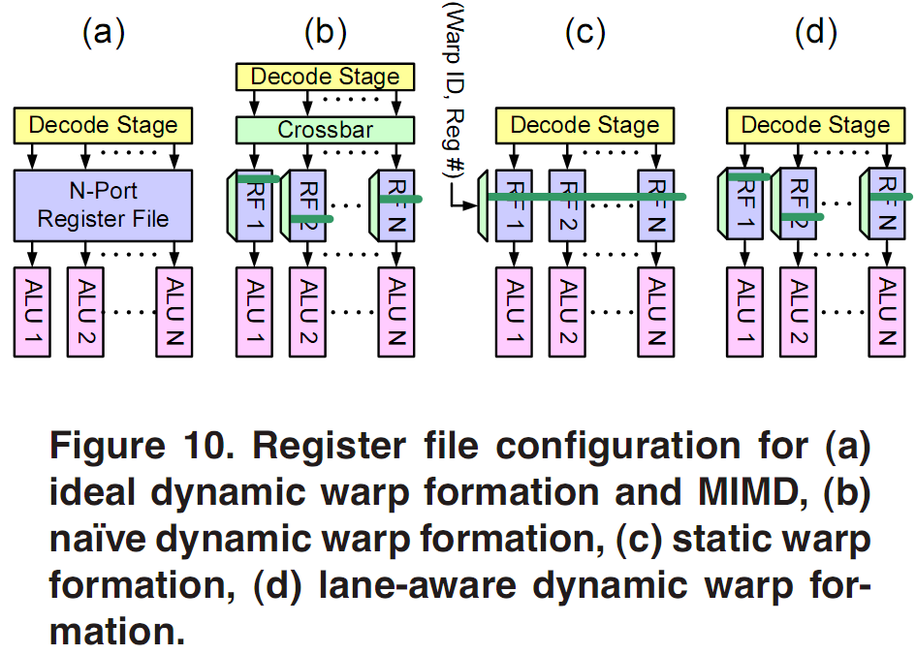
Multi-banked register file [Fung’MICRO2007]

Slide 51
Mechanism
No Branch Divergence Occurred
Similar to SBR
Upon Branch Divergence
Invalidate diverged warp
Create two new warps at diverging paths
Reserve a barrier to re-synchronize diverged threads at the re-convergence point
Reincarnation
Once all threads hit the re-convergence barrier, the barrier is turned into active warp

Slide 52
Operations Under State Machine
Lookup
(Waiting)
Second-Level
Swap threads
Ready
Waiting
Ready
Commit /
Initialize warp
Eviction
Issue
pool
Recently diverged
Lookup
(Ready)
As all are reached
Reconv.
Barriers
To the pipeline

Slide 53
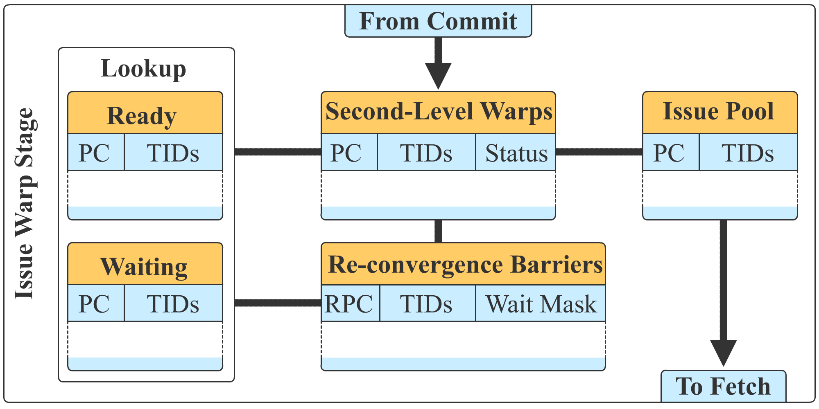
Microarchitecture
8-entry
fully-associative
512-entry
8-entry
128-entry
8-way
set-associative
8-entry
fully-associative
Notes:
- Each thread is allowed to reserve among a few entries (8 way here). Else, the re-convergence is bypassed.
- Lookup is intended to improve SIMD efficiency
- If the lookup is removed and the re-convergence barrier are large enough, it would be the same as SBR
- If the re-convergence barrier is removed it would be DWF

Slide 54
Related Works
 | SIMD Efficiency | Diverging path serialization | Re-convergence waiting | Memory divergence
DWF | Regrouping | Activate all
DWS |  | Heuristic | Heuristic | Heuristic
TBC | Compaction |  |  | Short warps
LWM | Compaction
CAPRI | Compaction |  | 2-bit Saturating counter | Short warps
CROWN | Regrouping | Activate all | Short warps | Short warps

Slide 55
PDOM
SIMD
Utilization
over time
A
W0 | 1111
W0 | RPC | PC | Mask Vector
 | - | A | 1 | 1 | 1 | 1
W0 | RPC | PC | Mask Vector
 | D | C | 1 | 0 | 0 | 1
 | D | B | 0 | 1 | 1 | 0
 | - | D | 1 | 1 | 1 | 1
W0 | RPC | PC | Mask Vector
 | D | D | 1 | 0 | 0 | 1
 | D | B | 0 | 1 | 1 | 0
 | - | D | 1 | 1 | 1 | 1
W0 | RPC | PC | Mask Vector
 | D | B | 0 | 1 | 1 | 0
 | - | D | 1 | 1 | 1 | 1
W0 | RPC | PC | Mask Vector
 | D | D | 0 | 1 | 1 | 0
 | - | D | 1 | 1 | 1 | 1
W0 | RPC | PC | Mask Vector
 | - | D | 1 | 1 | 1 | 1
W1 | 1111
TOS
B
C
W0 | 0110
W0 | 0110
W0 | 1001
W1 | RPC | PC | Mask Vector
 | - | A | 1 | 1 | 1 | 1
W1 | RPC | PC | Mask Vector
 | D | C | 1 | 1 | 1 | 0
 | D | B | 0 | 0 | 0 | 1
 | - | D | 1 | 1 | 1 | 1
W1 | RPC | PC | Mask Vector
 | D | D | 1 | 1 | 1 | 0
 | D | B | 0 | 0 | 0 | 1
 | - | D | 1 | 1 | 1 | 1
W1 | RPC | PC | Mask Vector
 | D | B | 0 | 0 | 0 | 1
 | - | D | 1 | 1 | 1 | 1
W1 | RPC | PC | Mask Vector
 | D | D | 0 | 0 | 0 | 1
 | - | D | 1 | 1 | 1 | 1
W1 | RPC | PC | Mask Vector
 | - | D | 1 | 1 | 1 | 1
W1 | 0001
W1 | 0001
W1 | 1110
TOS
D
W0 | 1111
W1 | 1111
Dynamic regrouping of
diverged threads at same path
increases utilization
Notes:
Color on CFG show activation of a warp and gray shows inactivation (masked warp).

Slide 56
DWF
SIMD
Utilization
over time
Warp Pool
A
W0 | 1111
W0 | 1111
Wi | PC | Mask Vector
W0 | A | 1 | 1 | 1 | 1
W1 | A | 1 | 1 | 1 | 1
Wi | PC | Mask Vector
W0 | B | 0 | 1 | 1 | 0
W1 | A | 1 | 1 | 1 | 1
W2 | C | 1 | 0 | 0 | 1
Wi | PC | Mask Vector
W0 | B | 0 | 1 | 1 | 0
W1 | B | 0 | 0 | 0 | 1
W2 | C | 1 | 0 | 0 | 1
W3 | C | 1 | 1 | 1 | 0
Wi | PC | Mask Vector
W0 | B | 0 | 1 | 1 | 1
W1 | C | 1 | 1 | 1 | 1
W2 | C | 1 | 0 | 0 | 0
Wi | PC | Mask Vector
W0 | D | 0 | 1 | 1 | 1
W1 | C | 1 | 1 | 1 | 1
W2 | C | 1 | 0 | 0 | 0
Wi | PC | Mask Vector
W0 | D | 0 | 1 | 1 | 1
W1 | D | 1 | 1 | 1 | 1
W2 | C | 1 | 0 | 0 | 0
Wi | PC | Mask Vector
W0 | D | 0 | 1 | 1 | 1
W1 | D | 1 | 1 | 1 | 1
W2 | D | 1 | 0 | 0 | 0
Wi | PC | Mask Vector
W0 | D | 1 | 1 | 1 | 1
W1 | D | 1 | 1 | 1 | 1
Wi | PC | Mask Vector
W0 | A | 1 | 1 | 1 | 1
W1 | D | 1 | 1 | 1 | 1
Wi | PC | Mask Vector
W0 | A | 1 | 1 | 1 | 1
W1 | A | 1 | 1 | 1 | 1
W1 | 1111
W1 | 1111
B
C
W0 | 0110
W2 | 1001
W1 | 1111
W0 | 0111
Merge Possibility
W1 | 0001
W3 | 1110
W2 | 1000
D
W0 | 0111
W0 | 1111
W1 | 1111
W2 | 1000
Notes:
Notice warp pool needs to keep TIDs instead of “Mask Vector”
Colors of the warps shows potential of different thread-placement

Slide 57
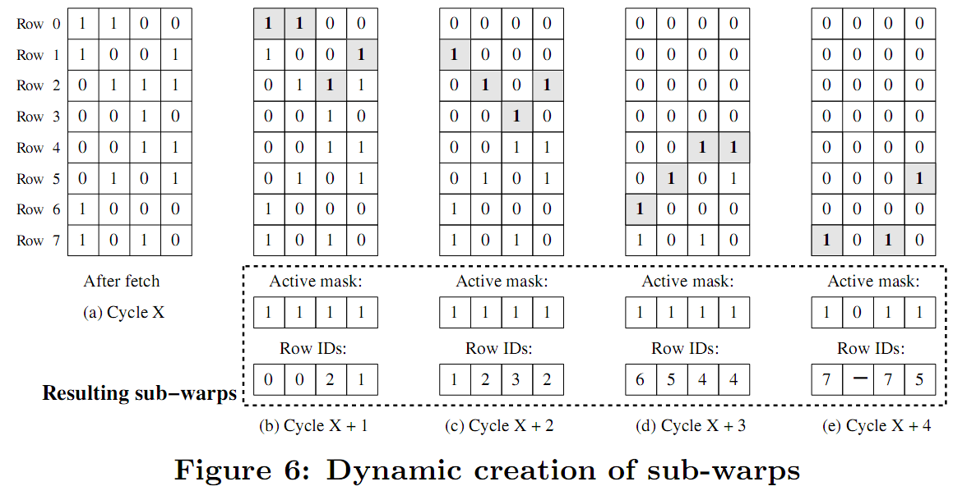
Large Warp Micro-architecture [Narasiman’MICRO2011]

Slide 58
Operation Example - SBR
1
2
4
3
5
6
1
1
1
1
1
1
1
1
2
2
2
6
6
6
6
2
3
4
4
6
6
6
6
4
5
4
4
6
6
6
6
4
5
5
5
6
6
6
6
5
6
6
6
6
6
6
6
6
Ready
Status of
Concurrent Threads
Inactive masked
Waiting at re-convergence
Terminated
Time
Active
SIMD
1
1
1
1
1
1
1
1
2
2
2
2
3
4
4
4
5
5
5
5
6
6
6
6
6
6
6
6
Idle

Slide 59
Operation Example - CROWN
1
Ready
2
Inactive masked
4
3
Active
Waiting at re-convergence
5
Idle
Terminated
6
1
1
1
1
1
1
1
1
2
2
1
1
1
1
1
1
2
2
2
6
1
1
1
1
2
2
2
6
6
6
1
1
2
2
2
6
6
6
6
2
3
4
2
6
6
6
6
2
3
4
4
6
6
6
6
4
3
4
4
6
6
4
5
4
4
6
6
4
5
5
5
6
6
4
5
5
5
6
6
5
6
6
5
6
6
5
6
6
6
6
6
6
6
6
6
6
6
6
Status of
Concurrent Threads
Time
SIMD
1
1
1
1
1
1
1
1
2
2
2
2
6
6
3
4
4
4
5
5
5
5
6
6
6
6
6
6

Slide 60
Branch Divergence Challenges
Branch divergence is three-sided problem:
SIMD efficiency
Diverging path serialization
Re-convergence waiting

Slide 61
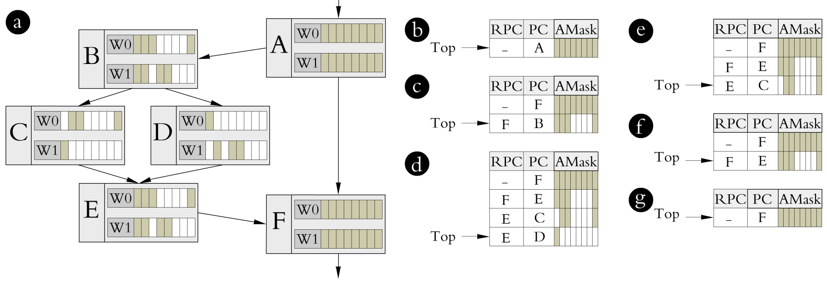
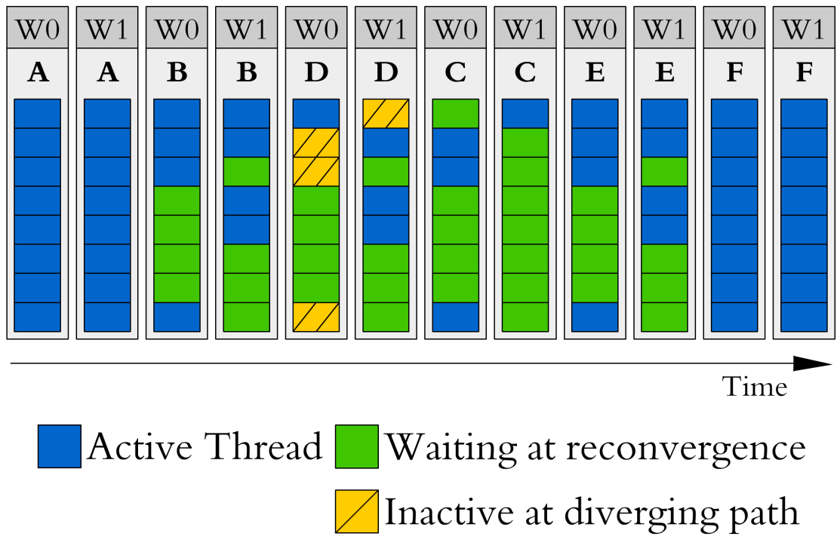
Understanding the challenges
SIMD efficiency is the dominant challenge as far as there are enough parallel warps to hide the memory latency
Once there is not enough parallelism, two other factor can impact performance significantly

Slide 62
Branch Divergence Challenges (cont.)
SIMD efficiency

Slide 63
Branch Divergence Challenges (cont.)
Diverging path serialization
Re-convergence waiting
Notes:
-Number of inactive/waiting threads during idle cycles.
-Large inactive/waiting threads can improve performance once idle cycles are significant

Slide 64
Design Space of CROWN
CROWN can be configured with different entries in
Fully-associative ready lookup
4, or 8
Fully-associative waiting lookup
4, or 8
Set associative re-convergence barriers
16, 32, 64, or 128 entries (fixed 8-way associative)
Second-level warps
We assume 256
Issue pool size
We assume 8

Slide 65
Sensitivity to Ready Lookup Size
Up to 8% performance change

Slide 66
Sensitivity to Waiting Lookup Size
Up to 10% performance reduction

Slide 67
Sensitivity to Reconv. Barriers Size
Lower Re-convergence barriers nears CROWN to DWF

Slide 68
Compared to Previous Works
1024-thread per SM 16-wide 8-stage SIMD
1024-thread per SM 8-wide 16-stage SIMD
1024-thread per SM 8-wide 16-stage SIMD
512-thread per SM 8-wide 8-stage SIMD

Slide 69
1024-thread 16-wide 8-stage SIMD
Larger synchronization overhead

Slide 70
1024-thread 8-wide 16-stage SIMD
Stay in lookup for shorter period of time

Slide 71
512-thread 8-wide 16-stage SIMD
Higher the importance of concurrent threads

Slide 72
DWR Backup

Slide 73
Sensitivity to SIMD Width
DWR technique is much effective under narrow SIMD

Slide 74
Sensitivity to ILT Size
ILT overflow in a few benchmarks
 | BFS | BKP | CP | DYN | GAS | HSPT | FWAL | MP | MTM | MU | NNC | NQU | SC | NW
LATs | 15 | 17 | 5 | 9 | 11 | 20 | 7 | 54 | 7 | 11 | 17 | 10 | 5 | 26
Ignored by ILT | 7 | 0 | 0 | 0 | 0 | 0 | 0 | 36 | 0 | 3 | 17 | 0 | 0 | 3

Slide 75
Ignore list
All of the LATs are not useful for coalescing:
Add the PC of such LATs to ignore list table (ILT) for bypassing the future synchronization
1: if( sub_warp_id == 0){ 2: regA = gmem[idxA]; 3: } 4: regB = gmem[idxB]; (a) | 1: if( sub_warp_id == 0){ 2: regA = gmem[idx]; 3: } 4: __syncthreads(); (b)

Slide 76
Improving the Energy-Efficiency of Short Warps
Locality can be exploited to design efficient pipeline front-end

Slide 77
Streaming Multiprocessor (SM)
Threads of same thread-block (CTA)
communicate through fast shared memory
Synchronized through fast synchronizer
Each CTA is assigned to one SM
Notes:
-Define warp, warp scheduler, and SIMD width
-Define the shared resource per SM: thread pool, shared memory, and register file
-Talk about memory access coalescing here

Slide 78
Introduction
Why accelerator?
SIMT accelerator overview
Memory divergence
Branch divergence
Control-flow Mechanisms
Postdominator Re-convergence (PDOM)
Dynamic Warp Formation

Slide 79
Why accelerator?
Heterogonous system to achieve optimal performance/watt
Superscalar speculative out-of-order processor for
latency-intensive serial workloads
Multi-threaded in-order SIMD processor for
High-throughput parallel workloads
6 of 10 Top500.org supercomputers today employ accelerators
IBM Power BQC 16C 1.60 GHz (1st, 3th, 8th, and 9th)
NVIDIA Tesla (6th and 7th)
[Dally’2010]

Slide 80
Why accelerator? (continued)
GPUs are most available accelerators
Class of general-purpose processors named SIMT
Integrated on same die with CPU (Sandy Bridge, etc)
Upcoming Exa-scale computing demands energy efficiency of 50 GFLOPS/W
GPU achieves 200 pJ/instruction
CPU achieves 2 nJ/instruction
[Dally’2010]

