Slide 1
Addressing Software-Managed Cache Development Effort in GPGPUs
Ahmad Lashgar
PhD Candidate at ECE Department
Supervisors:
Dr. A. Baniasadi
Dr. N. J. Dimopoulos
August 8, 2017
PhD Defense Session

Slide 2
Heterogeneous Computing
Use of different kinds of processing cores for higher efficiency
From high-performance to low-power embedded systems
High-performance computing style
Serial workloads run on multiple out-of-order fast cores
Traditional CPUs
Parallel workloads run on many in-order slow cores
Accelerators: GPUs, FPGAs, XeonPhi, etc.

Slide 3
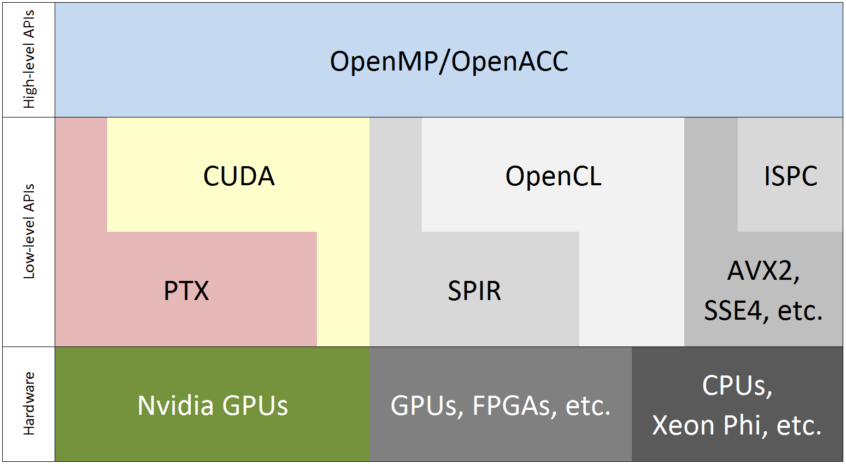
Accelerator Hardware/Software Stack
Scope of this work: OpenACC-over-CUDA for NVIDIA GPUs

Slide 4
Hardware
NVIDIA-like GPGPU Microarchitecture
…
GPU
SM_{N}
Thread Block Dispatcher
Ready Thread Blocks
…
Block 0
Block K-1
Core₁
Core_{N}
Scoreboard & Registerfile
…
L1$
L1$
Interconnect
Arith/Logic
SIMD
Special Fcn
SIMD
…
Load/Store Unit
Floating Point
SIMD
L2$
L2$
MC₁
MC_{M}
L1 Cache
Data cache
Constant cache
Texture
cache
Shared Memory
DRAM
Notes:
-Thread block -> group of loop iterations (1 to 1024 loop iterations) executed in lock-step on SIMD

Slide 5
Software Interface
OpenACC
Higher Productivity
int main(){
...
#pragma acc kernels copyin(a[0:LEN]) copyout(b[0:LEN])
#pragma acc loop independent
for(i=0; i<LEN; ++i) {
b[i] = a[i]+10;
}
...
}
CUDA
Higher Performance
__global__ void matrixMul(int *a, int *b, int len){
int i=threadIdx.x+blockIdx.x*blockDim.x;
b[i] = a[i]+10;
}
int main(){
...
bytes=LEN*sizeof(int);
cudaMalloc(&a_d, bytes);
cudaMalloc(&b_d, bytes);
cudaMemcpy(a_d, a, bytes, cudaMemcpyHostToDevice);
dim3 gridSize(LEN/16,LEN/16);
dim3 blockSize(16,16);
matrixMul<<<gridSize,blockSize>>>(a_d,b_d,LEN);
cudaMemcpy(c, b_d, bytes, cudaMemcpyDeviceToHost);
...
}
Notes:
-Not going to the detail of the code, just showing the relative code size
-Each loop iteration is executed by one thread

Slide 6
Software-managed Cache In GPUs
OpenACC
...
#pragma acc cache(a[i:256])
{
sum += a[i] + ... + a[i+255];
}
...
CUDA
__shared__ float smc[256];
smc[threadIdx.x] = a[i];
...
float sum = a[i] + ... + a[i+255];
...
GPU Core #1
Ready Thread Blocks
Scoreboard & Regfile
LDST units & SIMDs
L1$
Shared Memory
(SMC)
Other caches
Notes:
-Private per core space
-Trivial to use in OpenACC
-In CUDA though, two memory spaces should be maintained
-Data in shared memory is private and not backedup elsewhere

Slide 7
This Dissertation
Chapter 7
Proposed
Solutions
TELEPORT
Enhancing cache Directive
Chapter 6
Implementing cache directive
Chapter 5
CUDA
OpenACC
Chapter 4
Major performance bottleneck in
high-level accelerator programming: SMC
Observation
Chapter 3
IPMACC OpenACC Compiler
(microbenchmarking to tune the compiler)
Infrastructure
Compare high-level & low-level
programming models
Approach
Criteria
Productivity
Performance

Slide 8
Outline
Overview
Chapter 3: IPMACC
Chapter 4: Microbenchmarking GPGPUs
Chapter 5: Implementing OpenACC cache Directive
Chapter 6: Enhancing cache Directive
Chapter 7: TELEPORT
Conclusion

Slide 9
Chapter 3: IPMACC
Developed from scratch to run OpenACC codes on vector processors (GPUs and CPUs):
Translated
Source
Hand Optimization
Translator
System Compilers
to CUDA
gcc/nvcc
OpenACC Source
Machine Binary
to ISPC
gcc/ispc
to OpenCL
gcc
OpenACC API
IPMACC
libopenacc.so

Slide 10
Chapter 3: IPMACC (2)
Simple usage:
$ ipmacc sourceacc.c -o gpubinary
This generates an intermediate CUDA source code
Features:
Supported directives: data, kernels, loop, cache
Supported backends: CUDA, OpenCL, and ISPC
Supports user-defined datatypes and routines
Available to public since Dec 6, 2014:
https://github.com/lashgar/ipmacc
Repository includes our benchmarks too

Slide 11
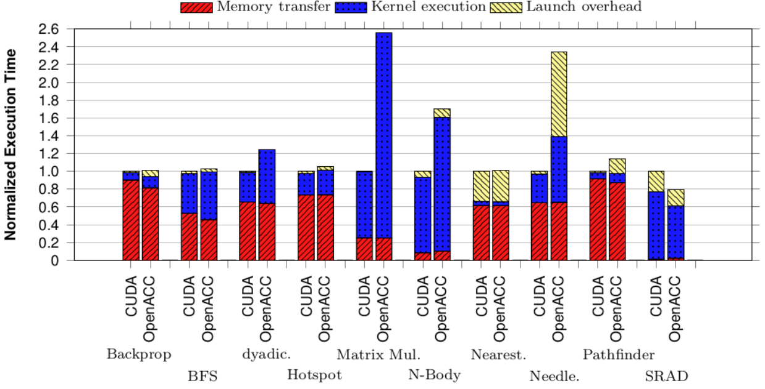
Chapter 3: IPMACC (2)
Investigating performance gap between CUDA and OpenACC

Slide 12
Chapter 4: Micro-benchmarking GPGPUs
Micro-benchmarking:
Understanding micro-architecture through software stress-tests
Purpose:
To tune IPMACC compiler for best performance
Targets:
L1 cache memory request handling resources
Shared memory organization
Available to public since Jun 9, 2015:
https://github.com/lashgar/microbenchmark

Slide 13
Chapter 4: Micro-benchmarking GPGPUs (2)
Findings on Tesla C2070 L1 cache: MSHR
128 MSHR entry, utmost, 8 mergers per entry, at least
MLP per SM:
Coalesced = 1024 (128 x 8) & Un-coalesced = 128
Findings on Tesla K20c L1 cache: PRT
44 PRT entries, utmost, 32 requests per entry (warp size)
MLP per SM:
Coalesced/Un-coalesced = 1408 (44 x 32)

Slide 14
Chapter 4: Micro-benchmarking GPGPUs (3)
Findings on shared memory
The layout of 2D arrays allocated in the shared memory is found to be the same as flattened 2D arrays
Adding a small padding in allocation vastly resolves bank conflict

Slide 15
This Dissertation
Proposed
Solutions
TELEPORT
Enhancing cache Directive
Implementing cache directive
Chapter 5
CUDA
OpenACC
Major performance bottleneck in
high-level accelerator programming: SMC
Observation
IPMACC OpenACC Compiler
(microbenchmarking to tune the compiler)
Infrastructure
Compare high-level & low-level
programming models
Approach
Criteria
Productivity
Performance

Slide 16
Chapter 5: Implementing cache Directive
First work investigating cache directive implementation
Example:
#pragma acc kernels loop
for(i=1; i<LEN-1; ++i){
int lower = i-1, upper = i+1;
float sum = 0;
#pragma acc cache(a[(i-1):3])
{
for(j=lower; j<=upper; ++j)
sum += a[j];
}
b[i] = sum/(upper-lower+1);
}
GPU Core #1
Ready Thread Blocks
Scoreboard & Regfile
LDST units & SIMDs
L1$
Shared Memory
(SMC)
Other caches

Slide 17
Chapter 5: Implementing cache Directive (2)
Directive is general, but implementation is hardware specific
We target NVIDIA GPUs
Critical optimizations:
Cache sharing, fetch, write policy, index mapping, occupancy
Proposed three implementations
Our best implementation performs near to CUDA, while reducing development effort by 29%
Evaluated various configurations under 3 test cases, 2 GPUs

Slide 18
This Dissertation
Proposed
Solutions
TELEPORT
Enhancing cache Directive
Chapter 6
Implementing cache directive
CUDA
OpenACC
Major performance bottleneck in
high-level accelerator programming: SMC
Observation
IPMACC OpenACC Compiler
(microbenchmarking to tune the compiler)
Infrastructure
Compare high-level & low-level
programming models
Approach
Criteria
Productivity
Performance

Slide 19
Chapter 6: Enhancing cache Directive
cache directive limitation:
...
Iteration
#1
Iteration
#2
Iteration
#N
Private
Read-only
Read
Read
Read
Read
SMC
SMC
Read
SMC
Write
Read
Private
Read-Write
...
...
...
Shared
Read-Only
Write
Write
Write
Write
Write
Shared
Read-Write

Slide 20
Chapter 6: Enhancing cache Directive (2)
Shared Read-Write SMC is very common in CUDA applications:
E.g. Reduction, Pathfinder, Hotspot, Dyadic Convolution
We proposed fcw directive to address this limitation
Shared Read-Write SMC in OpenACC
Notation is similar to cache directive
Introduces an inter-iteration communication model for sharing intermediate results
Evaluated under six test-cases:
Runtime improvement over baseline OpenACC, at a lower development effort than CUDA

Slide 21
This Dissertation
Chapter 7
Proposed
Solutions
TELEPORT
Enhancing cache Directive
Implementing cache directive
CUDA
OpenACC
Major performance bottleneck in
high-level accelerator programming: SMC
Observation
IPMACC OpenACC Compiler
(microbenchmarking to tune the compiler)
Infrastructure
Compare high-level & low-level
programming models
Approach
Criteria
Productivity
Performance

Slide 22
Chapter 7: TELEPORT
Key Idea:
Identify data with sharing opportunities in CUDA kernels
Fetch the data “automatically” to shared memory
Advantages:
No extra development effort
No extra instruction

Slide 23
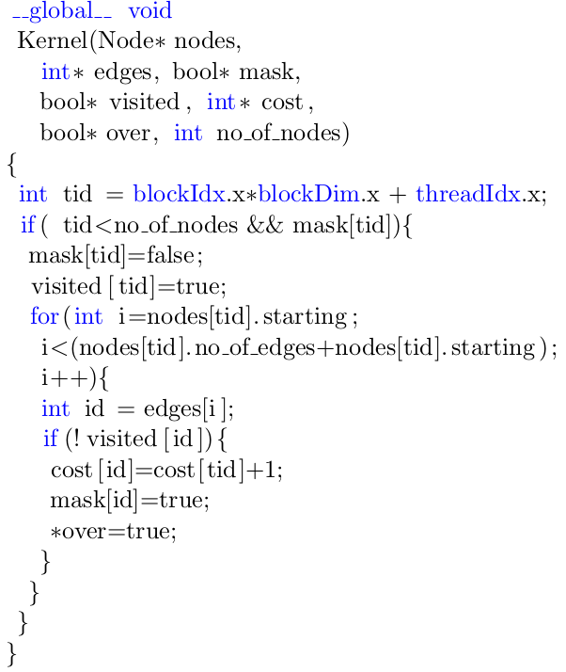
Chapter 7: TELEPORT (2)
tid range is a function
of blockIdx
Min = 0
Max = blockDim
Constant
blockDim, threadIdx,
blockIdx,
tid
i
Depends on an induction var
Known at runtime
id
Data dependent
Kernel<<< NTB, blockDim >>> ( <args> );
Notes:
Only memory reads are candidates
Range of tid is known if blockIdx is known.

Slide 24
Chapter 7: TELEPORT (2)
blockDim, threadIdx,
blockIdx,
tid
cudaSetCTATracker( nodes, <tid range>);
cudaSetCTATracker( cost, <tid range>);
Kernel<<< NTB, blockDim >>> ( <args> );
Notes:
Only memory reads are candidates
Range of tid is known if blockIdx is known.

Slide 25
Chapter 7: TELEPORT (2)
GPU
SM₁
Thread Block Dispatcher
On-Hold Thread
Ready Threads
…
Preloader
Scoreboard
Block 0
Block 1
Block NTB-1
Load/Store Unit
Execution Engine
SM₂
SM₁
Cache
Other caches
Shared Memory
Tag
$
$
Interconnect
…
cudaSetCTATracker( nodes, <tid range>);
L2$
L2$
cudaSetCTATracker( cost, <tid range>);
MC₁
MC_{N}
Kernel<<< NTB, blockDim >>> ( <args> );
Notes:
Only memory reads are candidates
Range of tid is known if blockIdx is known.

Slide 26
Chapter 7: TELEPORT (3)
Used GPGPU-sim 3.2.2 for modeling TELEPORT
Analyzed 16 benchmarks:
Limited evaluations to 5 test-cases
Three methods are compared:
Baseline no-SMC CUDA
Baseline no-SMC CUDA + TELEPORT
Hand-optimized CUDA
Evaluations show advantages in:
Development effort, runtime, dynamic instructions, DRAM accesses, DRAM row locality
Notes:
-
-Not replaces all functionalities of CUDA shared memory notation

Slide 27
Conclusion
Developed & introduced IPMACC OpenACC compiler
Derived set of micro-benchmarkings to understand GPUs
First work investigating cache directive implementation aspect
Proposed a directive to address cache directive limitations
Proposed a hardware/software alternative to CUDA shared memory programming

Slide 28
List of Publications
Efficient Implementation of OpenACC cache Directive on NVIDIA GPUs Ahmad Lashgar and Amirali Baniasadi To appear in the International Journal of High Performance Computing and Networking (IJHPCN), Special Issue on High-level Programming Approaches for Accelerators
OpenACC cache Directive: Opportunities and Optimizations Ahmad Lashgar and Amirali Baniasadi In proceedings of WACCPD 2016, (in conjunction with SC 2016), Salt Lake City, Utah, USA, November 14, 2016.
Employing Compression Solutions under OpenACC Ebad Salehi, Ahmad Lashgar, and Amirali Baniasadi In proceedings of HIPC 2016, (in conjunction with IPDPS 2016), Chicago, Illinois, USA, May 23-27, 2016.
A Case Study in Reverse Engineering GPGPUs: Outstanding Memory Handling Resources Ahmad Lashgar, Ebad Salehi, and Amirali Baniasadi ACM SIGARCH Computer Architecture News - HEART '15, Volume 43 Issue 4
Employing Software-Managed Caches in OpenACC: Opportunities and Benefits Ahmad Lashgar and Amirali Baniasadi ACM Transactions on Modeling and Performance Evaluation of Computing Systems (ACM ToMPECS), Volume 1 Issue 1, March 2016
Rethinking Prefetching in GPGPUs: Exploiting Unique Opportunities Ahmad Lashgar and Amirali Baniasadi In proceedings of HPCC’17, New York, NY, USA, August 24-26, 2015.
Understanding Outstanding Memory Request Handling Resources in GPGPUs Ahmad Lashgar, Ebad Salehi, and Amirali Baniasadi In proceedings of HEART’6 [Best Paper Candidate], Boston MA, USA, June 1-2, 2015.
IPMACC: Translating OpenACC API to OpenCL Ahmad Lashgar, Alireza Majidi, and Amirali Baniasadi In poster session of the 3rd International Workshop on OpenCL (IWOCL) Stanford University, California, USA, May 11-13, 2015.
A Case Against Small Data Types on GPGPUs Ahmad Lashgar and Amirali Baniasadi In proceedings of IEEE ASAP’25, IBM Research, Zurich, Switzerland, June 18-20, 2014.

Slide 29
Thank You!
Questions?

